Slide 1

Combining Family History and Machine Learning to Link Historical Records
Joe Price
joe_price@byu.edu
rll@byu.edu
Joint work with:
Kasey Buckles, Isaac Riley, and Jacob Van Leeuwen

Slide 2
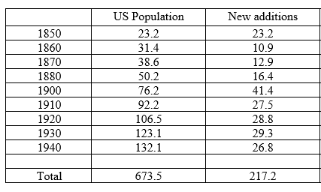
Goal: Link US population
Link everyone that lived in the US between 1850-1940 across each of the census records they appear in.
Linked to their parents, siblings, spouse, and children.
Linked to vital records, school records, draft cards, etc.

Slide 3
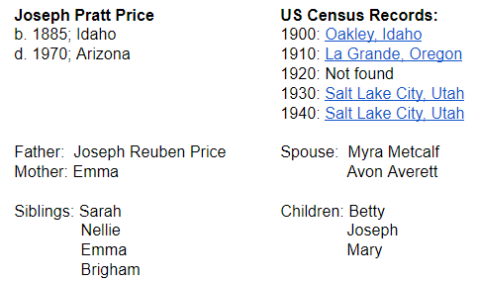
Census Tree
Immediate Goal:
Create a record-based tree that includes everyone who appears in a US Census between 1900 and 1940.
~188 million people. Each person has a unique row, linked to each census during lifetime.
Each person will have a row and it will include:
ID, name, gender, birth and death year
Link to each census + ID for each family member

Slide 4
Benefits of fully-linked data
Study long run and intergenerational effects of various shocks and public policies
Track migration, mobility, and the boundaries of markets
Exploit information about kin network
Assign treatment exposure based on birth city + where you live over time
Combine covariates from multiple data sources
Since it’s historical data, the final product can be shared with other scholars and other data can be merged to it.

Slide 5
Three ways to link records
https://ranabr.people.stanford.edu/matching-codes
Ran Abramitzky describes three ways to link records and provides the code and replication examples of each:
[1] Basic fully automated approach (Ferrie 1996; ABE)
[2] Fully automated probabilistic approach (Abramitsky, Mill, and Perez 2018)
[3] Machine learning approach (Feigenbaum 2016; Goekeven et al 2011)
The approach we are using is in the third category, just with a different way of gathering training data.

Slide 6
Economic research + Family history
Two ways family history can contribute:
First, people do careful family history research and identify multiple records for the same individual. We can use pairs of sources for the same person to create training data.
Second, traditional family history tools can help with groups that have lower match rates using machine learning approaches.
Includes women, immigrants, people who migrate a lot or have names that get misspelled.

Slide 7
Training data
Do we want our machine learning algorithms to identify the type of matches that a human trainer would label as a match or identify the true match?
Ground truth often requires hiring a: (1) professional genealogist, or (2) someone with personal knowledge about the individual, or (3) someone who has access to additional records to handle difficult cases.
This can be an laborious way to create training data (e.g. Early Indicators Project) but can be incredibly valuable.
Genealogical websites allow us to access conclusions made by people that fall into one of the three categories above.

Slide 8






Genealogy websites

Slide 9

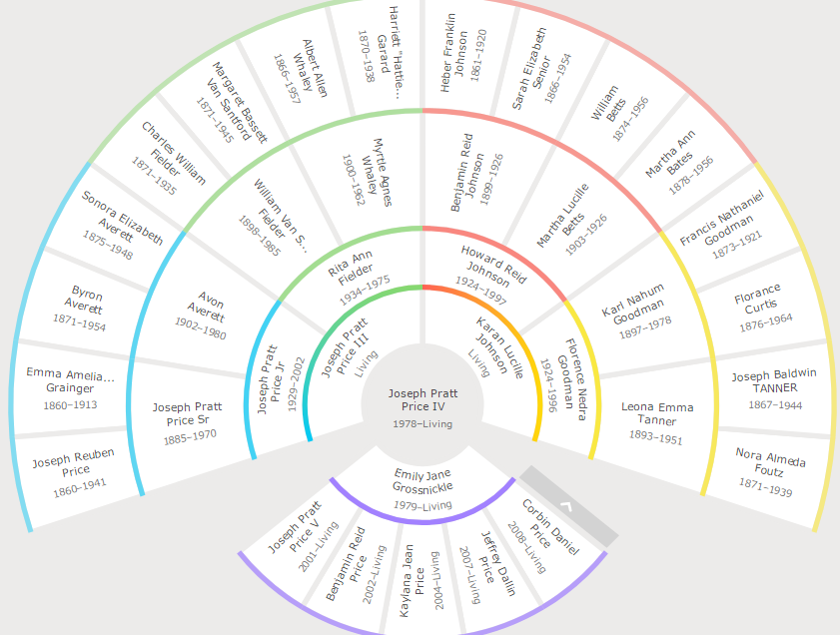
FamilySearch Family Tree
FamilySearch is an nonprofit family history organization dedicated to connecting families across generations.
Users start building their own family tree and then bump into people already on the tree and combine their efforts with others.

Slide 10
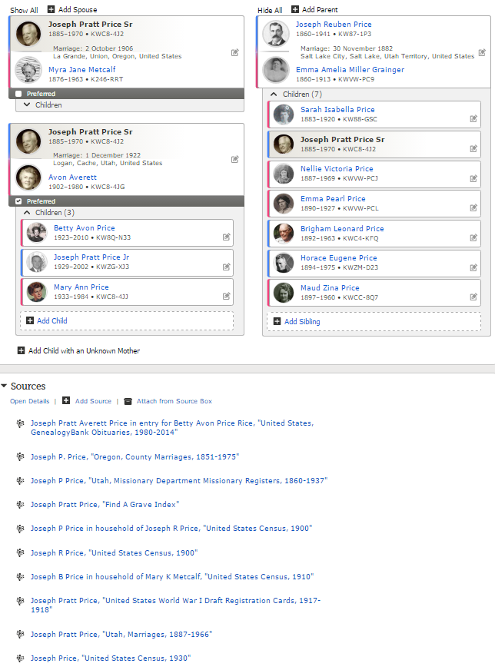
Info on the Family Tree

Slide 11
Sources on the Family Tree

Slide 12
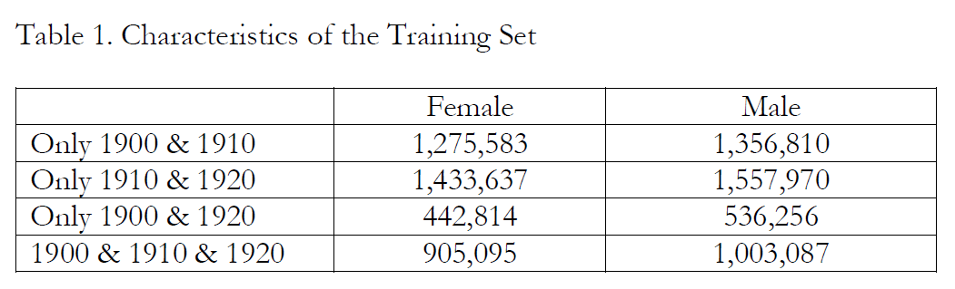
This provides a combined total of over 10 million linked pairs (since the 1900-1920 counts provide 3X)
As a point of comparison:
LIFEM: 44,000 boys born in Ohio and NC
Feigenbaum: 7,500 boys living in Iowa in 1915

Slide 13
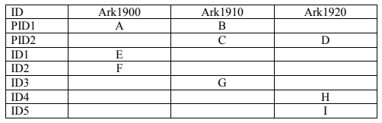
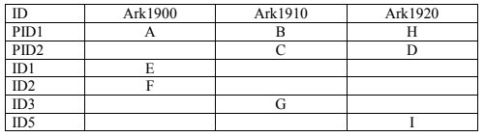

Process
Use attached records from Family Tree as training data
Use machine learning to predict the other links
Employ multiple blocking strategies, name-based network analysis, transitivity tests, iterative matching, and other new strategies.
Humans check links and help with hard-to-match records
Example: 3 people, 3 censuses
Training data = 2 matches
Possible compares =
B-D, B-H, B-I (A-D, A-H, A-I)
C-E, C-F (D-E, D-F)
E-F, E-G, F-G, G-H, G-I (E-H, E-I, F-H, F-I)
7 rows, 3 people = 4 matches to find
Final product: 3 rows, 3 people

Slide 14
How many possible matches?
217 million unique people, 673.5 million records
So we need to create 456.3 million links.
Example: 1910-1920.
106.5 – 28.8 = 77.7 million people that should appear in both.

Slide 15
Matching decisions
Our large training data provides some important insights that you need to make when linking records.
First, how to pre-process the data.
Standardize abbreviations, nick names, and misspellings for names. 1,704 nick names or abbreviations. 150,000 misspelled names.
Standardize birth places to birth state if US born or country if foreign born. Connecticut is spelled 97 different ways.
Second, which blocking variables are stable over time.
Third, which machine learning classifier has a higher precision and recall for this data environment.

Slide 16
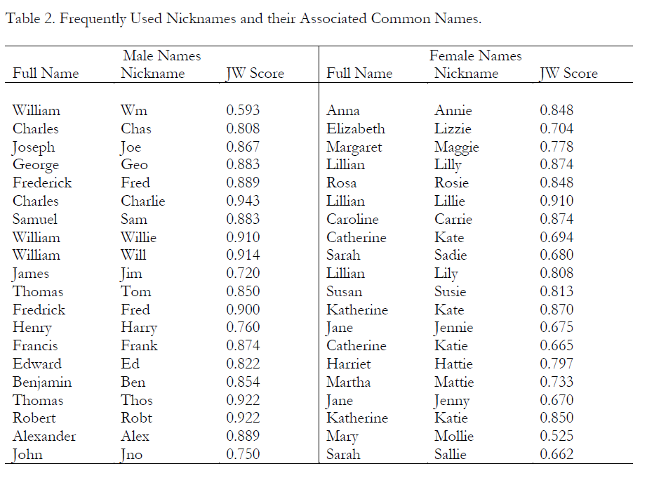

Slide 17
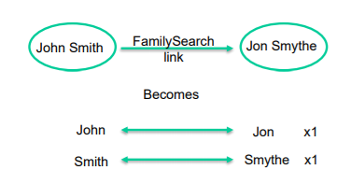
Name-based network analysis
A new approach to standardize names
Construct a network of names, where each node is a name and each edge is a record link between names.
(e.g. Nick in 1900 linked to Nicholas in 1910 is an edge, and Nick and Nicholas are nodes.)
Weight edges by number of links.

Slide 18
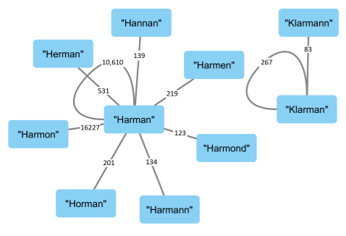
Name-based network analysis
Use community structure analysis to identify equivalent names.
Convert names in a multi-dimensional vector (lots of approaches when everything is measured in numbers).

Slide 19
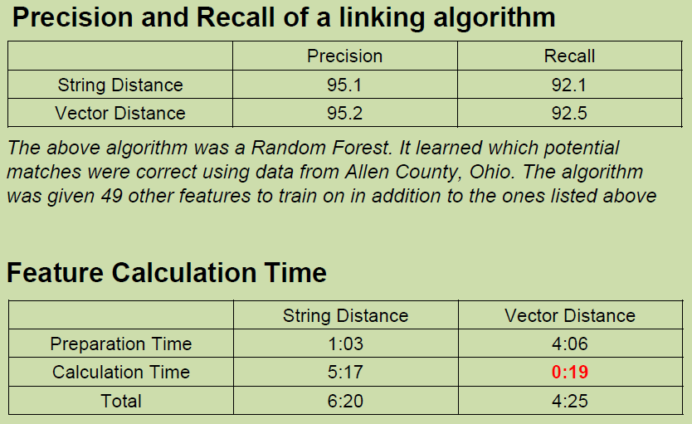
Name vectorization

Slide 20
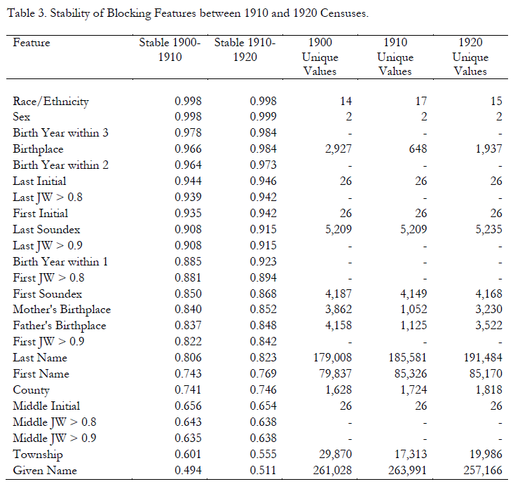

Slide 21
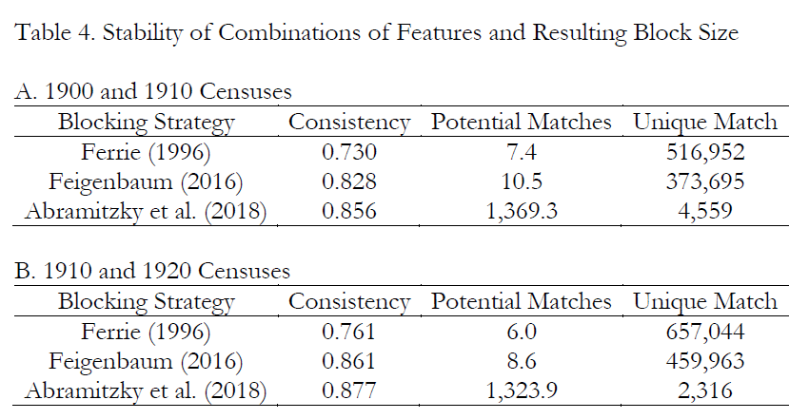

Slide 22
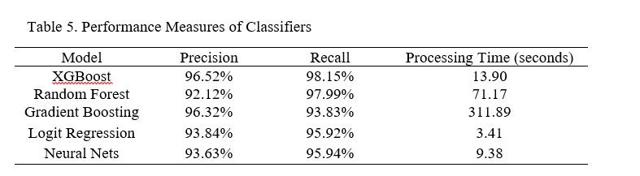
Choosing which classifier to use
Machine learning provides a to teach models how to predict results by feeding them large amounts of labeled data.
We have a very large training set and used a variety of models until we reached a model that could accurately predict if a match was true or false.

Slide 23
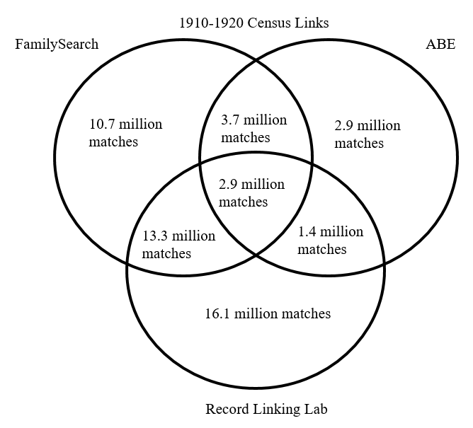
Combining methods

Slide 24
Iterative matching
One of the concerns with matching is that we might end up with a non-representative sample.
People with unique names, people who don’t move, people with names that are easy to correctly spell, etc.
Some of the features that we are using are likely to make our matched sample non-representative.
But, we can take out all of the easy matches first and then the average size of our blocks shrinks considerably, thus reducing the number of compares that are required.
If we iterate this process, we will end up with very small blocks which can make the matching of the “left overs” much easier and can solve the John Smith problem.

Slide 25
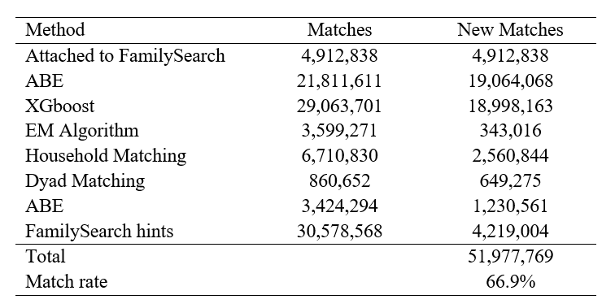
Iterative approach (1910-1920)

Slide 26
Final notes
Linking historical records open up the ability to address lots of interesting research questions.
Our approach to linking records combines data from a family history website with machine learning.
Training set of over 10 million true pairs
Our approach provides insights about pre-processing data, blocking and matching features, classifier, and validating quality of links.
Trade off between representativeness and precision/recall but iterative approach might allow us to achieve both in the end.
We’ve linked 52 million people from 1910 to 1920 (67% match rate).

Slide 27
Combining Family History and Machine Learning to Link Historical Records
Joe Price
joe_price@byu.edu
rll@byu.edu

