Slide 1
Microstructure in the Machine Age
David Easley, Marcos Lopez de Prado, Maureen O’Hara and Zhibai Zhang

Slide 2
Introduction
Microstructure measures should be predictive of price and liquidity dynamics
  They reflect the presence of informed traders
  Informed trade should lead to price changes
  Not directional, instead about spreads, volatility, and the shape of the distribution of returns
Don’t know how to (or need to) specify a structural model of how this occurs
Instead use machine learning
We ask about in-sample usefulness of these measures as well as their out-of-sample predictive power

Slide 3
Microstructure Measures
Roll measure - covariance of price changes
Roll Impact - normalized by dollar value of trade
Volatility - VIX index
Kyle’s λ - price impact of trade
Amihud measure - illiquidity
VPIN - volume adjusted probability of informed trade

Slide 4
Measures of Price Dynamics
Sign of change in bid-ask spread- Corwin-Schultz
Sign of change in realized volatility
Sign of change in Jacques-Bera statistic – test for normality of returns
Sign of change in sequential correlation of returns- first order autocorrelation
Sign of change in skewness of returns
Sign of change in kurtosis of returns

Slide 5
Results
We use 5 years of tick data from the 87 most liquid futures (currencies, indices, commodities, short rates and fixed income)
  Microstructure measures capturing info still work:
  Amihud measure, VIX and VPIN have the most in- sample explanatory power
  VPIN has the most out-of-sample explanatory power
With the exception of spread, our best predictor has a remarkable out-of-sample accuracy of 0.54 to 0.61

Slide 6
Literature
Varian [2014], Abadie and Kasy [2017], Mullainathan and Spiess [2017], Bajari, Nekipelov, Ryan and Yang [2015] and Cavallo and Rigobon [2016] - machine learning used on big data in econ
Chinco, Clarke-Joseph and Ye [2018] - LASSO to make 1-minute ahead equity return forecasts;
Rossi [2018] - boosted regression trees to forecast stock returns and volatility;
Krauss, Do, and Huck [2017] - machine learning for statistical arbitrage on the S&P 500
López de Prado [2018] - extensive analyses of financial machine learning techniques and applications.

Slide 7
Data
Tick data for eighty-seven liquid futures contracts from TickWrite
Sample period July 2, 2012 to October 2, 2017
Futures contracts expire, so we need to roll the contracts to create a price series
Transform the price of futures contract to the value of an “ETF” that tracks the futures
  Start with $1 of capital
  “Buy” the front contract
  When it is expiring “sell” it and “buy” the next contract
  The value of the investment is the “ETF” we track

Slide 8
Dollar Volume Bars
Aggregate tick data into bars: volume or time
τ-th bar formed at tick t if
where is the first tick in the τ-th bar, p_{j} is the trade price at tick j, V_{j} is the trade volume at tick j and L is a dollar volume threshold
We set L for each contract to give 50 bars per day on average in 2016
Microstructure measures use lookback windows of size W ranging from 25 bars to 2000 bars

Slide 9
Data for Our Random Forest
For each contract: sample of features and labels
  Features (the x’s)--microstructure variables
  Labels (the y’s)--sign of change in market statistics
10-fold cross-validation
  Partition data set in 10 intervals
  Repeat 10 times, once for each possible test set

Slide 10
Training the Random Forest
Draw bootstrapped samples from the training set
Create forest of 100 decision trees by repeatedly splitting the sample
At each node in the tree split the sample into two subsamples using one of two features selected at random to maximize label purity of the subsamples

Slide 11
Measuring Feature Importance
Mean decreased impurity MDI
  How does the feature contribute to purity of the splits in-sample
Mean decreased accuracy MDA
  How does the feature contribute to accuracy of predictions out-of-sample
Prediction
  generate predictions for the test set from the trained RF, compare the predicted label with each actual label point by point in the test set
Accuracy
  Number of correct predictions divided by total number of predictions

Slide 12
MDI Feature Importance for Spread
Window size | Amihud | Kyle Lambda | Roll Impact | Roll Measure | VIX | VPIN
25 bars | 0.181 ± 0.001 | 0.17 ± 0.001 | 0.155 ± 0.002 | 0.15 ± 0.002 | 0.165 ± 0.002 | 0.179 ± 0.001
50 bars | 0.184 ± 0.001 | 0.17 ± 0.001 | 0.153 ± 0.002 | 0.15 ± 0.002 | 0.167 ± 0.001 | 0.177 ± 0.0
250 bars | 0.194 ± 0.001 | 0.171 ± 0.001 | 0.15 ± 0.002 | 0.148 ± 0.002 | 0.157 ± 0.001 | 0.18 ± 0.001
500 bars | 0.197 ± 0.001 | 0.171 ± 0.001 | 0.149 ± 0.002 | 0.148 ± 0.002 | 0.151 ± 0.001 | 0.184 ± 0.001
1000 bars | 0.198 ± 0.001 | 0.172 ± 0.001 | 0.148 ± 0.003 | 0.148 ± 0.002 | 0.146 ± 0.001 | 0.187 ± 0.001
1500 bars | 0.197 ± 0.001 | 0.173 ± 0.001 | 0.148 ± 0.003 | 0.148 ± 0.002 | 0.145 ± 0.001 | 0.19 ± 0.001
2000 bars | 0.197 ± 0.001 | 0.172 ± 0.001 | 0.147 ± 0.003 | 0.147 ± 0.002 | 0.145 ± 0.001 | 0.192 ± 0.002

Slide 13
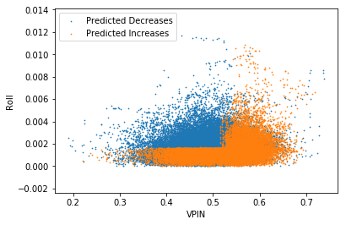
Spread Prediction

Slide 14
MDI Feature Importance for Volatility
Window size | Amihud | Kyle Lambda | Roll Impact | Roll Measure | VIX | VPIN
25 bars | 0.169 ± 0.003 | 0.157 ± 0.002 | 0.149 ± 0.003 | 0.157 ± 0.003 | 0.178 ± 0.003 | 0.178 ± 0.004
50 bars | 0.185 ± 0.001 | 0.155 ± 0.001 | 0.135 ± 0.002 | 0.144 ± 0.002 | 0.205 ± 0.001 | 0.175 ± 0.003
250 bars | 0.223 ± 0.002 | 0.148 ± 0.001 | 0.098 ± 0.002 | 0.119 ± 0.002 | 0.22 ± 0.002 | 0.192 ± 0.002
500 bars | 0.234 ± 0.001 | 0.146 ± 0.001 | 0.089 ± 0.002 | 0.114 ± 0.002 | 0.206 ± 0.001 | 0.211 ± 0.002
1000 bars | 0.234 ± 0.002 | 0.143 ± 0.002 | 0.085 ± 0.002 | 0.117 ± 0.003 | 0.18 ± 0.002 | 0.241 ± 0.004
1500 bars | 0.23 ± 0.002 | 0.143 ± 0.002 | 0.083 ± 0.002 | 0.119 ± 0.003 | 0.168 ± 0.002 | 0.257 ± 0.004
2000 bars | 0.226 ± 0.002 | 0.142 ± 0.002 | 0.082 ± 0.002 | 0.119 ± 0.003 | 0.165 ± 0.002 | 0.267 ± 0.004

Slide 15
MDI Summary
Measured by in-sample performance the Amihud measure does best, with VPIN and VIX also having strong feature importance at some windows
The Kyle lambda and Roll measures are not the most important features for any of our six variables for any lookback window

Slide 16
MDA Feature Importance for Spread
Window size | Amihud | Kyle Lambda | Roll Impact | Roll Measure | VIX | VPIN | Accuracy
25 bars | 0.0033 ± 0.00084 | 0.0042 ± 0.00068 | -0.0031 ± 0.00108 | 0.0174 ± 0.00154 | 0.0011 ± 0.00059 | 0.0248 ± 0.00142 | 0.4535
50 bars | 0.0042 ± 0.00094 | 0.0045 ± 0.00078 | -0.004 ± 0.00088 | 0.0126 ± 0.00142 | 0.0002 ± 0.00056 | 0.0167 ± 0.00117 | 0.4525
250 bars | 0.0048 ± 0.00125 | 0.0018 ± 0.00088 | -0.0047 ± 0.00087 | 0.0031 ± 0.00124 | 0.0021 ± 0.0009 | 0.0161 ± 0.00179 | 0.4572
500 bars | -0.0001 ± 0.00094 | -0.0003 ± 0.00082 | -0.003 ± 0.00103 | -0.003 ± 0.00097 | 0.0031 ± 0.00115 | 0.0268 ± 0.00214 | 0.4587
1000 bars | -0.002 ± 0.00106 | 0.0007 ± 0.00084 | -0.002 ± 0.00103 | -0.0033 ± 0.00108 | 0.0039 ± 0.00138 | 0.0198 ± 0.00166 | 0.4546
1500 bars | -0.0023 ± 0.00094 | -0.0007 ± 0.00083 | -0.002 ± 0.001 | -0.0017 ± 0.00109 | 0.0053 ± 0.00133 | 0.015 ± 0.00114 | 0.4513
2000 bars | -0.0005 ± 0.00093 | 0.0012 ± 0.00093 | 0.0002 ± 0.00099 | -0.0025 ± 0.00115 | 0.0058 ± 0.00148 | 0.0102 ± 0.0011 | 0.4498

Slide 17
MDA Feature Importance for Spread
Negative values possible
Window size | Amihud | Kyle Lambda | Roll Impact | Roll Measure | VIX | VPIN | Accuracy
25 bars | 0.0033 ± 0.00084 | 0.0042 ± 0.00068 | -0.0031 ± 0.00108 | 0.0174 ± 0.00154 | 0.0011 ± 0.00059 | 0.0248 ± 0.00142 | 0.4535
50 bars | 0.0042 ± 0.00094 | 0.0045 ± 0.00078 | -0.004 ± 0.00088 | 0.0126 ± 0.00142 | 0.0002 ± 0.00056 | 0.0167 ± 0.00117 | 0.4525
250 bars | 0.0048 ± 0.00125 | 0.0018 ± 0.00088 | -0.0047 ± 0.00087 | 0.0031 ± 0.00124 | 0.0021 ± 0.0009 | 0.0161 ± 0.00179 | 0.4572
500 bars | -0.0001 ± 0.00094 | -0.0003 ± 0.00082 | -0.003 ± 0.00103 | -0.003 ± 0.00097 | 0.0031 ± 0.00115 | 0.0268 ± 0.00214 | 0.4587
1000 bars | -0.002 ± 0.00106 | 0.0007 ± 0.00084 | -0.002 ± 0.00103 | -0.0033 ± 0.00108 | 0.0039 ± 0.00138 | 0.0198 ± 0.00166 | 0.4546
1500 bars | -0.0023 ± 0.00094 | -0.0007 ± 0.00083 | -0.002 ± 0.001 | -0.0017 ± 0.00109 | 0.0053 ± 0.00133 | 0.015 ± 0.00114 | 0.4513
2000 bars | -0.0005 ± 0.00093 | 0.0012 ± 0.00093 | 0.0002 ± 0.00099 | -0.0025 ± 0.00115 | 0.0058 ± 0.00148 | 0.0102 ± 0.0011 | 0.4498

Slide 18
MDA Feature Importance for Volatility
Window size | Amihud | Kyle Lambda | Roll Impact | Roll Measure | VIX | VPIN | Accuracy
25 bars | 0.0013 ± 0.00289 | 0.0185 ± 0.00138 | 0.0237 ± 0.00211 | 0.0558 ± 0.00288 | -0.0006 ± 0.00095 | 0.0531 ± 0.00482 | 0.61
50 bars | 0.0057 ± 0.0011 | 0.0133 ± 0.00125 | 0.019 ± 0.00155 | 0.0435 ± 0.00229 | 0.0004 ± 0.00093 | 0.0402 ± 0.00432 | 0.5813
250 bars | 0.0163 ± 0.00304 | 0.006 ± 0.00163 | 0.0063 ± 0.00148 | 0.025 ± 0.00245 | 0.0002 ± 0.0022 | 0.0172 ± 0.0037 | 0.5493
500 bars | 0.0133 ± 0.00373 | 0.0005 ± 0.00229 | -0.0029 ± 0.00149 | 0.0028 ± 0.00231 | -0.002 ± 0.00251 | 0.0307 ± 0.0044 | 0.5399
1000 bars | 0.0063 ± 0.00315 | 0.0024 ± 0.00265 | -0.0029 ± 0.00124 | -0.0002 ± 0.00251 | 0.01 ± 0.00288 | 0.0477 ± 0.0056 | 0.5578
1500 bars | 0.002 ± 0.00377 | 0.004 ± 0.00293 | -0.0072 ± 0.00187 | -0.0034 ± 0.0032 | 0.0101 ± 0.00311 | 0.0513 ± 0.00564 | 0.559
2000 bars | 0.0036 ± 0.00386 | 0.002 ± 0.00293 | -0.0076 ± 0.00191 | -0.0111 ± 0.00287 | 0.0187 ± 0.00418 | 0.056 ± 0.00544 | 0.5668

Slide 19
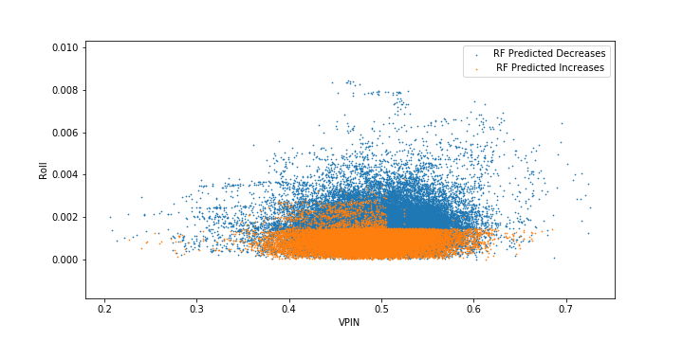
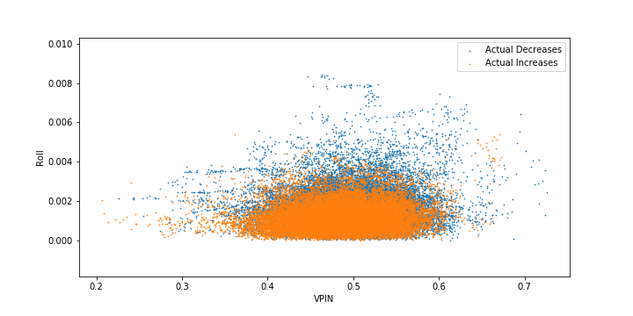
Volatility: Prediction and Actual

Slide 20
MDA Summary
Several measures useful for prediction
  VPIN dominates for spread, kurtosis and Jarque-Bera test prediction
  Roll measure dominates for autocorrelation prediction
  For volatility Roll measure dominates for short windows and VPIN dominates for long windows
  VIX generally has little prediction power
Microstructure measures reflecting information-based trade continue to be predictive

Slide 21
Accuracy of Volatility Prediction
Window size | Amihud | Kyle Lambda | Roll Impact | Roll Measure | VIX | VPIN | Accuracy
25 bars | 0.0013 ± 0.00289 | 0.0185 ± 0.00138 | 0.0237 ± 0.00211 | 0.0558 ± 0.00288 | -0.0006 ± 0.00095 | 0.0531 ± 0.00482 | 0.61
50 bars | 0.0057 ± 0.0011 | 0.0133 ± 0.00125 | 0.019 ± 0.00155 | 0.0435 ± 0.00229 | 0.0004 ± 0.00093 | 0.0402 ± 0.00432 | 0.5813
250 bars | 0.0163 ± 0.00304 | 0.006 ± 0.00163 | 0.0063 ± 0.00148 | 0.025 ± 0.00245 | 0.0002 ± 0.0022 | 0.0172 ± 0.0037 | 0.5493
500 bars | 0.0133 ± 0.00373 | 0.0005 ± 0.00229 | -0.0029 ± 0.00149 | 0.0028 ± 0.00231 | -0.002 ± 0.00251 | 0.0307 ± 0.0044 | 0.5399
1000 bars | 0.0063 ± 0.00315 | 0.0024 ± 0.00265 | -0.0029 ± 0.00124 | -0.0002 ± 0.00251 | 0.01 ± 0.00288 | 0.0477 ± 0.0056 | 0.5578
1500 bars | 0.002 ± 0.00377 | 0.004 ± 0.00293 | -0.0072 ± 0.00187 | -0.0034 ± 0.0032 | 0.0101 ± 0.00311 | 0.0513 ± 0.00564 | 0.559
2000 bars | 0.0036 ± 0.00386 | 0.002 ± 0.00293 | -0.0076 ± 0.00191 | -0.0111 ± 0.00287 | 0.0187 ± 0.00418 | 0.056 ± 0.00544 | 0.5668

Slide 22
Accuracy
With the exception of spread, out-of-sample accuracy levels range from 0.54 to 0.61
Surprisingly high
  Random guessing would be 0.5
  We are predicting 250 bars ahead---about one week

Slide 23
Robustness
Almost no effect of restricting to a regularized forest
Feature importance is stationarity across time (in our sample period)
High correlations between MDA results for 250 bar window and MDA results for 50 bar window (at least for short lookback windows)
Time-bar formulation gives similar feature importance ranking with dollar-volume bars
Logistic regression
  similar results to random forest in both feature importance ranking and total accuracy.

Slide 24
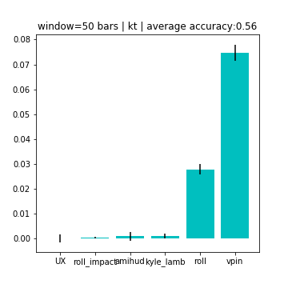
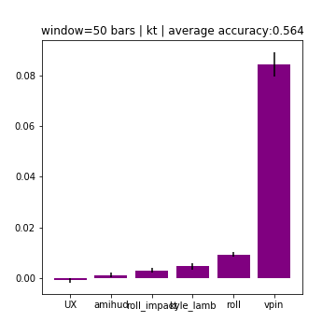
MDA: left-time bars, right-volume bars

Slide 25
Conclusion
Microstructure measures (particularly VPIN) are still useful
Some measures are useful in-sample, but not out-of-sample
High out-of-sample accuracy suggests that markets are less efficient than is generally believed
More research is needed

Slide 26
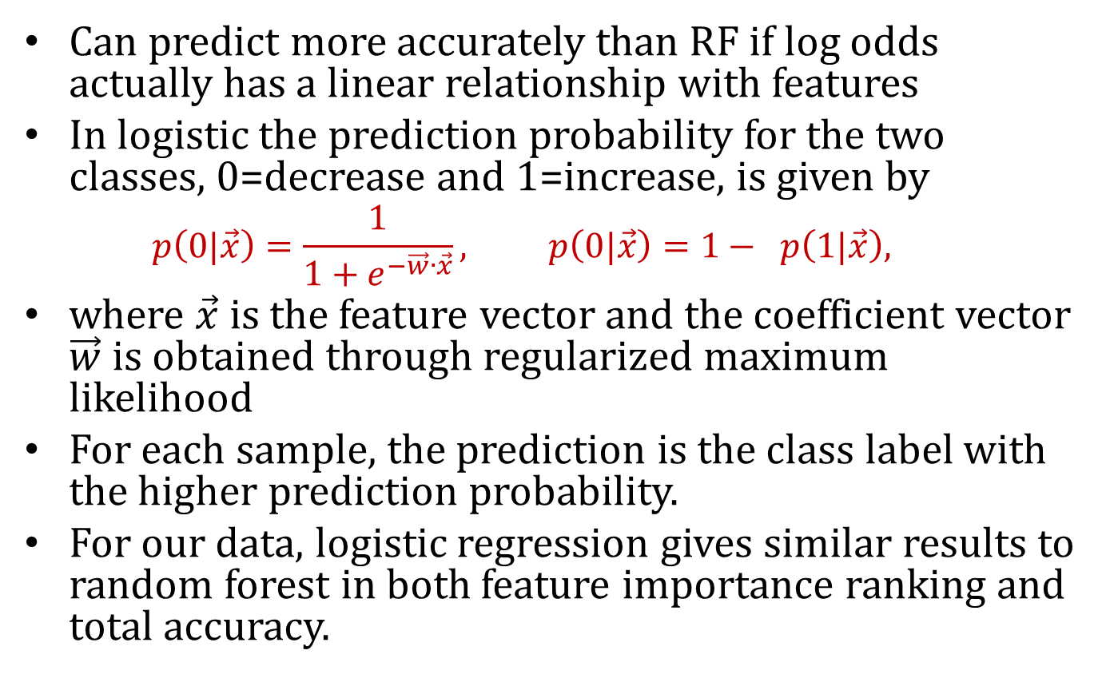
Logistic Regression
Can predict more accurately than RF if log odds actually has a linear relationship with features
In logistic the prediction probability for the two classes, 0=decrease and 1=increase, is given by
  $$p\left(0|\vec{x}\right)=\frac{1}{1+e^{−\vec{w}∙\vec{x}}}, p\left(0|\vec{x}\right)=1− p\left(1|\vec{x}\right),$$
where $\vec{x}$ is the feature vector and the coefficient vector $\vec{w}$ is obtained through regularized maximum likelihood
For each sample, the prediction is the class label with the higher prediction probability.
For our data, logistic regression gives similar results to random forest in both feature importance ranking and total accuracy.

Slide 27
Data Example for E-mini S&P 500
Time | Open | Symbol | Close | Ticks | Volume | High | Low | ETF Price
9:45 | 971.75 | ESU03 Index | 968.25 | 7691 | 69823 | 975 | 966.25 | 1
10:05 | 968.25 | ESU03 Index | 962 | 5946 | 70143 | 969.75 | 962 | 0.993545
10:19 | 962 | ESU03 Index | 963 | 5558 | 70304 | 964.25 | 960.25 | 0.994578
10:39 | 963 | ESU03 Index | 963.5 | 4936 | 70188 | 965.75 | 962.5 | 0.995094
11:17 | 963.5 | ESU03 Index | 964.5 | 5766 | 70171 | 965.25 | 961.75 | 0.996127
12:34 | 964.5 | ESU03 Index | 964 | 7571 | 70050 | 967 | 963 | 0.995611
13:27 | 964 | ESU03 Index | 970.75 | 6956 | 70024 | 970.75 | 962.75 | 1.002582
14:20 | 970.75 | ESU03 Index | 972.25 | 8294 | 69783 | 972.25 | 968.5 | 1.004131
14:42 | 972.25 | ESU03 Index | 976.75 | 6282 | 69424 | 977.25 | 971.75 | 1.008779

Slide 28
MDA feature importance correlation between logistic regression and random forest
Variable | 25 bars | 50 bars | 250 bars | 500 bars | 1000 bars | 1500 bars | 2000 bars
Kurtosis | 0.9818 | 0.9779 | 0.9602 | 0.9489 | -0.1058 | 0.5929 | 0.6807
Bid-Ask spread | 0.6478 | 0.5756 | 0.0999 | 0.1582 | -0.0639 | 0.0177 | 0.1712
Return variance | 0.9312 | 0.9223 | 0.8830 | 0.8264 | 0.9366 | -0.3209 | 0.9492
Sequential correlation | 0.9808 | 0.9929 | 0.9719 | 0.9268 | 0.9561 | 0.6887 | 0.9506
Skewness | 0.9983 | 0.9809 | 0.8963 | 0.8058 | 0.6231 | 0.2737 | 0.7509
Jarque-Bera test | 0.8611 | 0.9375 | 0.9589 | 0.9377 | -0.0275 | 0.5359 | 0.7963

