Slide 1
The Life Expectancy of Older Couples and Surviving Spouses
Janice Compton, University of Manitoba
Robert A. Pollak, Washington University in St. Louis, NBER, and IZA
April 26, 2019

Slide 2
Consider an older couple approaching usual retirement age
For definiteness, suppose that she is 60 and he is 62, that both spouses are non-Hispanic whites and that it is 2010.
With this information, we can look up their life expectancies in the CDC Life Tables:
Her Life Expectancy is 24.4 years
His Life Expectancy is 20.2 years

Slide 3
For decisions concerning savings, labor supply, retirement, long-term care insurance, etc.
The couple may be concerned not only with their individual life expectancies, but also
Joint Life Expectancy: how long they can expect to both be alive
and
Survivor Life Expectancy: how long the surviving spouse can expect to live as a widow or widower.

Slide 4
Intuitions-1
Our intuition was that these numbers imply that both spouses will be alive for a long time and that they will die at about the same time.
Our intuition also suggested the wife will be the surviving spouse and that, after she becomes a widow, she will not live for very many years.

Slide 5
Intuitions-2
These intuitions are wrong.
We will begin by formalizing these intuitions.
Then we show that these intuitions are wrong and explain why.

Slide 6
N-measures and O-measures
To formalize these intuitions, we construct what we call N-measures (for "naive measures" or, as we explain later, for "non overlapping measures") of joint life expectancy and survivor life expectancy.
Then we do it right.
We construct what we call the O-measures (for "overlapping measures") of joint and survivor life expectancy.
The N-measures give the wrong answer unless the mortality distributions of spouses do not overlap -- that is, the mortality distribution is such that all 62 year old men die before any 60 year old women die.
That's what we mean by "non-overlapping."

Slide 7
The life-cycle model
For economists, it would be convenient if husbands and wives died at about the same time and if surviving spouses did not survive for very long. WHY?
Because with this assumption it might be possible to analyze the behavior of couples using use a modified version of the standard life cycle model of saving and consumption, labor supply and retirement.
Of course you need additional assumptions to justify a unitary model (i.e., utility maximizing) model -- after all, even if spouses die at the same time, they may disagree about saving and consumption, labor supply and retirement. (If they disagree, you may need to think about bargaining.)

Slide 8
Whose life cycle?
But if husbands and wives do not die at the same time, we need to ask: "Whose life cycle?" The conventional answer is clear: "We're going to stick with the individual life cycle model and assume that our individuals are not married." An alternative but also unsatisfactory answer is: "In our model, we assume that spouses die at the same time -- or at about the same time."
We will show that it is not likely that spouses die at about the same time. (We don't actually show this, but there are data problems.)

Slide 9
Non-overlapping mortality distributions: The N-approach
The N-approach (N for “naïve” or for “non-overlapping”)
For this couple
N-Joint LE = min {24.4, 20.2} = 20.2 years
N-Survivor LE = (24.4 – 20.2) = 4.2 years
This calculation is simple and uses readily available information, namely, individual life expectancies.
It assumes that the wife, because she has the longer life expectancy, will be the surviving spouse.
This is not guaranteed. Because the spouses mortality distributions overlap, it is possible that the wife will die first.
The probability that the wife will die first is .37.

Slide 10
O-Joint life expectancy
Determine the probability that both spouses survive each year going forward – or equivalently, the couples’ mortality rate each year (at least one spouse dies).
From this, calculate Joint Life Expectancy of the Couple using the same methodology as calculating individuals’ life expectancies.
For our 60 & 62 couple, the O-joint life expectancy is 17.7 years
Recall: N-Joint life expectancy was 20.2 years
The 2.5 year difference between N-Joint and O-Joint LE is not negligible, but it is not dramatic.

Slide 11
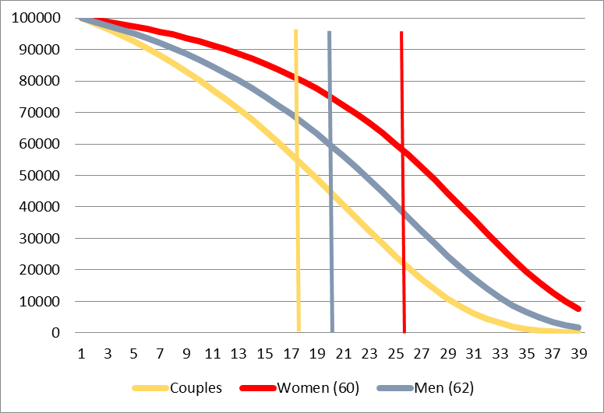
Cohort Survival probabilities and life expectancies: Women (60), Men (62), Couples

Slide 12
O-Survivor life expectancy - 1
The difference between N-survivor and O-Survivor LE is dramatic.
If the wife is the surviving spouse, her O-survivor LE is 12.5 years.
If the husband is the surviving spouse, his O-survivor LE is 9.5 years.
The N-measures assumed that the wife would be the surviving spouse and calculated that her LE as surviving spouse would be 4.2 years.
The probability that the wife will be the surviving spouse is not 1 ---
It is .63.
The probability that the husband will be the surviving spouse is .37.

Slide 13
O-Survivor life expectancy - 2
O-survivor LE takes account of the substantial probability that the husband will outlive the wife.
For each spouse, we calculate the probability of becoming a widow or a widower at each age, conditional on the couple surviving to those ages.
The O-Survivor LE is then a weighted average of the individual’s life expectancies at each age.

Slide 14
What factors determine life expectancy?
Why don't spouses die at about the same time and why do widows and widowers live so long after the death of their spouse?
Three factors contribute to these results:
1. women usually live longer than men so the age-specific male and female mortality schedules differ
2. wives are usually younger than their husbands -- in 2010, on average husbands were about 2 years older than their 60 year old wives.
3. death is random and male and female mortality distributions overlap a lot. This is why the probability that a 60 year old wife will predecease her 62 year old husband is .37.
All three factors matter, but some matter much more than others. We want to sort out their relative importance.
We find that randomness of age at death is doing almost all the work.

Slide 15

Overlapping mortality distributions

Slide 16
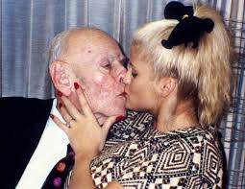
For some couples, the mortality distributions hardly overlap at all

Slide 17
The importance of randomness
To show the importance of randomness of the timing of death, we consider same-sex couples -- this eliminates the sex difference in mortality. To eliminate the age gap, we consider couples in which the spouses are the same age.
For definiteness, suppose Alice and Gertrude are a couple and that both are age 60 in 2010. By construction, their mortality distributions are identical. That is, the probability that Alice will die in year t is the same as the probability that Gertrude will die in year t. We proceed as we did with opposite sex couple to calculate joint and survivor life expectancies.

Slide 18
Mortality distribution for Alice and Gertrude

Slide 19
Joint and survivor life expectancies for Alice and Gertrude
 | Same Sex Couple (Women) Both Age 60 | Opposite Sex Couple Both Age 60 | Opposite Sex Couple Her 60, Him 62
Alice’s Life Expectancy | 24.4 | 24.4 | 24.4
Gertrude’s Life Expectancy | 24.4 | 21.5 | 20.2
N-Joint Life Expectancy | 24.4 | 21.5 | 20.2
N-survivor Life Expectancy | 0.0 | 2.9 | 4.2
O-Joint Life Expectancy | 20.3 | 18.6 | 17.7
O-Survivor Life Expectancy (Alice) | 10.8 | 11.9 | 12.2
O-Survivor Life Expectancy (Gertrude) | 10.8 | 9.4 | 9.5
Probability that Alice is the Surviving Spouse | 0.5 | 0.59 | 0.63
Age Gap (Gertrude – Alice) | 0.0 | 0.0 | 2.0
Calculations by authors

Slide 20
Mortality distribution for Oscar and Alfred, both age 62

Slide 21
Joint and survivor life expectancies for Oscar and Alfred
 | Same Sex Couple (Men) Both Age 62 | Same Sex Couple (Women) Both Age 60
Oscar’s Life Expectancy | 20.2 | 24.4
Alfred’s Life Expectancy | 20.2 | 24.4
N-Joint Life Expectancy | 20.2 | 24.4
N-survivor Life Expectancy | 0.0 | 0.0
O-Joint Life Expectancy | 15.9 | 20.3
O-Survivor Life Expectancy (Oscar) | 10.4 | 10.8
O-Survivor Life Expectancy (Alfred) | 10.4 | 10.8
Probability that Oscar is the Surviving Spouse | 0.5 | 0.5
Age Gap (Alfred – Oscar) | 0.0 | 0.0
Calculations by authors.

Slide 22
Mortality distributions and marital status
We would like to avoid assuming that mortality distributions are independent of marital status.
The conventional wisdom is that married people live longer and that some part of the association is causal (rather than entirely the result of selection because healthy people are more likely to marry)
If we had good mortality distributions for married non-Hispanic white men and for married non-Hispanic white women we would use them.
But there are problems with the distributions that do exist, and constructing better ones requires resolving conceptual issues and having better data.
For example, what does it mean to be married? “Ever married”?
Married at age 40? Continuously married from age 40 to age 60?
Requires longitudinal data on individuals (marriage; death).

Slide 23
Correlations between spouses mortality distributions
We would like to avoid assuming that the mortality distributions of husbands and wives are independent.
Shared environment and behavioral habits both before and during marriage suggest that they are not: smoking, diet, exercise
Correlated premarital environments; early nutrition (including in utero nutrition). The Barker hypothesis.
Correlated education, living standards, access to medical care
Estimating correlations in LE of spouses requires longitudinal data on couples (marriage; both deaths).
We are working on this.

Slide 25
Race and ethnicity, 2010
Using 2010 CDC Life Tables, we calculate joint and survivor LE for non-Hispanic white, black, and Hispanic couples.
Consider census couples in which the wife was age 60. Husbands can be any age. The means are presented.

Slide 26
 | Non-Hispanic White | Black | Hispanic
Wife’s Life Expectancy (at age 60) | 24.40 | 23.05 | 26.40
Husband's Life Expectancy | 20.17 | 18.22 | 21.05
N-Joint Life Expectancy | 19.91 | 17.96 | 20.73
 | (3.00) | (3.18) | (3.91)
N-survivor Life Expectancy | 4.75 | 5.34 | 5.98
 | (2.87) | (2.97) | (3.73)

Slide 27
 | Non-Hispanic White | Black | Hispanic
N-Joint Life Expectancy | 19.91 | 17.96 | 20.73
N-survivor Life Expectancy | 4.75 | 5.34 | 5.98
O-Joint Life Expectancy | 17.66 | 15.45 | 18.79
O-Survivor Life Expectancy (His) | 9.48 | 10.05 | 9.34
 | (1.51) | (1.77) | (1.85)
O-Survivor Life Expectancy (Hers) | 12.48 | 13.52 | 13.13
 | (1.21) | (1.19) | (1.77)

Slide 28
White couples and black couples, 1930-2010
Using 1930-2010 CDC Life Tables, we calculate joint and survivor LE for white and black couples.
Census couples in which the wife was age 60. Husbands can be any age. The means are presented.
These calculations take account of a change over time in the age specific mortality rates of men and women and a change over time in the age differences between spouses. The results are driven by the changes in age-specific mortalities.

Slide 31
Education and life expectancy
Using Bound, Geronimus, Rodriguez, and Waidmann (2015, Health Affairs), we can condition the 2010 joint and survivor life expectancies on education for non-Hispanic white couples and for and black couples.
Census couples in which the wife was age 60. Husbands can be any age. The means are presented.
Group couples by joint education:
Power couples (both college graduates)
Half-power Her (only she is college graduate)
Half-power Him (only he is college graduate)
Low-power couples (neither is a college graduate)

Slide 34
How do married couples make retirement- related decisions? Implications for policy.
Saving, retirement, claiming social security benefits.
Focus on claiming social security benefits:
do they understand social security rules?
do they understand mortality risks?
Would providing more information about social security rules and mortality risks improve things much?
Would changing the social security rules – perhaps changing the defaults -- improve things much?

Slide 35
Annuitization
Are O-Joint and O-Survivor life expectancies all that couples need to know about their mortality risks. NO
More complicated measures of longevity are relevant because, to first approximation, people don’t annuitize unless they have to. (Social security is an example of compulsory annuitization.)

Slide 36
How do married couples make retirement- related decisions? Implications for economics.
The standard “life-cycle model” in economics assumes an unmarried / unpartnered individual making retirement-related decisions.
To generalize the individual life-cycle model by assuming that married couples maximize a “household utility function” sweeps the problem of conflicting interests under the rug.
The difference in which spouse is likely to be the surviving spouse and differences in survivor life expectancies suggest that spouses’ interests are not identical
Bargaining models of marriage provide a way to think about how couples resolve conflicting interests.
.

Slide 37
Dimensions of inequality: life expectancy
Race (white, black, Asian) and ethnicity (Hispanic, non-Hispanic)
Education (big differences, controlling for race/ ethnicity)
But what does education stand for? Is it what people learn in college? A proxy for income? A proxy for parents SES? Is it mostly selection?

Slide 38
Dimensions of inequality: marital status
Social security treatment of married and unmarried individuals favor marriage:
spousal benefits
survivor benefits.
How does this interact with race/ethnicity?

Slide 39
60 Year old Women, Marital Status
 | NHWHITE | BLACK | HISPANIC
Married | 65.24 | 36.75 | 54.96
Previously | 20.50 | 32.57 | 25.46
Widowed | 7.70 | 13.41 | 9.83
Never Married | 6.56 | 17.28 | 9.75
Total | 100 | 100 | 100

Slide 40
Other applications of O-measures
Our methodology (O-measures) can be applied not only to spouses, but also to other pairs.
For example
a parent and a child
pairs of siblings
Can be generalized beyond pairs to larger groups
a parent and two children
three siblings
two parents and two children

Slide 41
Conclusion
The issues of joint and survivor life expectancy have not been well addressed in demography or economics.
Attaching numbers to joint life expectancy and survivor life expectancy is a prerequisite to thinking about retirement saving, retirement, and the claiming of social security benefits.
The differences between the N-measures and the O-measures of survivor life expectancy are dramatic.

Slide 42
Thank you

Slide 43
Qualifications
A general problem with life tables -- they fail to recognize all of the observable and unobservable factors that affect life expectancies.
Education is correlated across spouses, but other factors that affect life expectancy are also correlated.
.

Slide 44
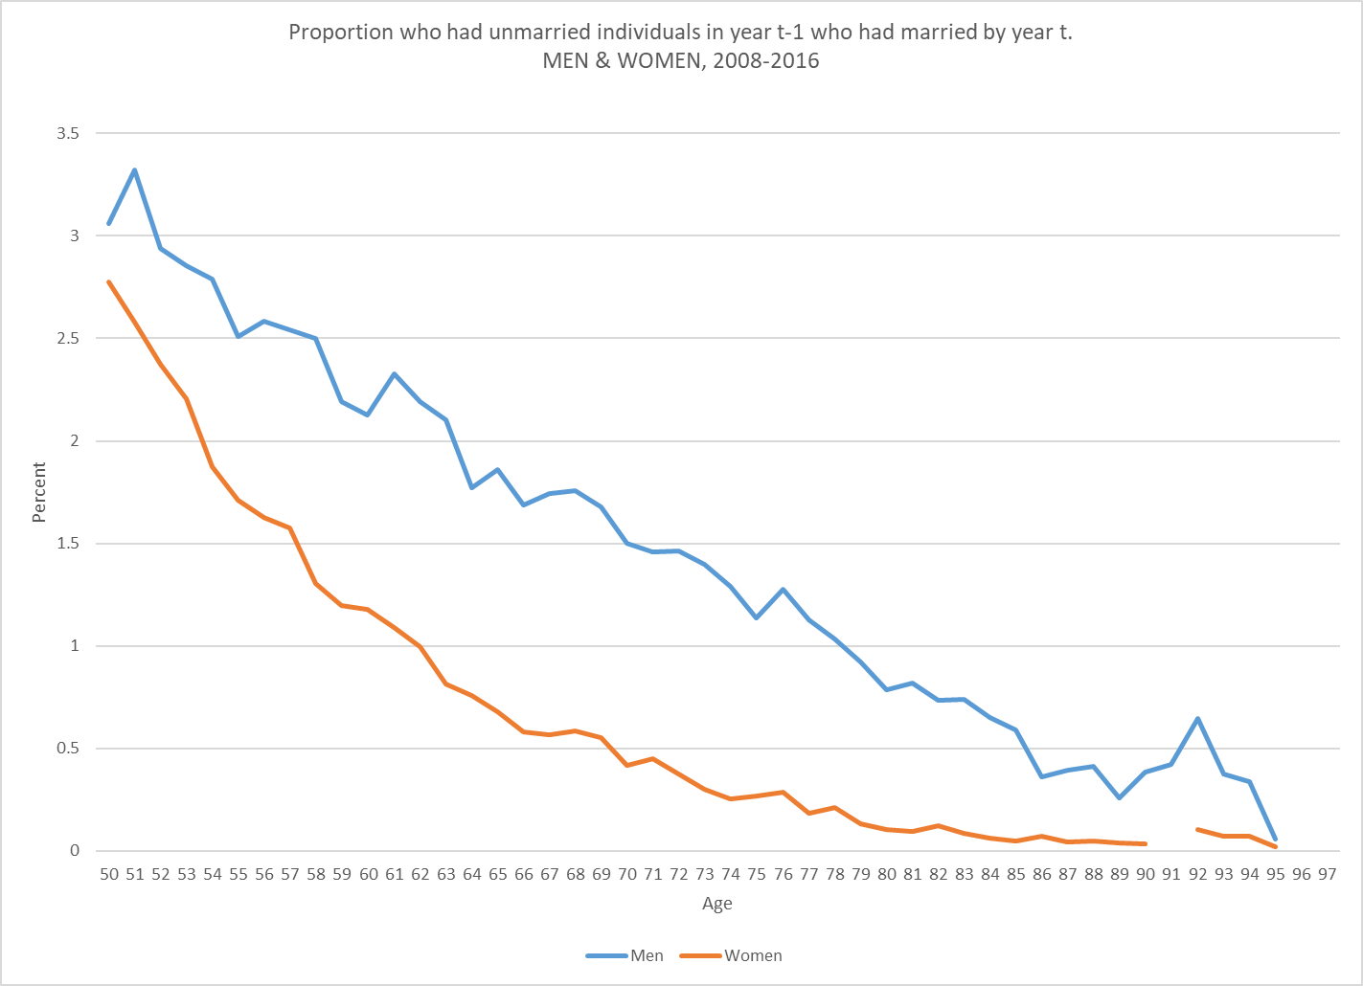

Slide 45
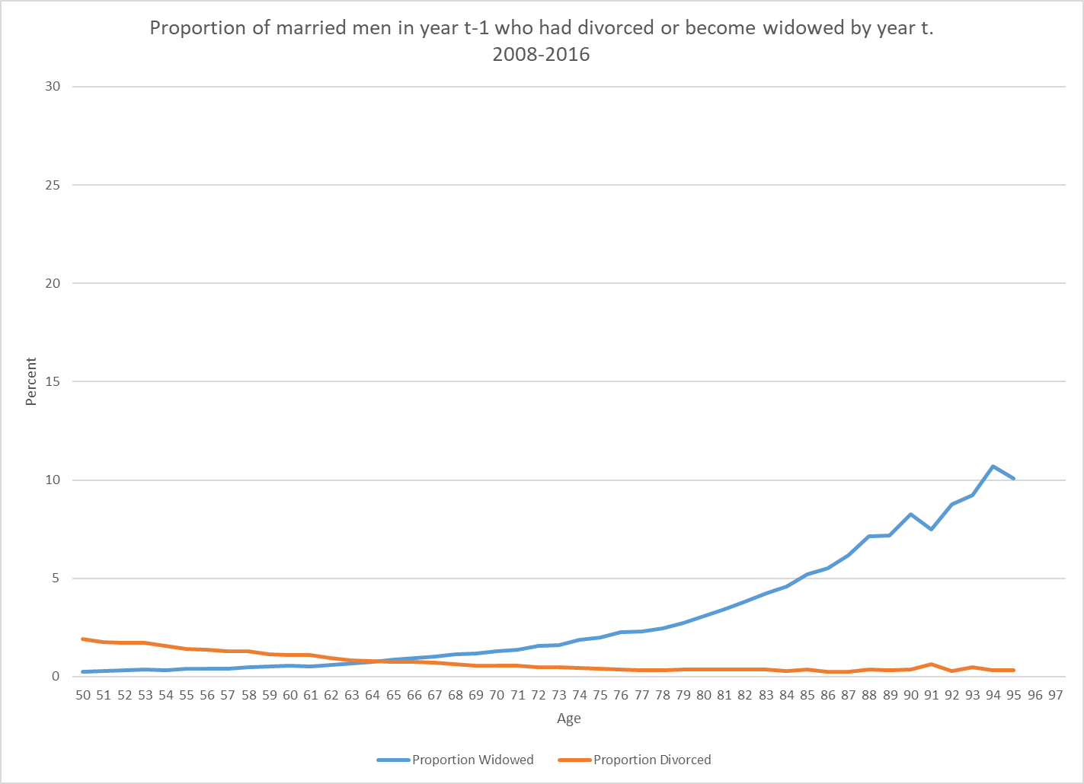

Slide 46
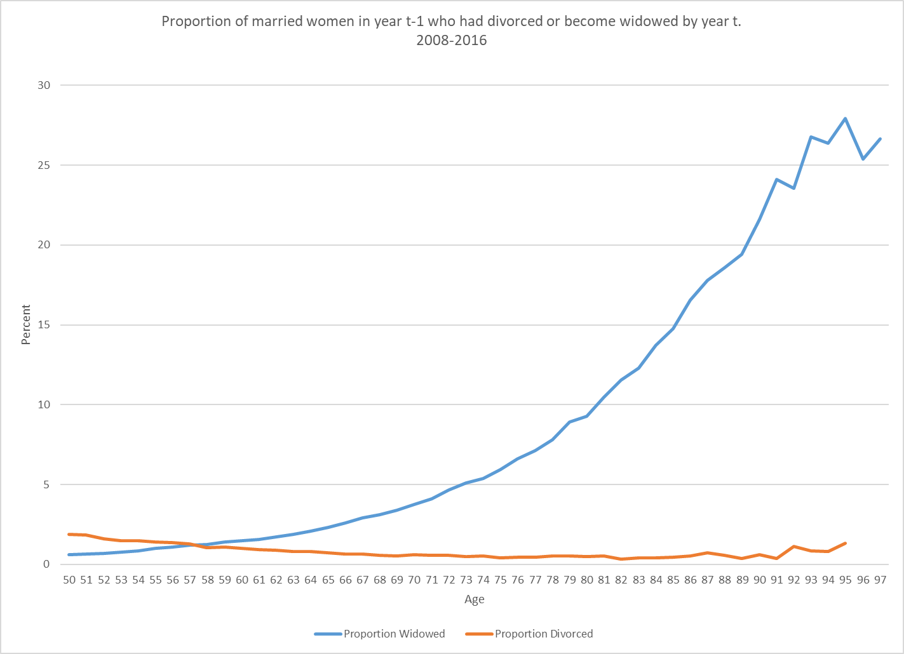

Slide 47
Non-overlapping mortality distributions: The N-approach
The N-approach (N for naïve or for non-overlapping – see next slide)
N-Joint life Expectancy = min {her LE, his LE}
N-Survivor Life expectancy = max {her LE, his LE} - min {her LE, his LE}
For this couple
N-Joint LE = min{24.4, 20.2} = 20.2 years
N-Survivor LE = (24.4 – 20.2) = 4.2 years
This calculation implicitly assumes
The wife will be the surviving spouse or, equivalently,
non-overlapping mortality distributions.

Slide 48
 | Non-Hispanic White | Black | Hispanic
Wife’s Life Expectancy (at age 60) | 24.40 | 23.05 | 26.40
 | (0.00) | (0.00) | (0.00)
Husband's Life Expectancy | 20.17 | 18.22 | 21.05
 | (3.59) | (3.74) | (4.59)
N-Joint Life Expectancy | 19.91 | 17.96 | 20.73
 | (3.00) | (3.18) | (3.91)
N-survivor Life Expectancy | 4.75 | 5.34 | 5.98
 | (2.87) | (2.97) | (3.73)

Slide 49
 | Non-Hispanic White | Black | Hispanic
N-Joint Life Expectancy | 19.91 | 17.96 | 20.73
 | (3.00) | (3.18) | (3.91)
N-survivor Life Expectancy | 4.75 | 5.34 | 5.98
 | (2.87) | (2.97) | (3.73)
O-Joint Life Expectancy | 17.66 | 15.45 | 18.79
 | (2.08) | (2.12) | (2.82)
O-Survivor Life Expectancy (His) | 9.48 | 10.05 | 9.34
 | (1.51) | (1.77) | (1.85)
O-Survivor Life Expectancy (Hers) | 12.48 | 13.52 | 13.13
 | (1.21) | (1.19) | (1.77)

Slide 50
How do married couples make retirement- related decisions? implications for economics.
Inside baseball. I won’t say much.
The standard “life-cycle model” in economics assumes an unmarried / unpartnered individual making retirement-related decisions.
To generalize the individual life-cycle model by assuming that married couples maximize a “household utility function” sweeps the problem of conflicting interests under the rug.
The difference in survivor life-expectancies suggests that spouses are likely to have conflicting interests.
Bargaining models of marriage are one way to think about these issues.
All this without think about the possibility that the marriage may end in divorce (there is now a literature on “gray divorce”) or that the surviving spouse may remarry.
.

Slide 51
Moved material
(In Hindu tradition, the ideal wife would throw herself on her husband's funeral pyre and immolate herself, a practice called sati or suttee.)

