Slide 1
Incomplete Contracting and
AI Alignment
Gillian K. Hadfield
U of T Law and Management, Vector Institute, CHAI, OpenAI
Dylan Hadfield-Menell
UC Berkeley Computer Science, CHAI
NBER AI and Economics Conference, U of Toronto, September 2018

Slide 2
What is the AI alignment problem?
Robot ethics
Moral machines
Algorithmic fairness
AI Safety
Superintelligence

Slide 3
What is the AI alignment problem?
How do we get agents to do what we want them to do?

Slide 4
What is the contracting problem?
How do we get agents to do what we want them to do?

Slide 5
(How) are robots like humans?
Maximizing value functions (on steroids)
  “Self-interest-seeking with guile” (Williamson)
What do we take for granted in human contracts?
What institutions/norms could improve behavior of artificially intelligent agents?

Slide 6
What is reinforcement learning?
What RL is not: a human programming a for all states s
Give agent (robot/algorithm) reward function R(s, a)
Train agent on data: observe state, take action, observe new state & reward, update model/algorithm, repeat
Search, exploration, discovery of optimal policy (best action in each state)
UNEXPECTED BEHAVIOR: robot figures out things the human (planner/designer) didn’t think about

Slide 7
What, me worry?
Sneaky robot

Slide 8
How should we regulate AI?
AI ethics
AI liability
Algorithmic fairness
Autonomous weapons treaties

Slide 9
How CAN we regulate AI?
How do we get artificial agents (built using machine learning) to do what we want them to do?

Slide 10
“An AI system must be subject to the full gamut of laws that apply to its human operator….Our common law should be amended so that we can’t claim that our AI system did something that we couldn’t understand or anticipate.”
–Oren Etzioni (NYT September 2, 2017)

Slide 11
How CAN we regulate AI?
How do we BUILD AI systems that can interface with human normative systems?

Slide 12
How CAN we regulate AI?
An engineering research program
+
A social science research program

Slide 13


How do we get an agent to do what we want?

Slide 14

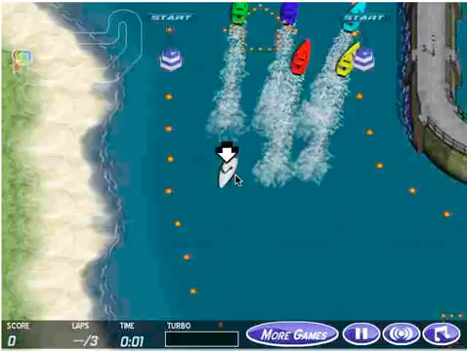


Slide 15
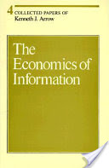
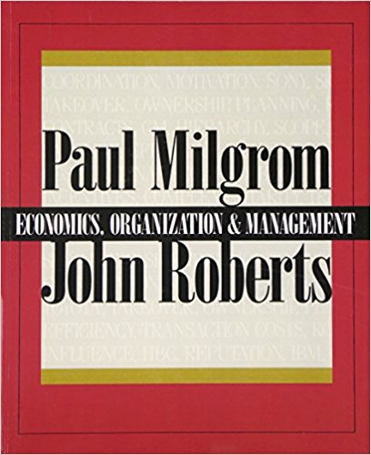
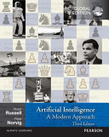

Slide 16
Reward Engineering is Hard
Figure credit: Jack Clark and Dario Amodei,“Faulty Reward Functions in the Wild”
OpenAI Blog (December 21, 2016)

Slide 17







Reward Engineering is Hard
Figure credit: Dylan Hadfield-Menell, Smitha Milli, Pieter Abbeel, Stuart Russell and Anca Dragan, “Inverse Reward Design” (NIPS 2017)

Slide 18








Contract Design is Hard
™
100
™
™
30
20
-10
10
-20
Complete Contingent Contract
Incomplete Contract

Slide 19
Misalignment
Fundamental to economic analysis (welfare theorems, P-A analysis)

Slide 20
Incomplete contract
Strategic behavior
Exploitation of gaps
Sub-optimal behavior

Slide 21
Misaligned reward function
Strategic behavior
Exploitation of gaps
Sub-optimal behavior

Slide 22






Strategic robots?
Thaler Shefrin (1981) “Self control"

Slide 23
Why are contracts incomplete?
Why are rewards
misspecified?
Bounded rationality (can’t think of all contingencies)
Costly cognition/drafting
Non-contractibility (variables not describable/observable)
Strategic behavior
Planned renegotiation
Planned completion by third-party in event of dispute
Bounded rationality (negative side effects)
Costly engineering/design
Non-implementability (unsolved learning problems)
Adversarial design, multiple “owners”
Planned iteration on rewards
Planned completion by third-party in event of dispute

Slide 24
Insights from econ theory: weakly strategic AI
Property Rights
Allocate property rights to agent whose whose non-contractible actions have bigger impact (Grossman & Hart 1986, Hart & Moore 1988)
Best solution may not reside in more finely tuned contract
  Sometimes better to sell firm to agent
Allocation of property = transformation of agent’s utility function

Slide 25
Insights from econ theory: weakly strategic AI
Property Rights
Can we incorporate information about global return to task
  e.g. platform engagement: short-term (clicks) may damage long-term (Ananny & Crawford 2016)
    “Selling Facebook to its algorithms” = endow algorithms with broad set of values users, advertisers, etc. care about
  e.g. mistagging photos: add info about impact on network size, publicity
  e.g. fair algorithms: add broader information on human valuation

Slide 26




Insights from econ theory: weakly strategic AI
Measurement and Multi-tasking
Sometimes better to reduce incentives on measured tasks to reduce distortion in unmeasurable task (Holmstrom & Milgrom 1991, Baker et al 1994)

Slide 27
Insights from econ theory: weakly strategic AI
Measurement and Multi-tasking
May want to use sub-optimal (or even omit) rewards for easily measurable (components of) tasks of important tasks cannot be rewarded
E.g. sub-optimal rewards for speed in autonomous car so unreliable rewards for courteous driving (facilitating traffic flow) to have maximum effect?

Slide 28
Insights from econ theory: strongly strategic AI
Control rights
Sometimes optimal for principal to commit to remain uninformed and therefore in poor position to intervene (Aghion & Tirole 1997)
“Off switch” problem: AI’s prediction of human intervention affects AI’s learned policy
  Sub-optimal policy
  Avoidance of human intervention
Hadfield-Menell et al (2017): Design reward taking into account incentive of robot to share info and offer human opportunity to intervene
Can humans have info robots don’t know/ignore?

Slide 29
Insights from econ theory: strongly strategic AI
Costly signaling
“Good” agents can credibly signal type by choice of contract when “good” types have lower cost of performance than “bad” (Spence 1973)
Cost of human intervention is higher for less than more aligned AI
Can we use willingness of AI to seek human input as a signal of alignment?

Slide 30
Insights from econ theory: strongly strategic AI
Renegotiation
Initial contracts set the terms at which agent can be “bought off” in renegotiation to better result (Hart 1988)
Shutdown problem: anticipating “buy out” of robot to shift from initial to revised reward function? (e.g. Armstrong (2015) “Motivated Value Selection”, Orseau & Armstrong (2016) “Safely Interruptible Agents”)

Slide 31
Insights from relational contracting
Economists: Informal sanctions for breach; self-enforcing (termination, reputation) (Baker, Gibbons & Murphy 2002, Levin 2003)
Legal/organizational theorists: contracts incorporate/are embedded in external structure/norms/relationships (Macaulay 1963, Macneil 1974, Williamson 1975, Granovetter 1985)

Slide 32
Insights from relational contracting
Cognitive schema
Norms
Law
Language
Culture
Relationships

Slide 33


Dario Amodei et al, “Concrete Problems in AI Safety” (2016)

Slide 34
Dario Amodei et al, “Concrete Problems in AI Safety” (2016)

Slide 35


Slide 36
How do humans do it?
What makes incomplete contracting rational?

Slide 37

Implied terms
Human contracts rely on tons of structure
  e.g. “what was it reasonable to think the parties had in mind when they agreed”
  “reasonable” (and other gap-fillers) provided by institutions (norms, law)

Slide 38
Can we build …
Robots that can fill in their reward functions like humans do?
Replicate human process of reading, imagining, and predicting classification of behaviors? (Smith’s impartial spectator)
Assign negative weight to actions classified as sanctionable?

Slide 39
Can we build …
Institutions that can support robot normativity?

