Slide 1
Two Kinds of Robots in Growth Models
Edmund Phelps
Economics of Artificial Intelligence
Toronto, ON
September 13, 2018

Slide 2
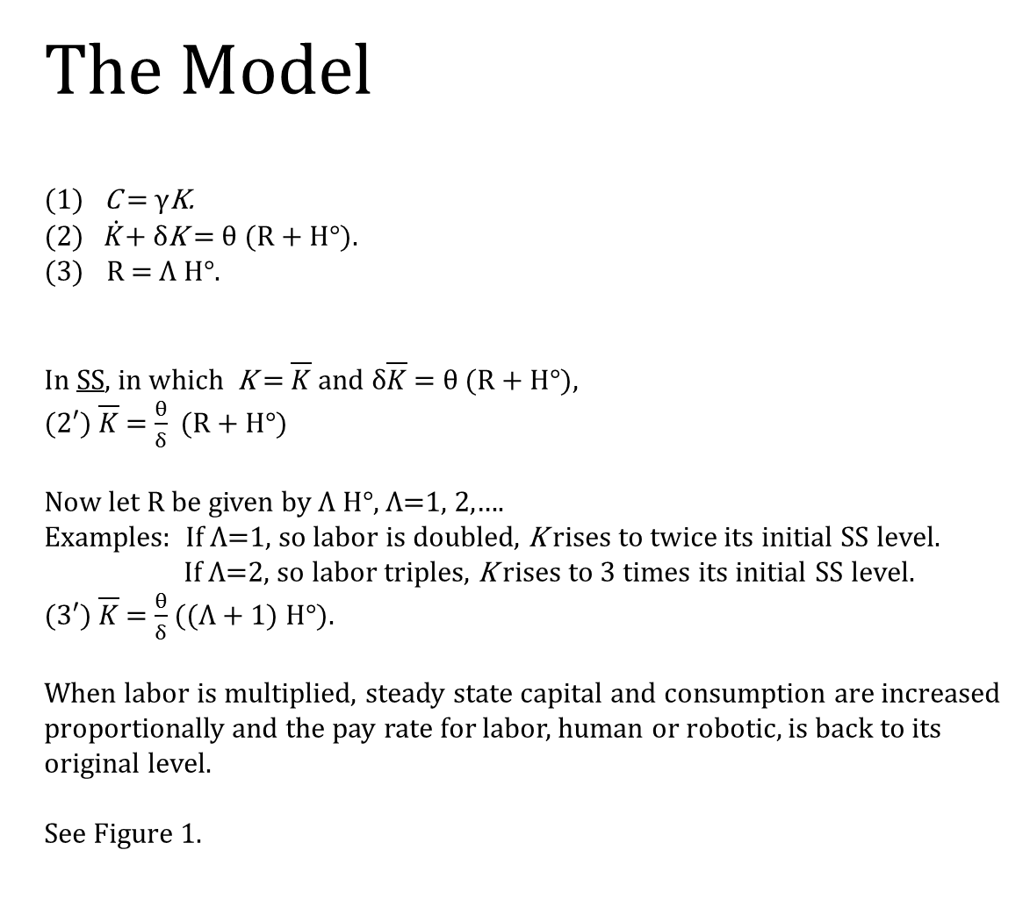
The Model
(1) C = γK.
(2) $\dot{K}$+ δK = θ (R + H°).
R = Λ H°.
In SS, in which K =$\overline{K}$ and δ$\overline{K}$ = θ (R + H°),
(2′) $\overline{K}$ = $\frac{θ}{δ}$ (R + H°)
Now let R be given by Λ H°, Λ=1, 2,….
Examples: If Λ=1, so labor is doubled, K rises to twice its initial SS level.
If Λ=2, so labor triples, K rises to 3 times its initial SS level.
(3′) $\overline{K}$ = $\frac{θ}{δ}$ ((Λ + 1) H°).
When labor is multiplied, steady state capital and consumption are increased proportionally and the pay rate for labor, human or robotic, is back to its original level.
See Figure 1.

Slide 3
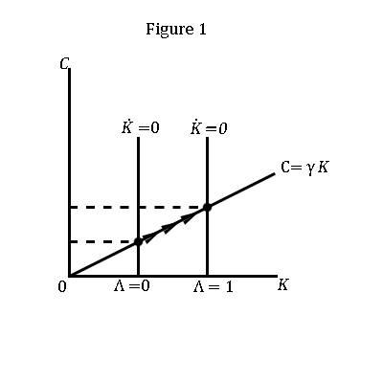

Slide 4
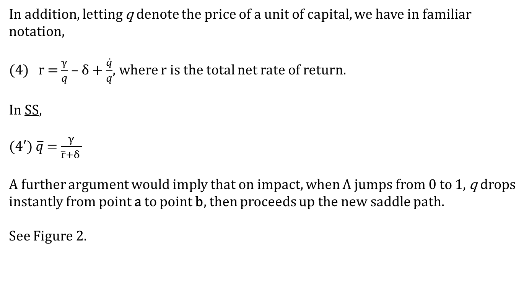
In addition, letting q denote the price of a unit of capital, we have in familiar notation,
(4) r = $\frac{γ}{q}$ – δ + $\frac{\dot{q}}{q}$, where r is the total net rate of return.
In SS,
(4′) $\overline{q}$ = $\frac{γ}{\overline{r}+δ }$
A further argument would imply that on impact, when Λ jumps from 0 to 1, q drops instantly from point a to point b, then proceeds up the new saddle path.
See Figure 2.

Slide 5
