Slide 1
Can time heal all wounds?
Anne de Hond
Pieter Bakx
Matthijs Versteegh

Slide 2
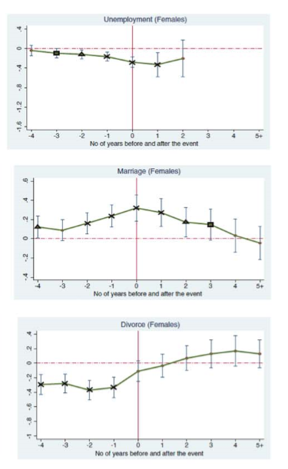
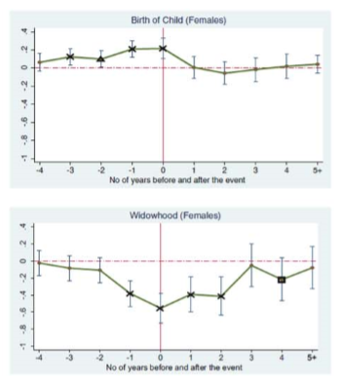
Source: Clark (Rev Income Wealth 2018)

Slide 3
Issue for policy analysts
Whose preferences should be guiding when evaluating interventions?

Slide 4
Can time heal all wounds?
Anne de Hond
Pieter Bakx
Matthijs Versteegh

Slide 5
Health issues occur frequently at old age;
Not all of them have an immediate impact on what the person is still capable of doing;
But when they do, it’s likely permanent
→ Do elderly adapt to these functional limitations?

Slide 6
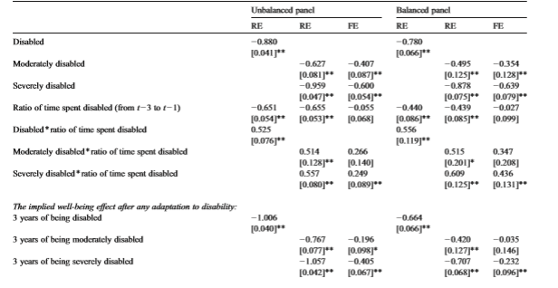
Oswald and Powdthavee (J Pub Econ 2008) for disability or long-term illness
“[T]he data do not support (…) a return to the old well-being level (…) we estimate the degree of adaptation to be of the order of 30% to 50%”

Slide 7
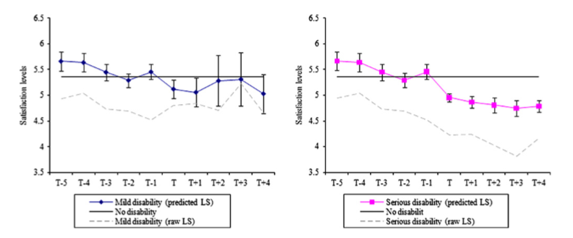
Powdthavee (2009): disability without (left) and with (right) consequences for functional limitations

Slide 8
What is new?
Focus on elderly: mean age is 72;
Larger study sample: 15000 observations for 5000 individuals with functional limitations;
Because of its focus on middle-aged and elderly, SHARE has more standard measures of functional limitations.
In the near future, we set out to uncover:
How the adaptation occurs;
Where in the distribution of life satisfaction the adaptation occurs;
Cross-country differences exist, and link these to the role of family and the state.

Slide 9
Key findings
Full adaptation in life satisfaction;
Which appears to occur across the full distribution.
And is not caused by a return in self-rated health to original levels;

Slide 10
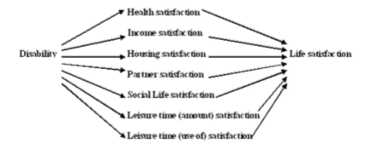
There are many pathways/domains through which functional limitations may affect life satisfaction
Source: adapted (…) from Powdthavee 2009

Slide 11
Adaptation may happen in three ways
Adaptation
Response shift
Reconceptualization
Changing values
Scale recalibration
(changing standards)
(Peeters & Stiggelbout, 2013)

Slide 12
Data: sample selection
Survey on Health, Ageing and Retirement in Europe (SHARE)
5 regular waves (1, 2, 4-6) in the period 2004-2015;
19 countries;
290.000 observations for 50+ respondents.
Study sample has:
Initially no problems with Instrumental Activities of Daily Living (IADL);
Had a chronic illness;
Developed and continued to report ≥ 1 IADL problem.
→ 15,826 observations (6.1% of total).

Slide 13
Data: outcomes
Life satisfaction: “On a scale from 0 to 10 where 0 means completely dissatisfied and 10 means completely satisfied, how satisfied are you with your life?”
Self-rated health: “how would you describe your health in general?” with five answer categories: Poor, Fair, Good, Very good and Excellent.

Slide 14
Data: Instrumental Activities of Daily Living
Using a map;
Preparing a hot meal;
Shopping for groceries;
Making telephone calls;
Taking medications;
Doing work around the house or garden;
Managing money, such as paying bills and keeping track of expenses;
Leaving the house independently and accessing transportation services;
Doing personal laundry.

Slide 15
Data: Instrumental Activities of Daily Living
We use:
An indicator of having ≥ 1 IADL problem for the first time;
Duration indicators: the time since onset in years.
Severity: the number of limitations;

Slide 16

Methods
$$Y_{it}^{∗}=D_{it}^{′}δ+IADL_{it}γ{+ C}_{it}^{′}θ+α_{i}+ε_{it}$$
Fixed-effects ordered logit models (Baetschmann et al. 2015 blow-up and cluster estimator);
Include covariates to account for other life events;
Fully descriptive, no exogenous variation.

Slide 17
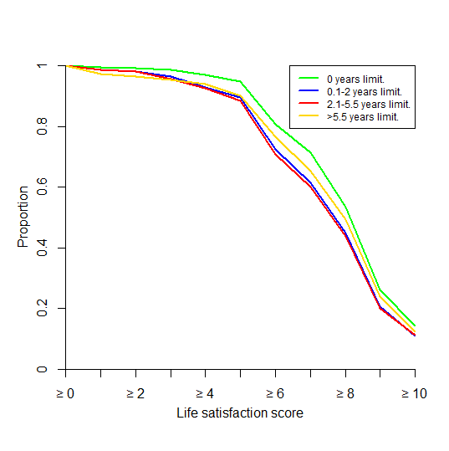
Distribution life satisfaction, by duration

Slide 18
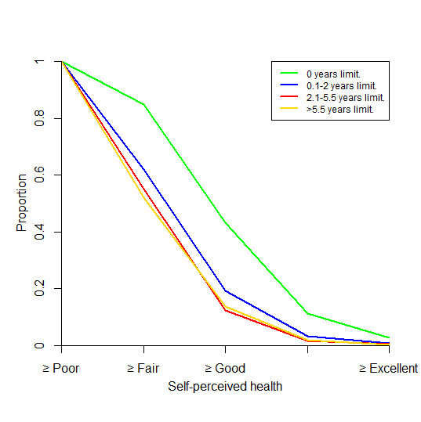
Distribution self-reported health, by duration
Life satisfaction
Self-reported health

Slide 19
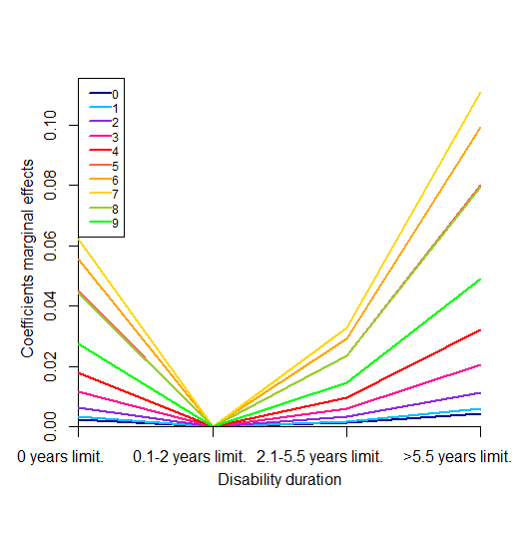
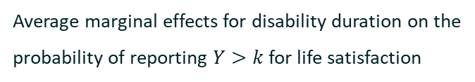
Results: marginal effects
Average marginal effects for disability duration on the probability of reporting $Y>k$ for life satisfaction

Slide 20
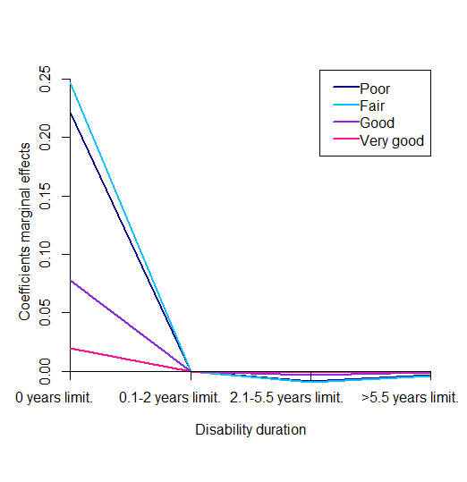
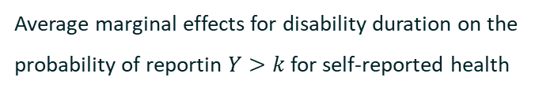
Results: marginal effects
Average marginal effects for disability duration on the probability of reporting $Y>k$ for life satisfaction
Average marginal effects for disability duration on the probability of reportin $Y>k$ for self-reported health

Slide 21
Robustness
 | Effect of duration on life satisfaction | Effect of duration on self-perceived health
Linear model | + | 0
Continuous duration | + | -
Subgroup IADL limitation ≥ 3 waves | + | -
ADL | + | 0
Mobility | + | -
Complete observations IADL | + | 0
Complete observations ADL | + | 0
Complete observations mobility | + | -
Note. + indicates a positive significant effect for at least one of the duration dummies. - indicates a negative significant effect for at least one of the duration dummies. 0 indicates no significant effect for any duration dummies.

Slide 22
Conclusions
No evidence of adaptation in self-rated health following a health-induced setback;
Yet, life satisfaction returns to its original level;
Assuming no scale recalibration, this could be consistent with both:
The adaptation comes from other domains (cf. Powdthavee 2009)
The onset leads one to completely rethink what matters (cf. Peeters and Stiggelbout 2013)
Level-specific marginal effects adaptation occurs across the entire distribution;
Broader measures of well-being show more adaptation to functional limitations show his broader measure of well-being → in evaluating health policies

Slide 23
Next up
Satisfaction with additional subdomains of life satisfaction→ distinguish between explanations;
Cross-country differences → what helps to speed up recovery?
Test for scale recalibration by looking if cut-offs from the ordinal logit differ by duration (Bond and Lang 2018);

Slide 24
Future work: the promise of linked survey and admin data
SHARE is being linked to a wealth of admin data in an increasing number of countries, including the Netherlands;
These admin data contain information on employment, income, health spending and mortality, among other things;
This enables:
Better definition of events;
Ruling out other ;
Looking at whether unsatisfied people act differently, w.r.t. health care use, including medication, among other things;

