Slide 1
Inputs to Industry Price indexes
Jonathan Weinhagen
Producer Price Index
Bureau of Labor Statistics
7/17/2018

Slide 2
Introduction: output versus input price indexes
Industry output indexes
  measure the average change in prices for outputs produced by domestic industries
Input to industry indexes
  measure the average change in prices for inputs consumed by domestic industries

Slide 3
Introduction: potential uses
Potential uses include
  Industry level analysis
  Contract price adjustment
  Price transmission analysis
  Productivity
Notes:
Replaced escalation with price adjustment

Slide 4
Introduction: background
BLS began publishing PPI inputs to construction industries indexes in 1980s
  These indexes excluded imports, labor, capital investment, and services
BLS introduced a set of new PPI input indexes in January 2015
  Expanded coverage by adding input indexes for selected manufacturing and services industries
    Paint manufacturing, offices of physicians, etc.
  Improved methodology , including addition of services inputs
www.bls.gov/opub/mlr/2015/article/new-ppi-net-inputs-to-industry-indexes.htm

Slide 5
Introduction: including imports
A limitation of the current PPI input to industry indexes is that they exclude imported inputs
A number of key data users have requested that BLS add imported inputs to the indexes
  especially important in cases where the industry is a heavy user of imports
BLS developed a methodology to add imports to its inputs to industry indexes using BLS import price indexes (MPIs)

Slide 6
Source data
BLS PPI commodity indexes to measure price change for domestically produced industry inputs
BLS NAICS-based import indexes (MPIs) to measure price change for imported industry inputs

Slide 7
Index limitations
Excludes labor and capital investment
Excludes imported services
  BLS does not produce MPIs for all but a very few services
Excludes any domestically-produced services for which BLS does not publish PPIs
  Currently, PPI covers approximately 72 percent of services industries
Not a true buyers’ price indexes
  Output data is used as a proxy for what a manufacturer actually procures
  Does not capture price changes due to purchaser substitution to lower cost imports

Slide 8
Methodology: product selection
Bureau of Economic Analysis (BEA) Input-Output “Use of Commodities by Industries” table used to determine inputs to an industry

Slide 9
Methodology: product selection –
Use table, selected values
IO industry (NAICS) | industry title | IO Commodity (NAICS) | Commodity title | Industry Use
336111 | Automobile manufacturing | 326210 | Tire manufacturing | 888
336111 | Automobile manufacturing | 327200 | Glass and glass product manufacturing | 1688
336111 | Automobile manufacturing | 332720 | Turned product and screw, nut, and bolt manufacturing | 408
336111 | Automobile manufacturing | 333415 | Air conditioning, refrigeration, and warm air heating equipment manufacturing | 332
336111 | Automobile manufacturing | 334300 | Audio and video equipment manufacturing | 1202
336111 | Automobile manufacturing | 334413 | Semiconductor and related device manufacturing | 512
336111 | Automobile manufacturing | 334514 | Totalizing fluid meter and counting device manufacturing | 516
336111 | Automobile manufacturing | 336211 | Motor vehicle body manufacturing | 1098
336111 | Automobile manufacturing | 336310 | Motor vehicle gasoline engine and engine parts manufacturing | 9128
336111 | Automobile manufacturing | 336320 | Motor vehicle electrical and electronic equipment manufacturing | 1101
336111 | Automobile manufacturing | 336350 | Motor vehicle transmission and power train parts manufacturing | 8081
336111 | Automobile manufacturing | 336360 | Motor vehicle seating and interior trim manufacturing | 5328
336111 | Automobile manufacturing | 336370 | Motor vehicle metal stamping | 6222
336111 | Automobile manufacturing | 484000 | Truck transportation | 906

Slide 10
Methodology: product selection
IO data is matched with PPI commodity data for domestic portion of index, some “translation” is necessary
IO data and MPI data are both NAICS-based, so translation between them is generally unnecessary in order to match up
The PPI and MPI index data used are not necessarily published

Slide 11
Methodology: product selection –
IO to MPI to PPI concordance
IO code (NAICS) | IO title | MPI code (NAICS) | MPI title | PPI code | PPI title
326210 | Tire manufacturing | 326210 | Tire manufacturing | 071201 | Tires
 |  |  |  | 071203 | Tread rubber, tire sundries, and repair materials
333618 | Other engine equipment manufacturing | 333618 | Other engine equipment manufacturing | 119408 | Diesel, semidiesel, & dual-fuel engines, automotive
 |  |  |  | 119413 | Parts and accessories for internal combustion engines
 |  |  |  | 119419 | Miscellaneous engine equipment
334413 | Semiconductor and related device manufacturing | 334413 | Semiconductor and related device manufacturing | 117839 | Integrated microcircuits
 |  |  |  | 117847 | Other semiconductor and related devices
484000 | Truck transportation | N/A | N/A | 301201 | Local motor carrying
 |  |  |  | 301202 | Long-distance motor carrying

Slide 12
Methodology: weights
After the set of domestically-produced and imported commodities consumed by the industry are determined, BLS develops weights for each PPI and MPI index included in the industry input index
The weight for a given commodity within the industry reflects the relative share of the commodity in relation to total industry inputs
Notes:
Edited to reflect BLS

Slide 13
Methodology: domestic weights
Weights are derived from:
  BEA’s “Use of Commodities by Industries”
  Census’ wherever-made (WEM) value of shipments (VOS) data

Slide 14
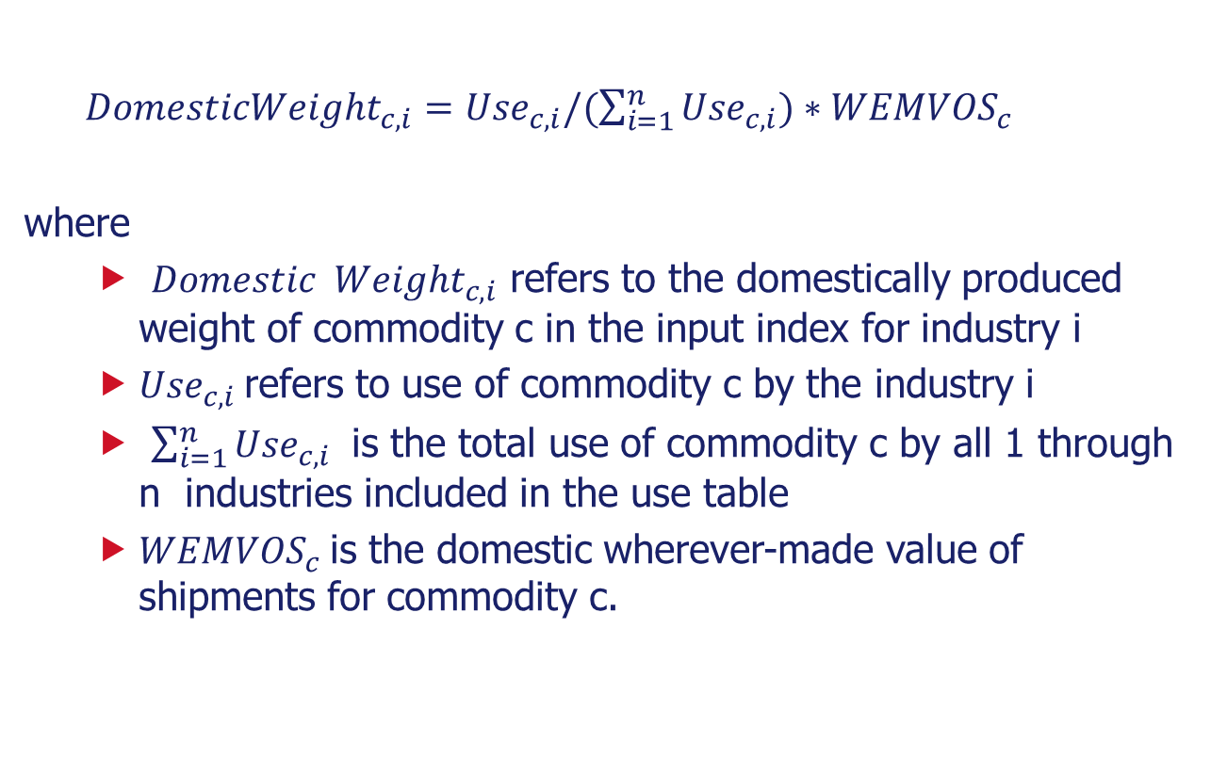
Methodology: weights – domestic inputs
${DomesticWeight}_{c,i}={Use}_{c,i}/(\sum_{i=1}^{n}{{Use}_{c,i})∗{WEMVOS}_{c} }$
where
  ${Domestic Weight}_{c,i}$ refers to the domestically produced weight of commodity c in the input index for industry i
  ${Use}_{c,i}$ refers to use of commodity c by the industry i
  $\sum_{i=1}^{n}{{Use}_{c,i}}$ is the total use of commodity c by all 1 through n industries included in the use table
  ${WEMVOS}_{c}$is the domestic wherever-made value of shipments for commodity c.

Slide 15
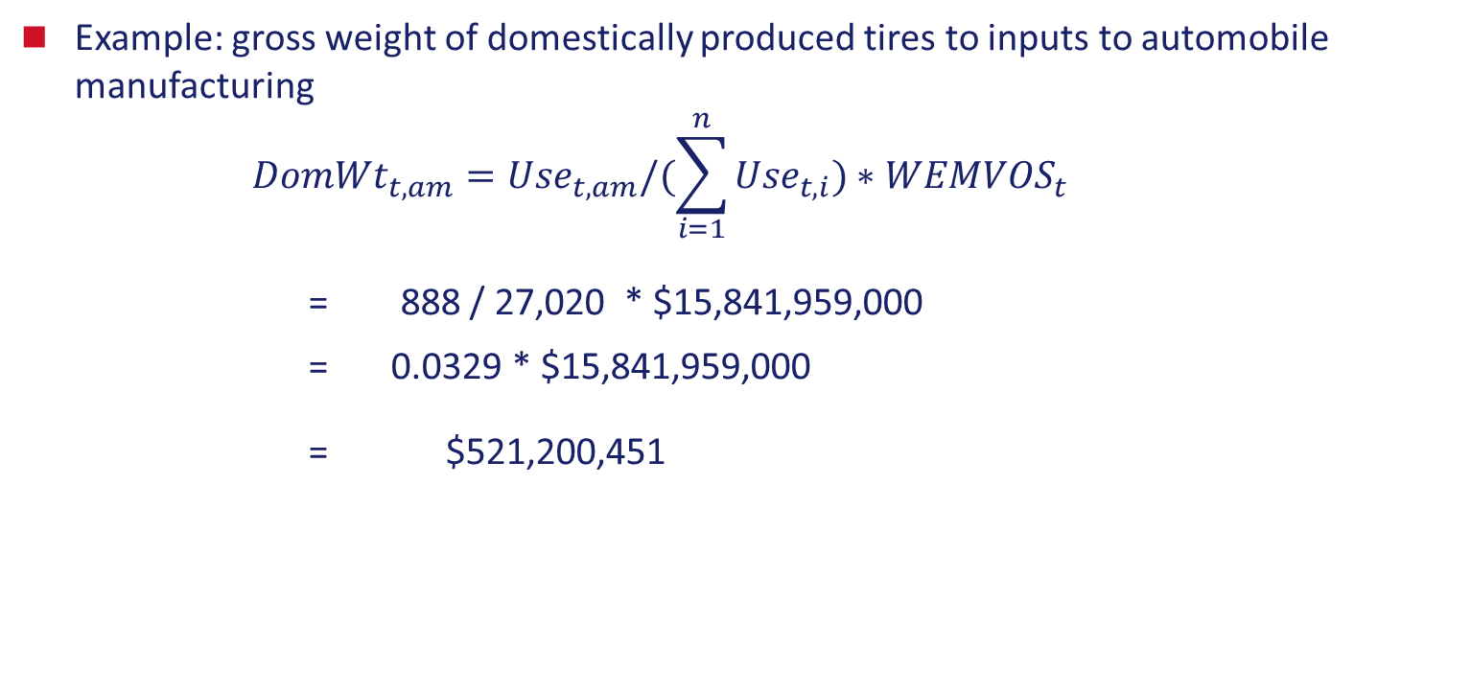
Methodology: weights – domestic inputs
Example: gross weight of domestically produced tires to inputs to automobile manufacturing
$${DomWt}_{t,am}={Use}_{t,am}/(\sum_{i=1}^{n}{{Use}_{t,i})∗{WEMVOS}_{t} }$$
= 888 / 27,020 * $15,841,959,000
= 0.0329 * $15,841,959,000
= $521,200,451

Slide 16
Methodology: imported weights
Weights are derived from:
  BEA’s “Use of Commodities by Industries”
  Census’ import trade VOS

Slide 17
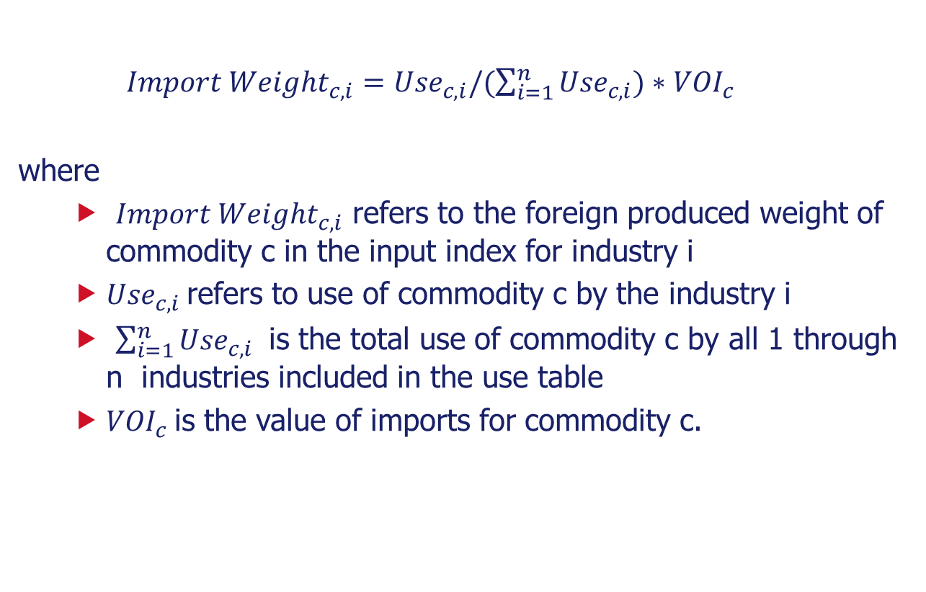
Methodology: weights – imported inputs
${Import Weight}_{c,i}={Use}_{c,i}/(\sum_{i=1}^{n}{{Use}_{c,i})∗{VOI}_{c} }$
where
  ${Import Weight}_{c,i}$ refers to the foreign produced weight of commodity c in the input index for industry i
  ${Use}_{c,i}$ refers to use of commodity c by the industry i
  $\sum_{i=1}^{n}{{Use}_{c,i}}$ is the total use of commodity c by all 1 through n industries included in the use table
  ${VOI}_{c}$is the value of imports for commodity c.

Slide 18
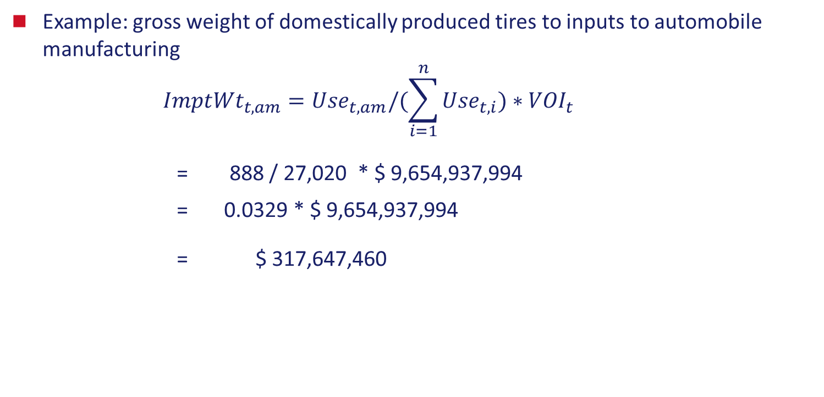
Methodology: weights – imported inputs
Example: gross weight of domestically produced tires to inputs to automobile manufacturing
$${ImptWt}_{t,am}={Use}_{t,am}/(\sum_{i=1}^{n}{{Use}_{t,i})∗{VOI}_{t} }$$
= 888 / 27,020 * $ 9,654,937,994
= 0.0329 * $ 9,654,937,994
= $ 317,647,460

Slide 19
Methodology: net weights
As a final step, weights are converted to net weights by multiplying the gross weights by net output ratios
Net output ratios reflect the portion of the value of commodity that is produced outside of the industry
Applying net output ratio eliminates multiple counting by removing intra-industry transactions

Slide 20
Example: Automobile manufacturing- Selected PPI commodity indexes included in inputs to automobile manufacturing
PPI Code | Title | Relative importance (to overall input index)
141205 | Motor vehicles parts | 36.601
108905 | Other metal products | 9.973
301202 | Long-distance motor carrying | 1.26
119408 | Diesel, semidiesel, & dual-fuel engines, automotive | 1.054
117906 | Other motor vehicle electrical and electronic equipment | 0.84
071201 | Tires | 0.838
131107 | Specialty glass | 0.771
118401 | Fluid meters and counting devices | 0.666
117839 | Integrated microcircuits | 0.54
072B01 | Consumer, institutional, and commercial products, n.e.c. | 0.539

Slide 21
Example: Automobile manufacturing- Selected import indexes included in inputs to automobile manufacturing
MPI (NAICS) Code | Title | Relative importance (to overall input index)
33631 | Motor vehicle gasoline engine and engine parts | 3.739
33635 | Motor vehicle transmission and power | 2.994
33639 | Other motor vehicle parts manufacturing | 2.873
33636 | Motor vehicle seating and interior trim | 1.643
3343 | Audio and video equipment manufacturing | 1.525
33634 | Motor vehicle brake system manufacturing | 0.729
33633 | Motor vehicle steering and suspension | 0.674
333618 | Other engine equipment manufacturing | 0.614
33632 | Motor vehicle electrical and electronic | 0.604
32621 | Tire manufacturing | 0.472

Slide 22
Example: Automobile manufacturing
Index | Relative importance
Inputs to automobile manufacturing | 100.0
Domestic inputs | 82.5
Imported inputs | 17.5

Slide 23
Example: Automobile manufacturing: Index for inputs to automobile manufacturing and components

Slide 24
Index limitations
Excludes labor and capital investment
Excludes imported services
Excludes any domestically produced services that BLS does not publish PPIs for
Not a true buyers’ price indexes

Slide 25
Future steps
Increase coverage to the 3-digit NAICS level
Include domestically-produced and imported inputs

Slide 26
Jonathan Weinhagen
Economist
Producer Price Index
www.bls.gov/ppi
202-691-7709
weinhagen.jonathan@bls.gov

