Slide 1
How E-Commerce Improves Brick and Mortar Stores
Explaining the Post-2002 Productivity Slowdown
Rachel Soloveichik

Slide 2
Introduction
“Free” shopping experiences are currently excluded from industry output, final output and GDP.
  I assume a barter transaction: shoppers give sales attention in return for experiences.
  Both consumers and businesses shop to get information.
Many different types of sellers provide “free” shopping experiences.
Notes:
Improved experiences cost more to provide – and so measured productivity in the wholesale and retail sector appears to fall.
Brick and mortar retailers provide in-person help at their physical stores.
Traveling salespeople give demonstrations at industry conferences. They may also visit clients at their homes or businesses.
E-commerce retailers provide help remotely and ship goods for trial.

Slide 3
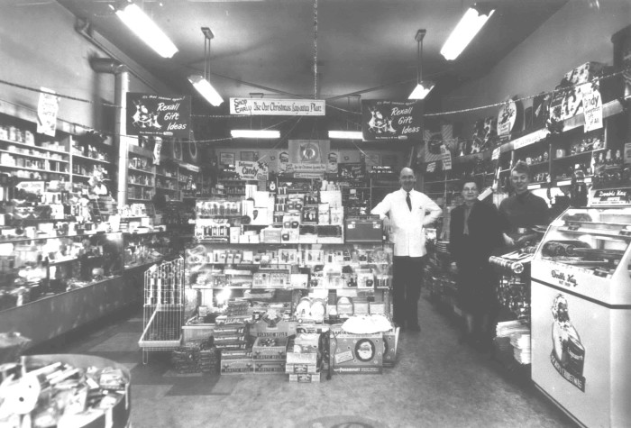
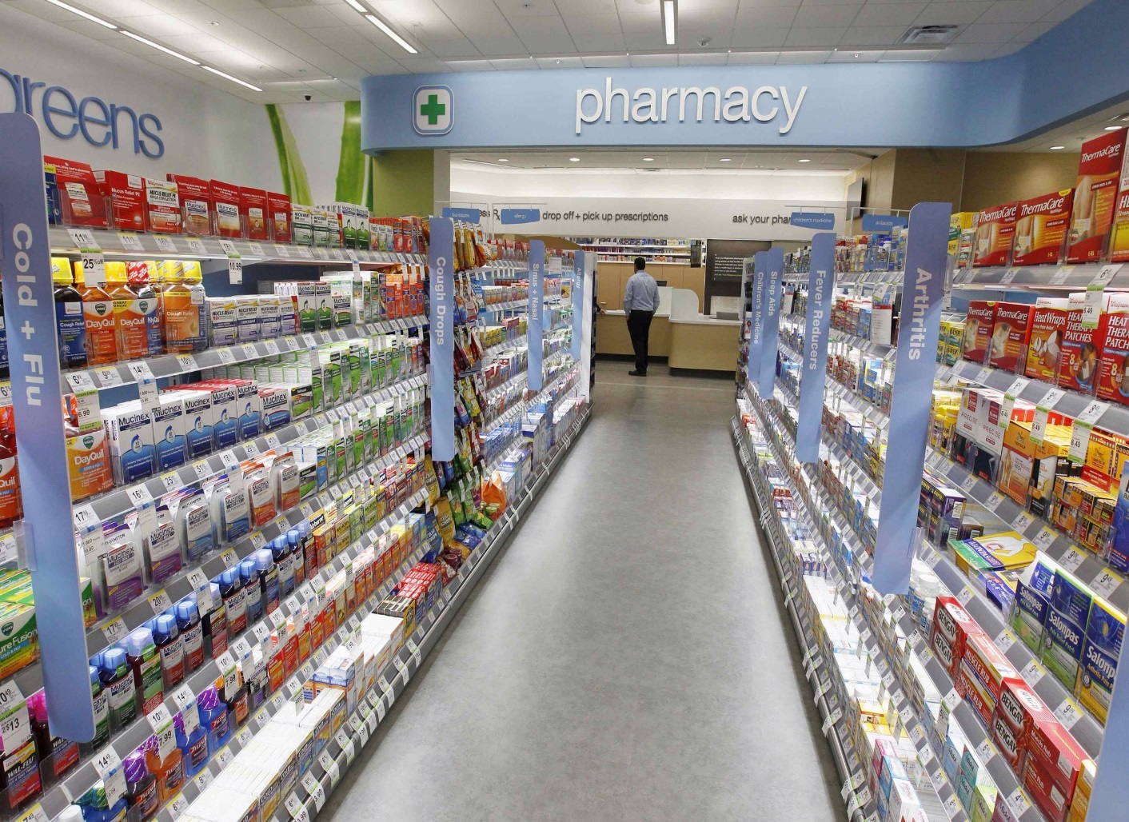
How Have Shopping Experiences Changed?
Modern stores have layouts carefully planned to slow shopping, and few staff to help.
Older stores had lots of staff to help shoppers find items quickly.

Slide 4
Preview of Talk
Shopping Category | Verbal | Display | Tactile
Nominal GDP Impact in 2016 | $220B | $264B | $211B
Real GDP growth impact percentage points per year | 2002-2016 | 0.01% | 0.01% | 0.04%
 | 1975-2002 | -0.01% | 0.00% | 0.02%
 | 1929-1975 | -0.03% | 0.02% | 0.00%
TFP growth impact percentage points per year | 2002-2014 | 0.03% | 0.05% | 0.03%
 | 1975-2002 | 0.01% | 0.02% | 0.02%
 | 1948-1975 | -0.05% | -0.04% | -0.00%

Slide 5
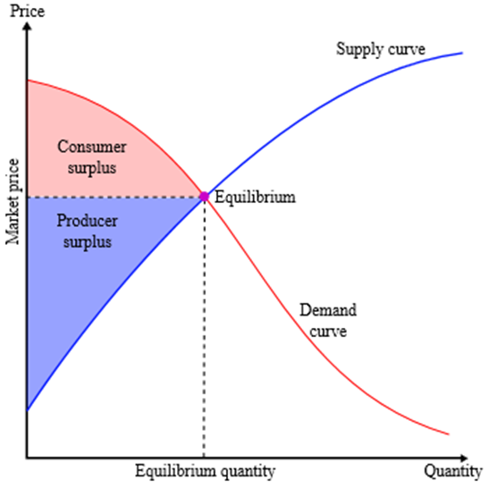
GDP Theory
Blue rectangle shows consumer spending
  Planned and unplanned purchases are valued equally.
  “Free” shopping experiences are not included in GDP
Red area, consumer surplus, is out of scope for GDP measurement.
Notes:
Recent research uses Google consumer surveys to estimate consumer surplus directly. It finds very large values for the Internet, health care, plumbing and other items.

Slide 6
Current vs. Experimental Methodology
Current Treatment of “Free” Shopping Experiences:
  They’re not tracked as industry output, industry input or personal consumption.
  Measured GDP rises when “free” consumer shopping experiences are replaced by paid consumer shopping experiences.
Experimental Treatment of “Free” Shopping Experiences”
  Just like paid shopping experiences, they’re tracked as industry output, industry input or personal consumption.
  “Free” experiences are valued based on production cost.
  Value of sales attention = value of “free” experiences.

Slide 7
Many Literatures Study Shopping
Consumer Shopping as Household Production
  (Aguiar and Hurst 2007), (Griffith, et al. 2009), (Nevo and Wong 2015), etc.
Product Variety
  Benefits: (Hausman 1996),(Petrin 2002), (Lecznar and Smith 2017), etc.
  Costs: (Iyenger and Lepper 2000), (Sinaiko and Hirth 2011).
Spillovers from Shopping
  Within a Store: (FTC 2003), (White, et al. 2000), (Hui, et al. 2013)
  Between Stores: (Koster, et al. 2017), (Gould, et al. 2005), (Jardim 2016), (Brooks and Strange 2011)
  Resale Price Maintenance: (Klein 2009), (Gundlach, et al. 2014), (Kalyanam and Tsay 2013), (Winter 1983), (Overstreet 1983), etc.
“Free” Digital, Audiovisual and Print Content
  (Nakamura, Samuels and Soloveichik 2017), (Samuels and Soloveichik 2018), (Brynjolfsson and Oh 2012), (Dean, et al. 2012) (Brynjolfsson, et al. 2017) , (Noll 1973), etc.
Notes:
For product variety, discuss how shelf-space directly impacts sales. As a result, an increase in category sales associated with an increased number of products may not necessarily suggest huge gains from product variety. For example, creating a large endcap of a single product also increases sales.

Slide 8
Sales Expenses by Retailers and Wholesalers
The Occupational Employment Survey (OES) provides data on earnings by occupation and industry.
(Sales Labor Share) = (Earnings for Definitely Sales Workers)/
[(Earnings for Definitely Sales Workers) + (Earnings for Definitely Non-Sales Workers)]
The Annual Wholesale and Retail Trade Surveys provide some data on non-sales intermediate expenses.
(Sales Share) =(Sales Labor Share)*[1-(Packaging Share)-(Delivery Share) –
(Sales Commission Share) – (Advertising and Marketing Share) – (Bad Debt Share)]
For other industries, I use sales earnings to impute sales expenses.
  My sales expense numbers include an imputed return on capital.
Notes:
Be quick with this slide.

Slide 9
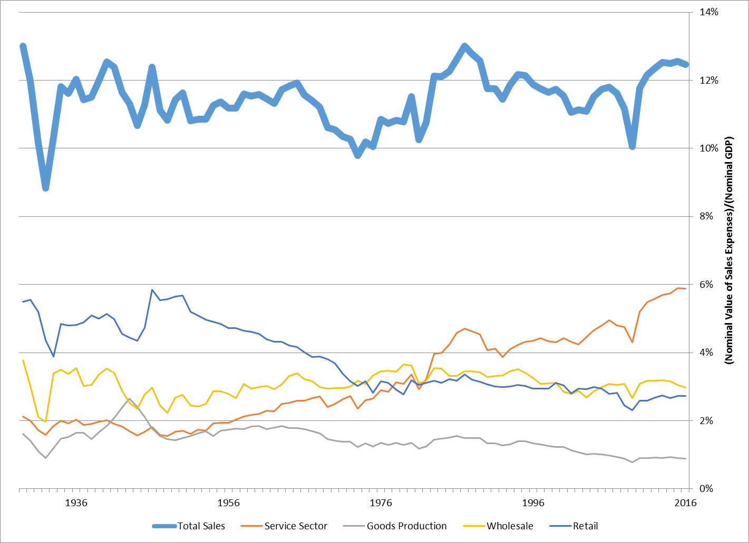
Total Sales Expenses
Share of Total Nominal GDP
Notes:
These expenses include a return on capital, so they are larger than reported operating expenses.

Slide 10
Sales Opportunity Costs
Sellers frequently provide “free” trials to potential customers
  Generally accepted accounting practice (GAAP) generally does not count lost revenue from unsold or discounted items.
I estimate sales opportunity costs for consumer goods:
  Customer returns which are discounted for resale.
  Customer shoplifting.
  Food wastage from customer handling.
I impute sales opportunity costs for business goods, consumer services and business services.
Notes:
Open source software is a well-known sales opportunity cost.

Slide 11
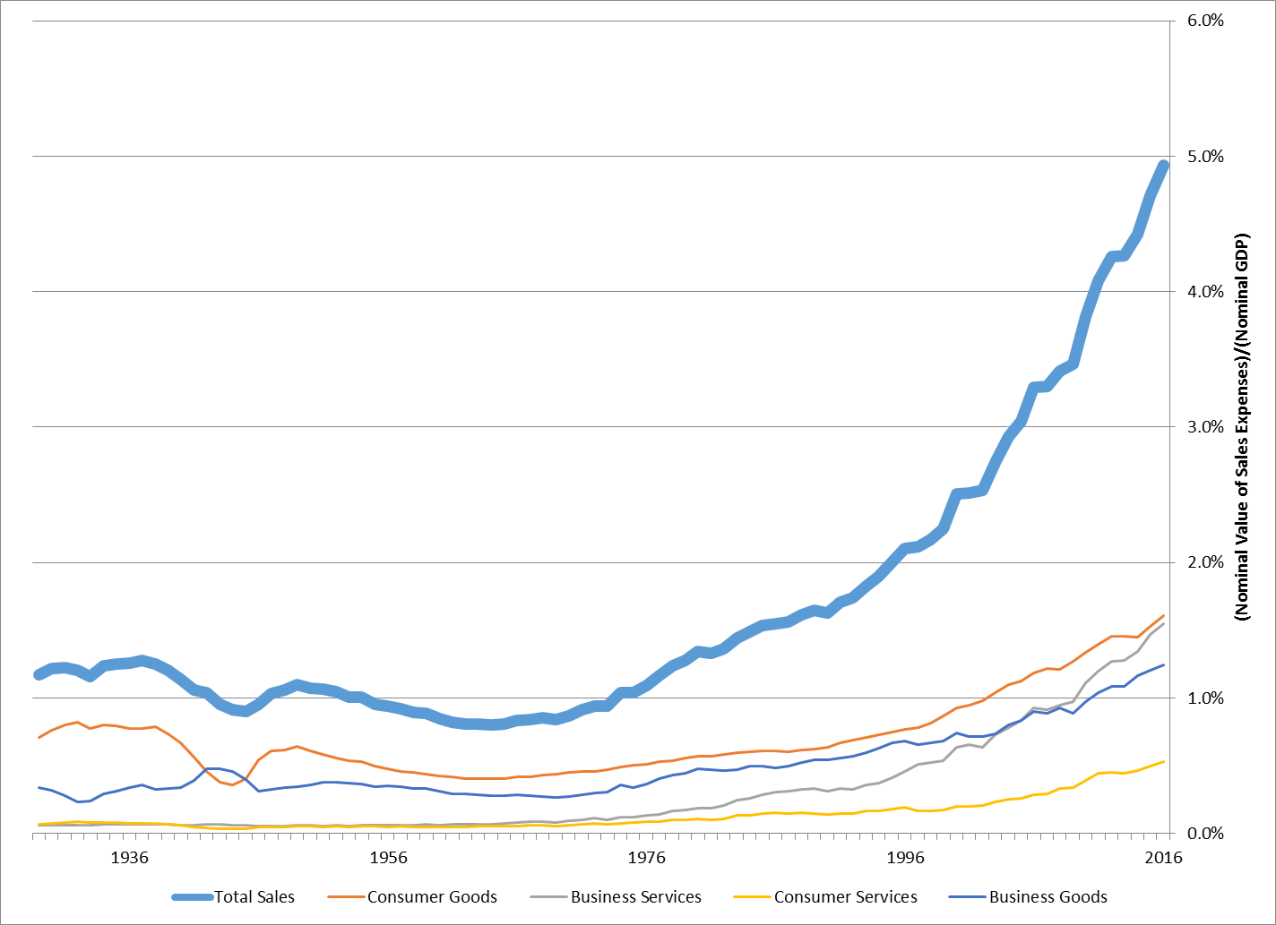
Total Sales Opportunity Costs
Share of Total Nominal GDP
Notes:
In the past, retailers generally resold customer returns at their original price. However, inspection and repair is very labor intensive. So, they’ve switched to reselling the items to specialty liquidators for 15 to 30 cents on the dollar.

Slide 12
Valuing “Free” Consumer Experiences
I use BEA’s pre-existing I-O tables to allocate shopping between consumers, government and businesses.
  For the wholesale and retail sector, I used the Economic Census to get more detailed industry data than the published I-O tables.
  I allocate sales expenses and sales opportunity costs similarly.
“Free” experiences benefit the ultimate user of a good.
  Wholesalers stock retail shelves, set up promotional displays, etc.
  I allocate “free” experiences provided to paid experts (doctors, investment brokers, etc.) to their client’s industry.
I value “free” experiences at 50% of total sales output.
Notes:
Be quick with this slide.

Slide 13
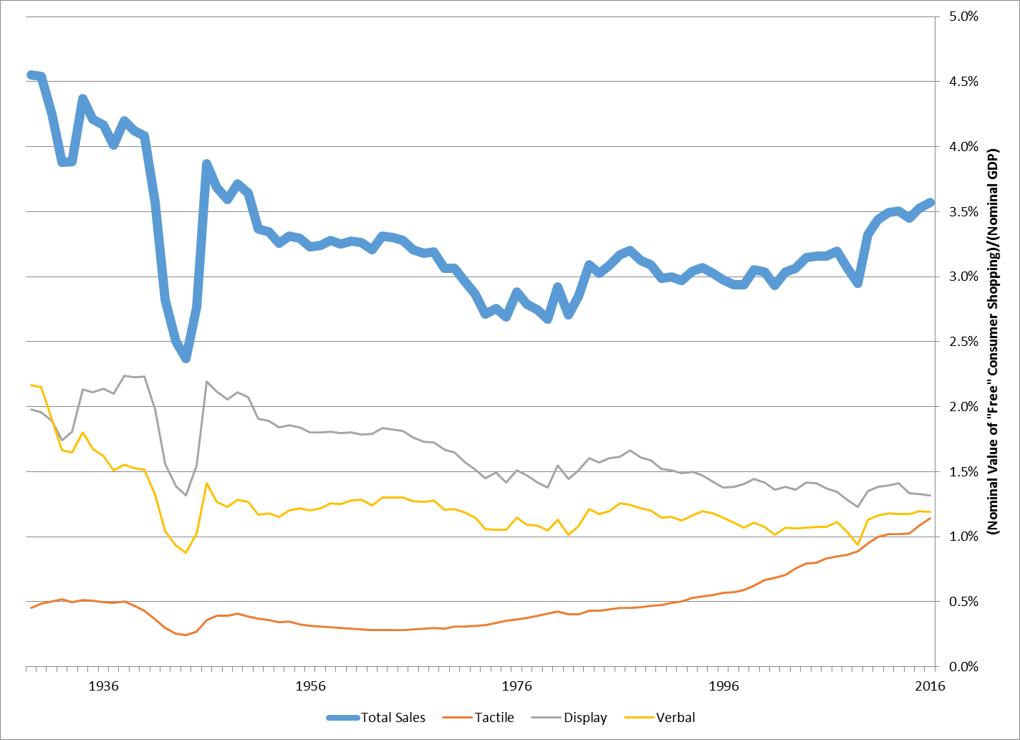
Value of “Free” Consumer Experiences
Share of Total Nominal GDP

Slide 14
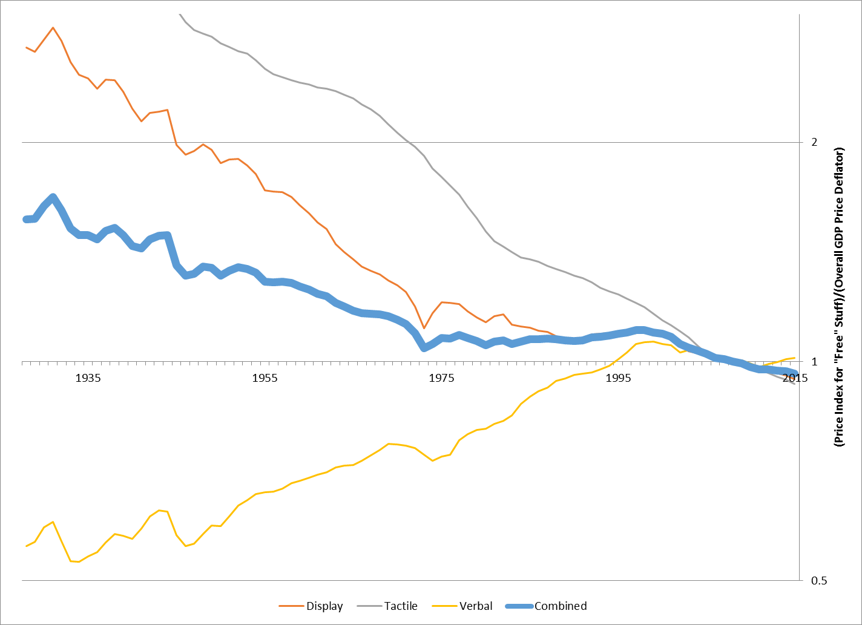
Prices for Display and Verbal Shopping
Ratio of “Free” Experience Prices to Overall GDP Prices, 2009 Base Year
My verbal price index is based on sales labor costs and space rental costs.
My display price index is based on sign manufacturing PPI’s and space rental costs.
My tactile price index is based on the cost of the “free” goods and services.

Slide 15
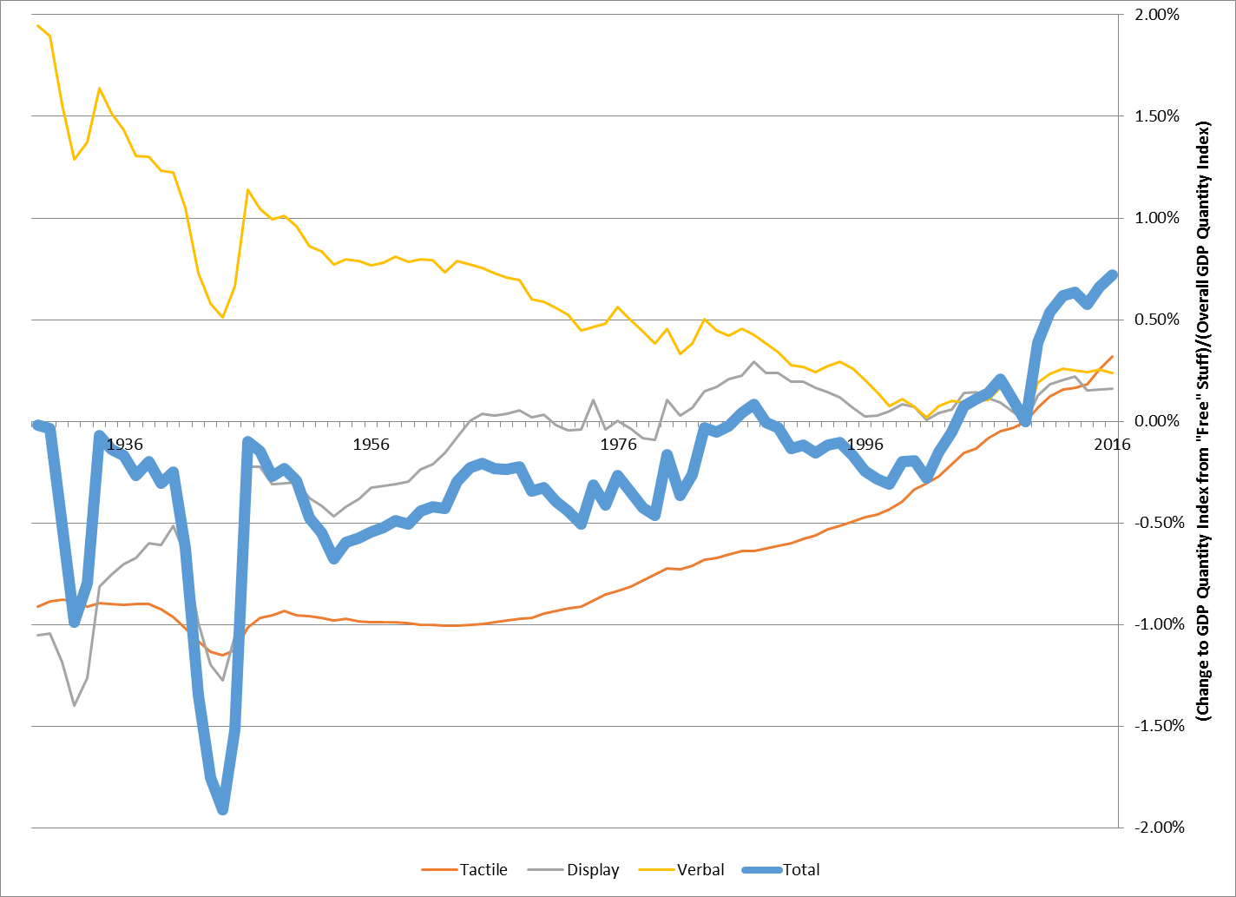
Changes to Real GDP from “Free” Experiences
(Change to Quantity Index from “Free” Experiences)/
(Overall Quantity Index)
The pre-1995 and post-1995 trends are both robust.
  However, the short-term fluctuations are partially due to my imputation methods.

Slide 16
Tracking Sales Attention Over Time
Input prices needed to calculate total factor productivity (TFP)
  TFP Impact = (Attention Input Price)/(“Free” Experience Output Price)
  Attention Price_{t} = (Sales Output_{t})/(Attention Quantity_{t})
The American Time Use Survey (ATUS) provides my main dataset.
  The ATUS has been providing high quality time diary data since 2003.
  Online shopping experiences are part of “free” digital content, so I focus on the ATUS’s reported location rather than reported activity.
The historical time diary data is much spottier, but I located samples from 1939, 1954, 1965, 1975, 1985 and 1993.
Notes:
The historical data tracks activities better than location, so I use that.
I have no data on attention supplied per hour, so I hold it fixed

Slide 17
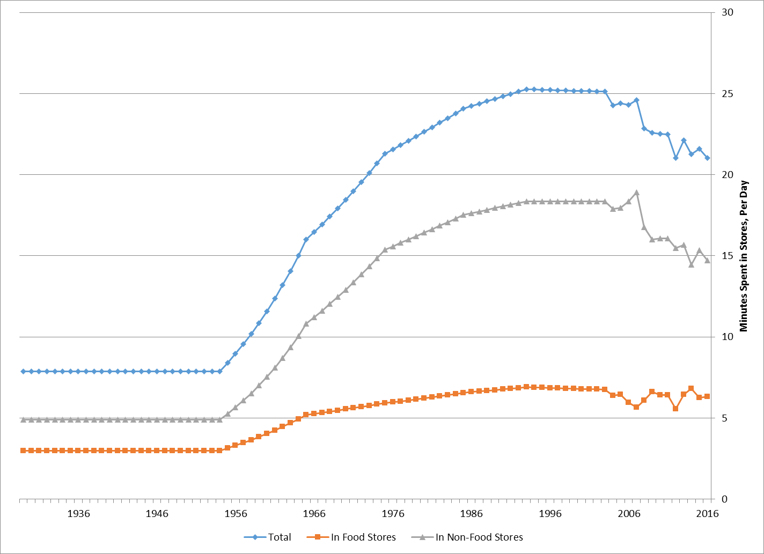
Shopping Time, Per Adult Per Day

Slide 18
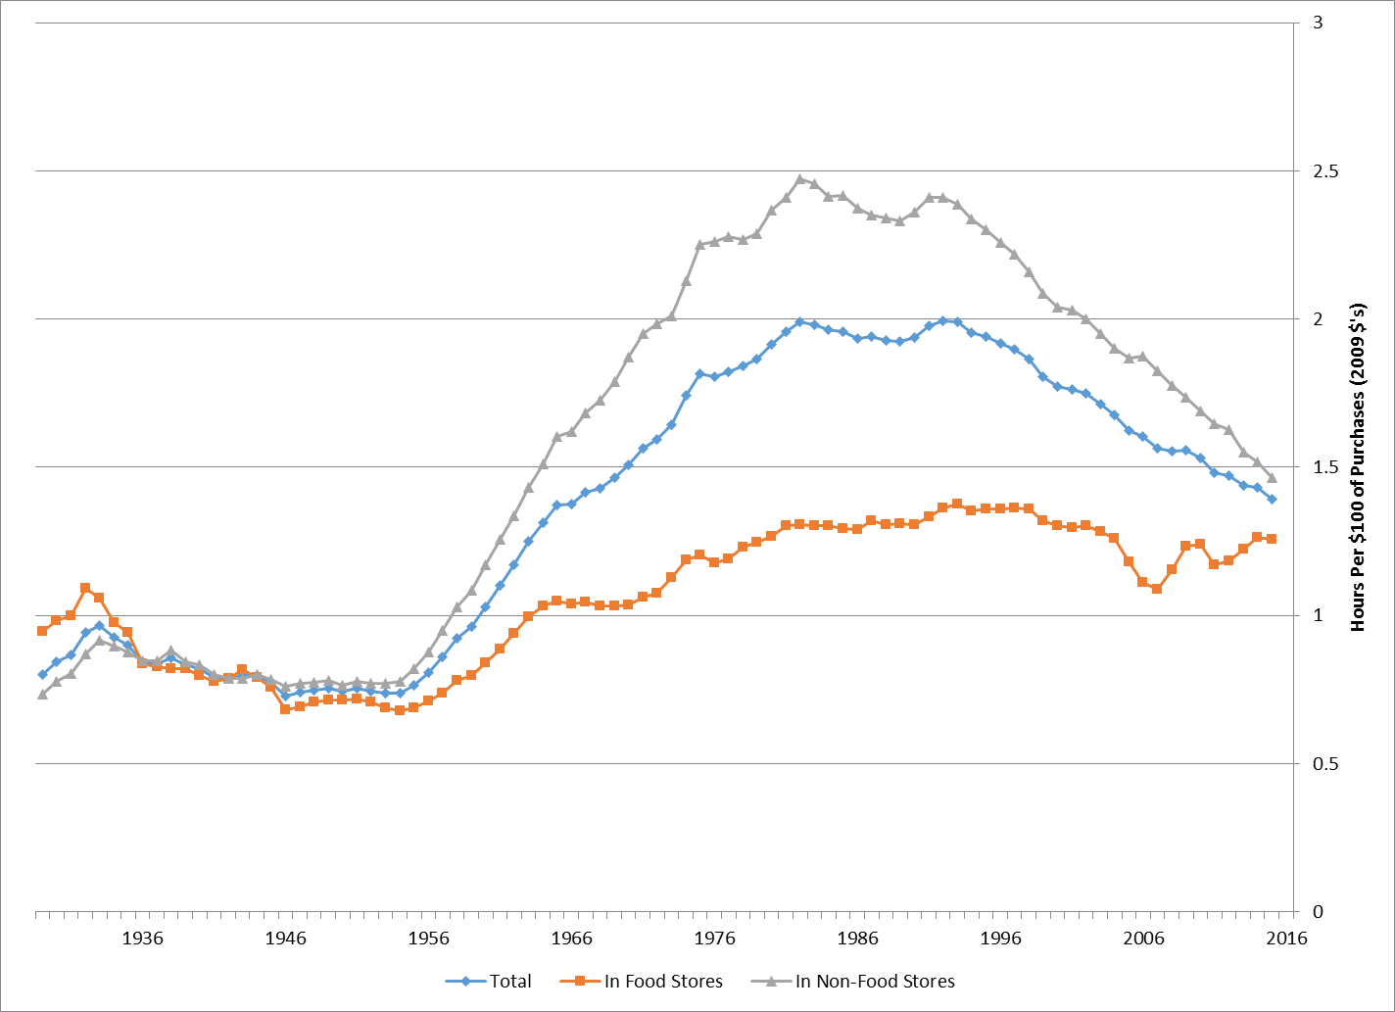
Shopping Time, Relative to Goods Purchased

Slide 19
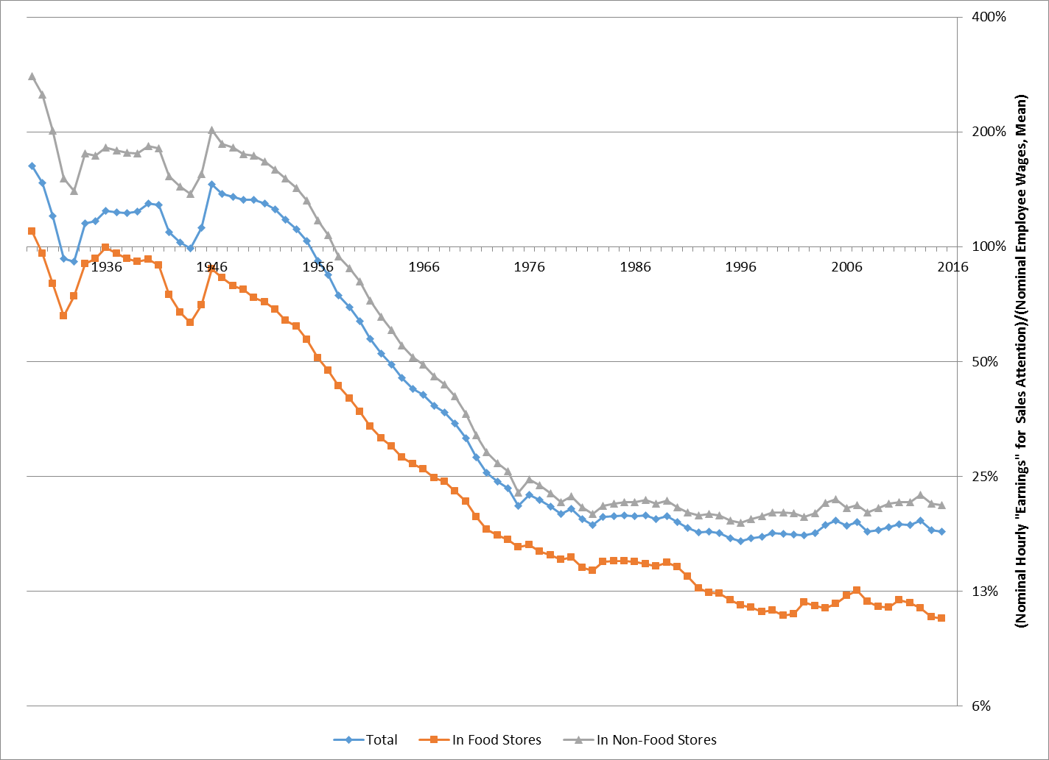
Prices for Sales Attention Over Time
(Hourly “Earnings” for Sales Attention)/(Mean Employee Wage)

Slide 20
Constructing Industry-Level Production Accounts
Current Methodology
Experimental Methodology
New output and input by industry: “free” experiences and attention

Slide 21
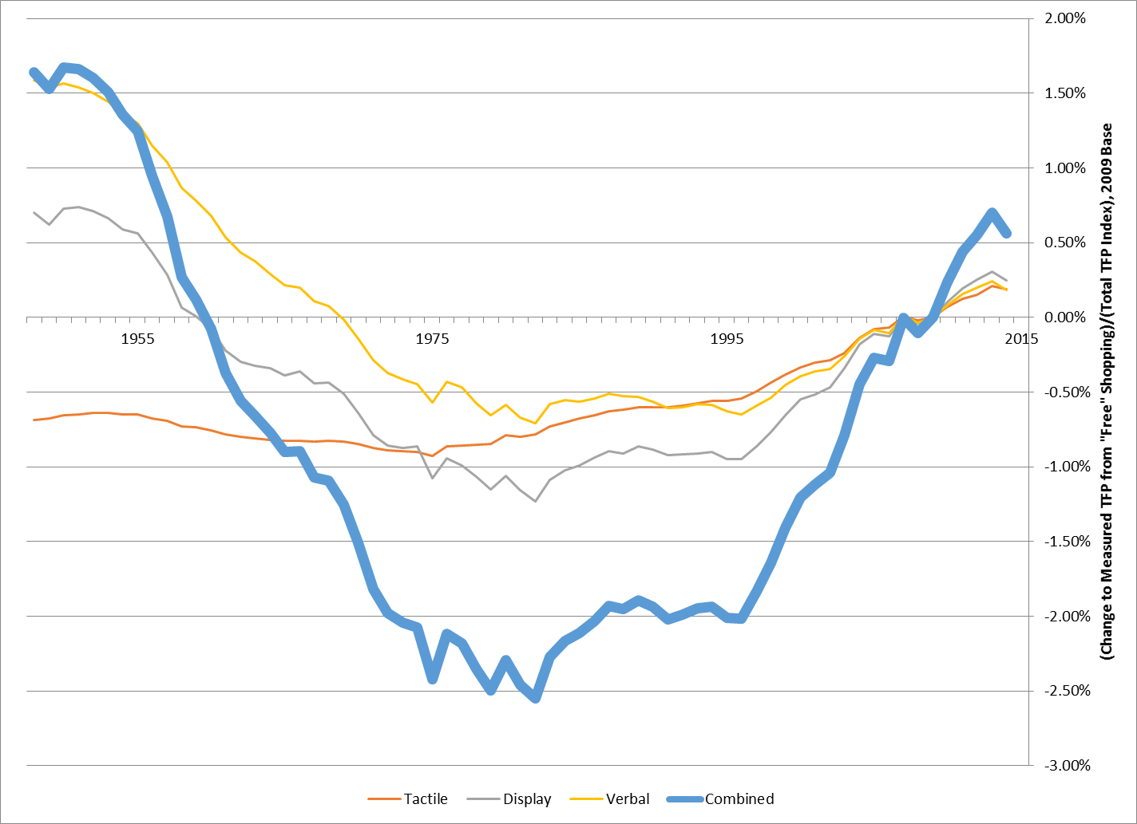
“Free” Experiences Reduce the TFP Slowdown
(Change in TFP Index)/(Overall TFP Index), 2009 Base Year

Slide 22
Conclusion
Overall GDP Percent points per year (ppy) | 2002-2016 | 1975-2002 | 1929-1975
Nominal GDP growth | 3.81% | 7.18% | 5.09%
Real GDP growth | 1.83% | 3.29% | 2.95%
TFP growth | 0.27% | 0.54% | 1.22%
“Free” Experience Impact Percent points per year (ppy) | 2002-2016 | 1975-2002 | 1929-1975
Nominal GDP growth | 0.03% | 0.02% | -0.04%
Real GDP growth | 0.06% | 0.01% | -0.01%
TFP growth | 0.11% | 0.05% | -0.10%

