Slide 1
Are Immigrants More Innovative? Evidence from the Annual Survey of Entrepreneurs
J. David Brown
U.S. Census Bureau
Mee Jung Kim
George Mason University and
U.S. Census Bureau
John S. Earle
George Mason University
Kyung Min Lee
George Mason University
April 2018
Any opinions and conclusions expressed herein are those of the authors and do not necessarily reflect the views of the U.S. Census Bureau. All results have been reviewed to ensure that no confidential information on individual firms is disclosed.

Slide 2
Main Questions
Does the propensity to innovate differ across native- and immigrant-owned firms?
Product vs. process innovation activities
R&D
Trademarks and patents
What can explain the differences?
Other demographic characteristics
Human capital
Motivations
Start-up finance
Choice of industry
Do differences between native- and immigrant-owned firms vary by:
Sector: high-tech vs. low-tech
Owner education
Owner race/ethnicity
Notes:
2

Slide 3
Latent factors underlying immigrant-native differences
Self-selection
“Quality” of entrepreneur
Skills / resources
Idea / plan
Diverse experiences -> creativity
Constraints
Finance
Local knowledge
Discrimination (financial or product market)
Preferences/motivations
Idea-driven
“Life-style entrepreneurship,” non-pecuniary benefits
“Necessity entrepreneurship”
Notes:
3

Slide 4
Related Research: Individual Immigrants
STEM education:
Kerr (2013): immigrants are disproportionately represented in workforce with bachelor’s degrees in STEM fields (25% vs. 15% in general population)
Important source of patents:
Kerr and Lincoln (2010) document important and growing contribution of persons with Chinese (9%) and Indian (6%) ethnicity to U.S. patents in 2004 compared to 1975 (<2%)
High propensity to be superstar scientists:
Peri (2007) – immigrants are disproportionately represented among U.S. Nobel Prize winners
Hunt & Gauthier-Loiselle (2010) – immigrants have higher propensity to be in National Academy of Sciences
High propensity to file patent, but fully explained by choice of field of study and educational attainment (Hunt 2011)
Notes:
4

Slide 5
Related Research: Immigrant Entrepreneurs
Over-representation among founders of high-tech firms (Wadhwa et al. 2007)
Immigrant-owned businesses have more start-up capital, with wide variation by race/ethnicity – less for Hispanic immigrants and more for Asians (Fairlie 2012)
Similar industry distributions for immigrant- and non-immigrant-owned businesses (Fairlie 2012)
Schuetze and Antecol (2007) – better international entrepreneurs may choose to start businesses in the U.S. due to low income tax and large market
Hart and Acs (2010): high-tech firms with immigrant owners similar to native-owned (sample of 1300 “high impact” firms)
Notes:
5

Slide 6
Related Research: Share of Immigrant Entrepreneurs
Studies | Data | Sample | % of Immigrant Entrepreneurs
Saxenian (2002) | D&B 1980-1998, Survey | High-tech firms in Silicon Valley Size: 11,443 firms | 24%
Wadhwa et al. (2007) | D&B 1995-2005, Survey | High-tech firms (>$1M sales, 20+ employees) Size: 4589 firms (Response: 44.8%) | 25%
Hart & Acs (2010) | CRB ACSL 2002-2006, Survey | High-impact high-tech firms Size: 1300 firms, 2000 founders | 16%
Hunt (2011) | NSCG 1998-2003 | Individuals with college degree (working in 2003) Size: 75,940 to 90,293 | n/a
Fairlie & Lofstrom (2014) | SBO 2007, ACS 2006-2010, CPS 2007-2011 | All firms (excluding publicly held firms and firms without owner information) Size: n/a | 13% (SBO, All) 18% (ACS, All) 25% (CPS, New Firms)
Kerr & Kerr (2017) | LEHD 1992-2008 (linked to LBD & 2010 Census) | Single unit firms showing up in the LEHD in the first year Size: 535,580 firms | 24% (LEHD, New Firms)
Notes:
6

Slide 7
Related Research: Measuring Innovation
R&D (input)
Patents (output)
Innovation surveys (Mairesse and Mohnen 2010)
Qualitative measures
Process vs. product innovation
Correlated with productivity (Griffith et al. 2006, Hall 2011)
Problems:
No characteristics of owners/entrepreneurs
Samples focus on innovating firms (large, particular industries)
Notes:
7

Slide 8
Data: 2014 Annual Survey of Entrepreneurs
Random sample of all nonfarm businesses filing IRS tax forms with at least $1,000 in receipts and at least one employee
Sampling frame categories:
American Indian, Asian, Black, Hispanic, Non-Hispanic white men, Native Hawaiian and Other Pacific Islander, Other, Publicly owned, Women
Response rate: 74.0%; weights adjust for sampling
Full ASE: 290,000 employer businesses
We exclude businesses with no owner with at least 10%
Robustness: Results with young firms (<=3 years) sample are qualitatively similar
Variables:
Detailed innovation measures
Detailed owner characteristics
Notes:
8

Slide 9
Data: Limitations
No entry mode, visa type
No source country (only race/ethnicity)
No wealth, income
No family information (unless co-owners)
Limited information on skills (education, prior business)
Limited information on patents, innovation intensity
Notes:
9

Slide 10
CPS Monthly 2014 (Public Micro Data)
Share of Immigrants
 | Share of Immigrants
 | All Immigrant | Hispanic | Non-Hispanic Black | Non-Hispanic Asian | Non-Hispanic Other
CPS Adult Population | 0.156 | 0.072 | 0.013 | 0.039 | 0.032
Employment | 0.166 | 0.080 | 0.014 | 0.040 | 0.031
Self-employment | 0.186 | 0.084 | 0.010 | 0.040 | 0.052
Incorporated self-employment | 0.171 | 0.046 | 0.010 | 0.055 | 0.060
Non-incorporated self-employment | 0.195 | 0.105 | 0.011 | 0.033 | 0.047
Note: Final sample weights. Authors’ calculations from NBER public CPS files.
Notes:
10

Slide 11
ASE 2014 (Public Data)
Share of Immigrants
 | All Population | Share of Immigrants
 | Weighted. Obs. | All | Hispanic | Non-Hispanic | African American | Asian
Employer | 5,766,694 | 0.158 | 0.029 | 0.129 | 0.004 | 0.070
Source: ASE 2014 public data are available in the following link:
https://factfinder.census.gov/faces/tableservices/jsf/pages/productview.xhtml?src=bkmk
Notes:
11

Slide 12
Innovation
Innovation Measures | Mean
Innovation Dummy | XXX
Innovation Count | XXX
Product Innovation
New good or service no other business has offered before | 0.051
New good or service this business has never offered before | 0.152
Improved good or service’s performance | 0.268
Developed new use for good or service | 0.090
Added new feature to good or service | 0.194
Made it easier for customers to use good or service | 0.264
Process Innovation
Applied new way: purchasing, accounting, computing, maintenance, inventory | 0.200
Reduced costs by changing way a good or service was distributed | 0.158
Upgraded technique, equipment, or software to improve good/service | 0.338
Made significant improvement in technique or process by increasing automation, decreasing energy consumption, or using better software | 0.200
Decreased production costs by improving materials, software, other components | 0.135
Changed delivery method to be faster or more reliable | 0.127
Source: Public calculations from the ASE
https://factfinder.census.gov/faces/tableservices/jsf/pages/productview.xhtml?src=bkmk
Notes:
12

Slide 13
R&D
R&D Measures | Mean
Applied R&D
Conducted work that might lead to a patent | 0.027
Developed and tested prototypes that were derived from scientific research or technical findings | 0.025
Applied scientific or technical knowledge in a way that has never been done before | 0.021
Basic R&D
Produced findings that could be published in academic journals or presented at scientific conferences | 0.021
Created new scientific research or technical solutions that can be generalized to other situations | 0.018
Conducted work to discover previously unknown scientific facts, structures, or relationships | 0.013
Conducted work to extend the understanding of scientific facts, relationships or principles in a way that could be useful to others | 0.027
Source: Public calculations from the ASE https://factfinder.census.gov/faces/tableservices/jsf/pages/productview.xhtml?src=bkmk
Notes:
13

Slide 14
Intellectual Property
R&D Measures | Mean
Copyright | 0.040
Trademark | 0.064
Patents Pending | 0.013
Patents Granted | 0.009
Source: Public calculations from the ASE https://factfinder.census.gov/faces/tableservices/jsf/pages/productview.xhtml?src=bkmk
Notes:
14

Slide 15
Bar Graphs:
Immigrant versus Native Employers
(from confidential micro data)
Proportional difference between immigrants (M) and non-immigrants (N) for characteristic (X):
$$\frac{\overline{X_{M}}−\overline{X_{N}}}{\overline{X_{N}}}$$
Standard Error:
$$\frac{S.E.}{\overline{X_{N}}}$$
Notes:
15

Slide 16
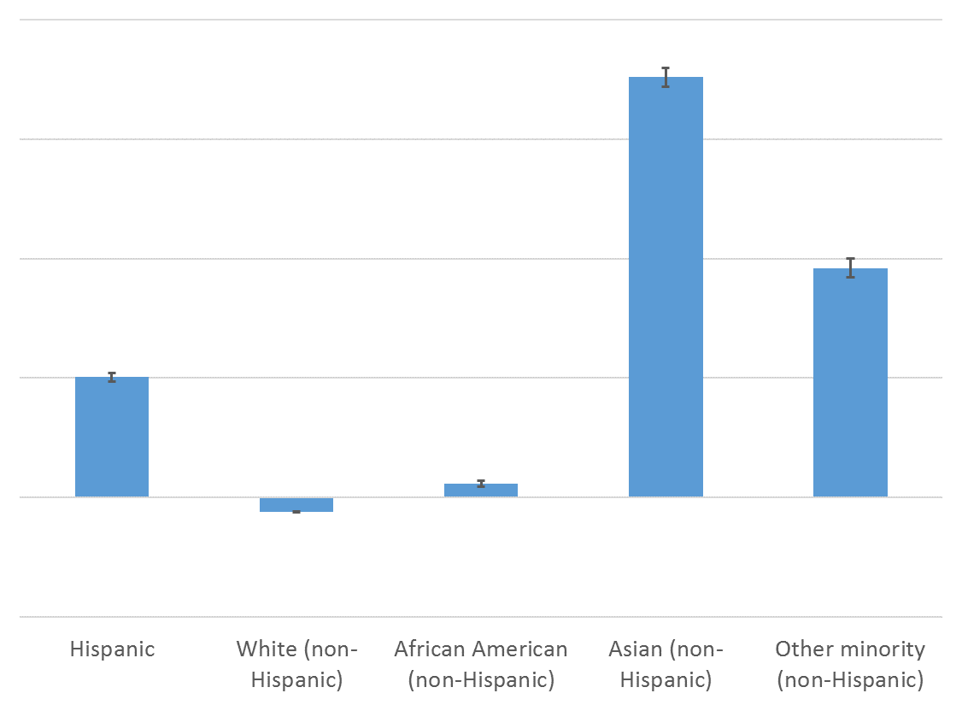
Immigrant-Native Owner Differences by Race and Ethnicity

Slide 17
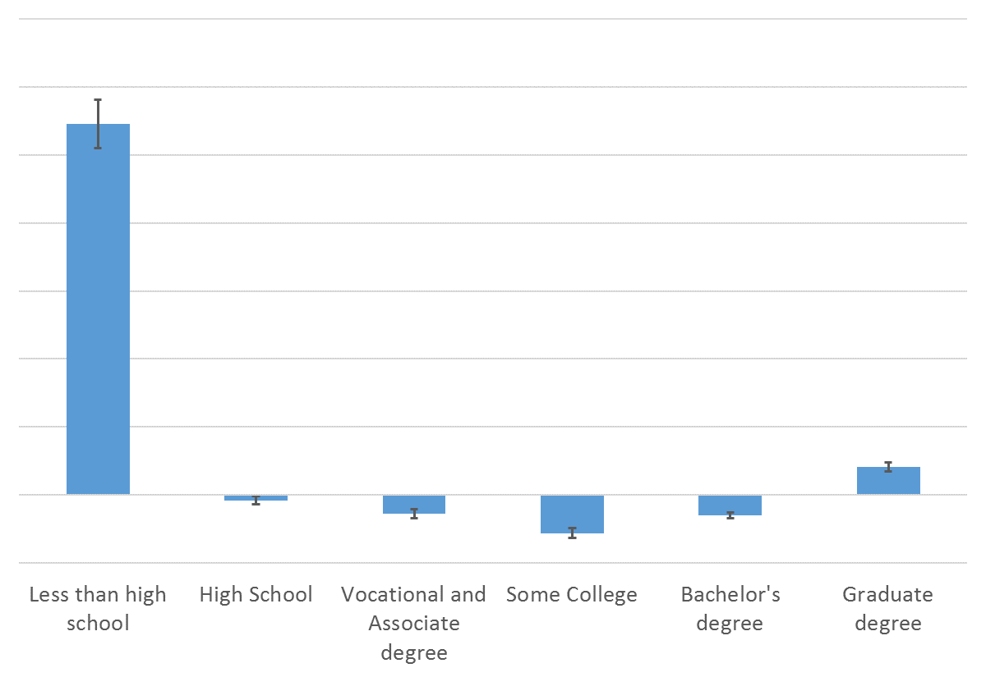
Immigrant-Native Owner Differences by Education

Slide 18
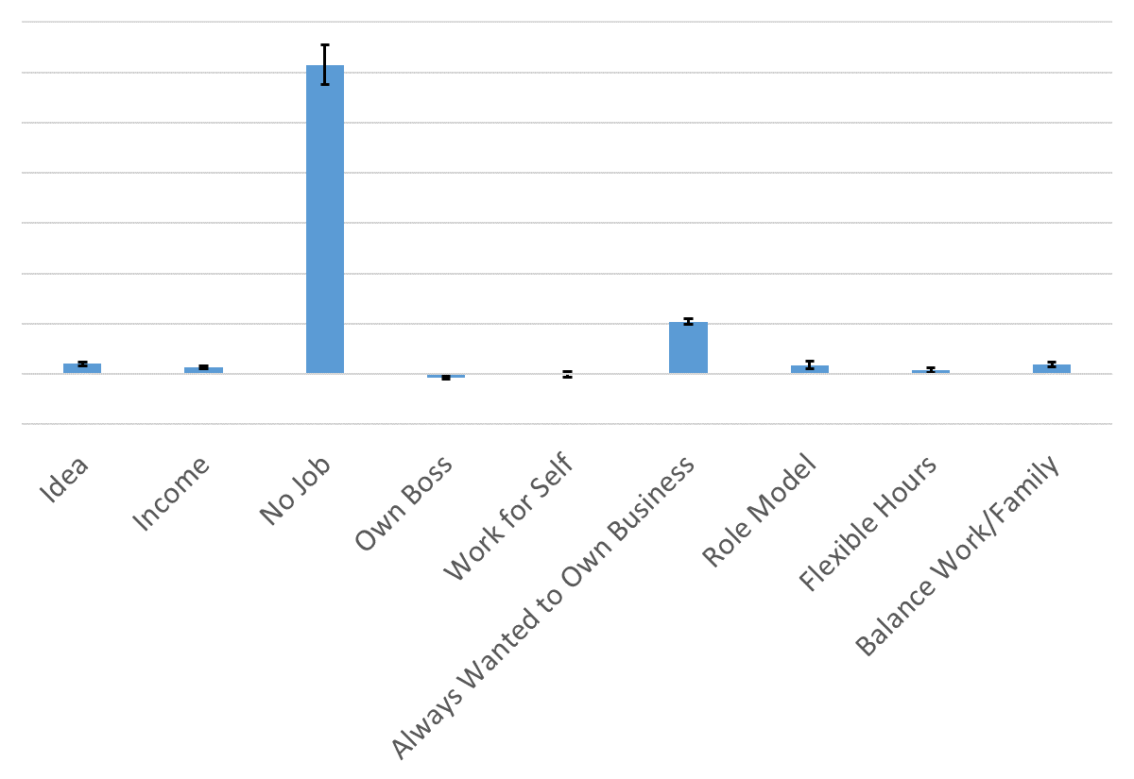
Immigrant-Native Owner Differences by Motivations

Slide 19
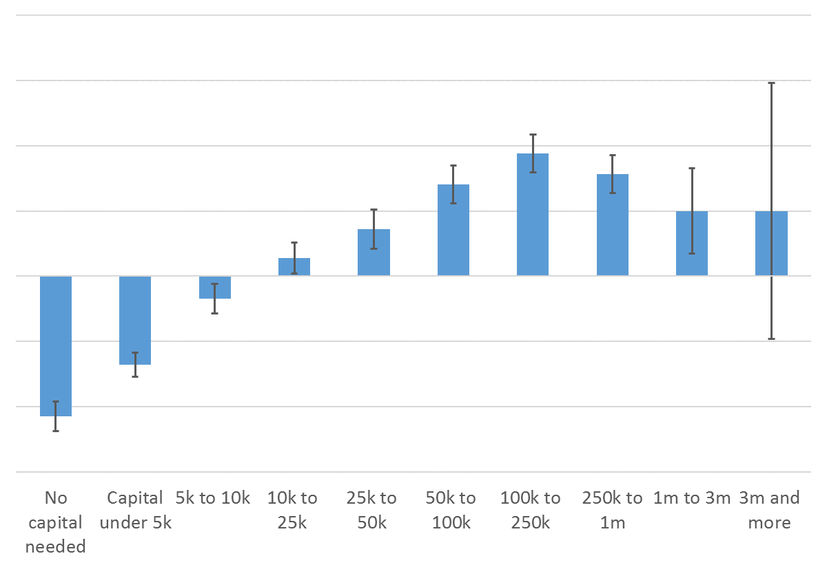
Immigrant-Native Owner Differences by Start-up Capital Amount

Slide 20
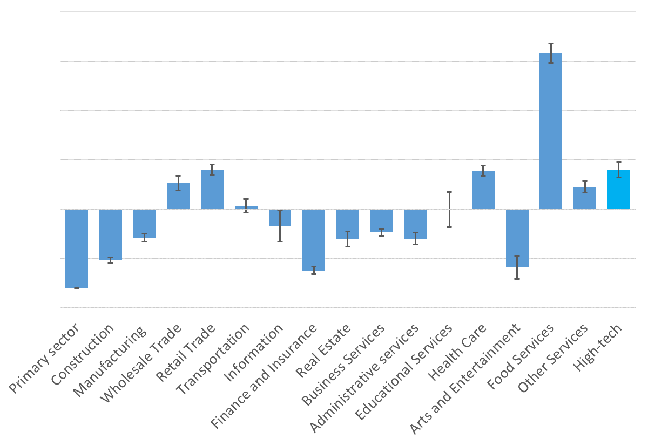
Immigrant-Native Owner Differences by Industry Composition

Slide 21
Regression Specifications
$Y_{ij}=βM_{ij}+{f(Age}_{j})+u_{ij}$ (“Base”)
$Y_{ij}$ = outcome variable for owner i of firm j
$M_{ij}$ = immigrant status for owner i of firm j
${f(Age}_{j})$ = quadratic function of firm age
$Y_{ij}=βM_{ij}+{f(Age}_{j})+X_{ij}λ+u_{ij}$ (“+ Demographics”)
$X_{ij}=$ characteristics of owner $i$of firm $j$
Demographics: age, gender, race/ethnicity
Human capital: education, veteran, prior business
Ownership team: size, family relationships, multi-generation
$Y_{ij}=βM_{ij}+{f(Age}_{j})+X_{ij}λ+Q_{ij}+u_{ij}$ (“+ Motivations”)
$Q_{ij}=$ Set of motivation variables (very important and somewhat important)
$Y_{ij}=βM_{ij}+{f(Age}_{j})+X_{ij}λ+Q_{ij}+K_{j}+u_{ij}$ (“+ Finance”)
$K_{j}$ = vector of start-up capital amount categories
$Y_{ij}=βM_{ij}+{f(Age}_{j})+X_{ij}λ+Q_{ij}+K_{j}+S_{j}+u_{ij}$ (“+ Industry”)
$S_{j}$ = vector of 4-digit NAICS industry dummies
$Y_{ij}=ZijM_{ij}δ+{f(Age}_{j})+X_{ij}γ+ε_{ij}$ (“Interactions”)
$Zij$= vector of interacted variables (high/low tech, education, race/ethnicity)
Notes:
21

Slide 22
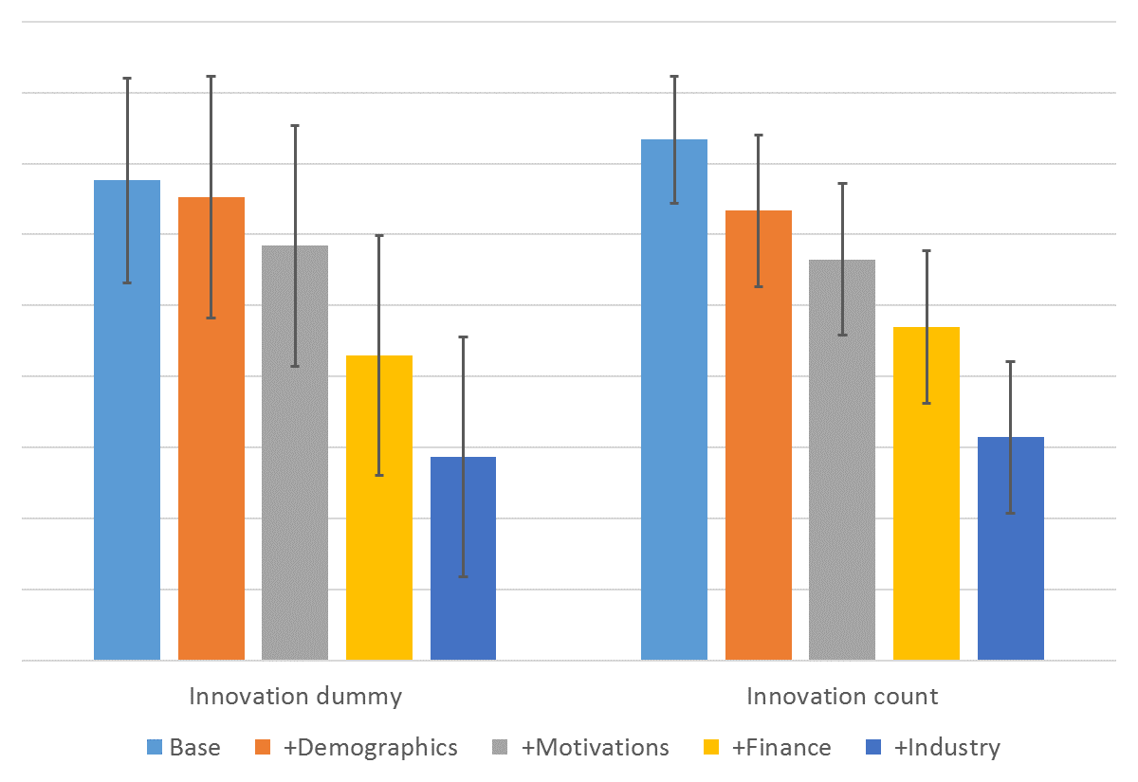
Innovation (Dummy & Count)

Slide 23
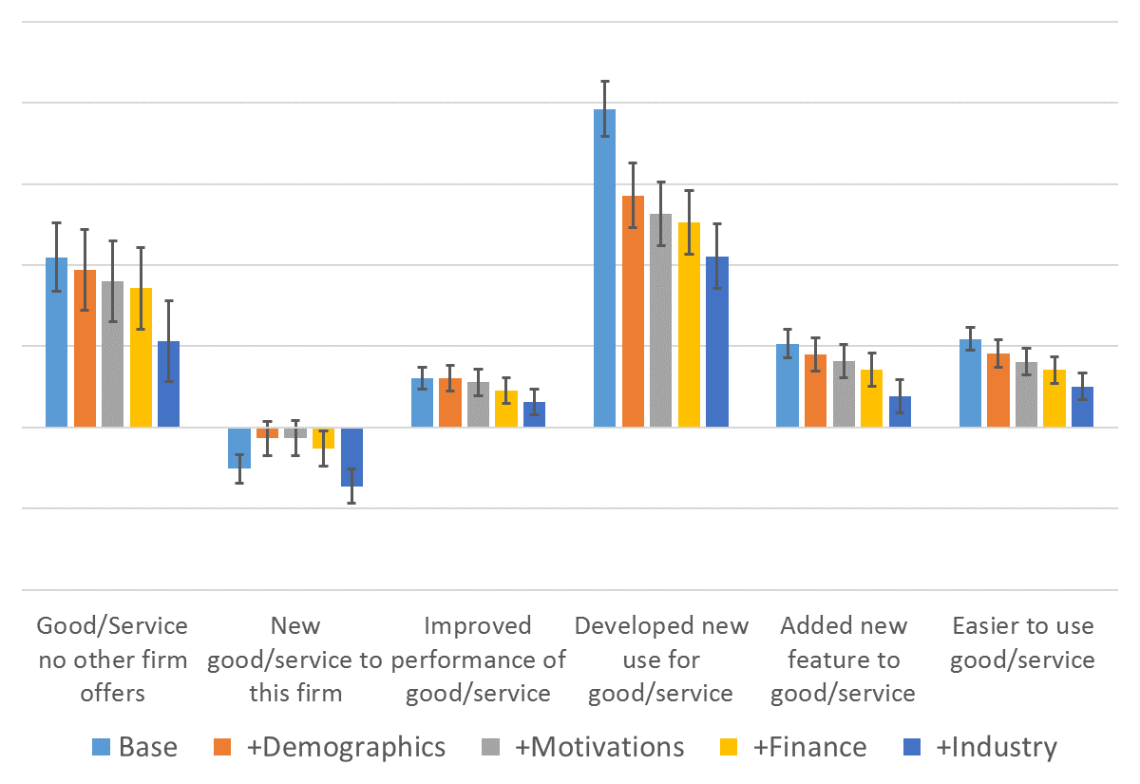
Product Innovation (Dummy)

Slide 24
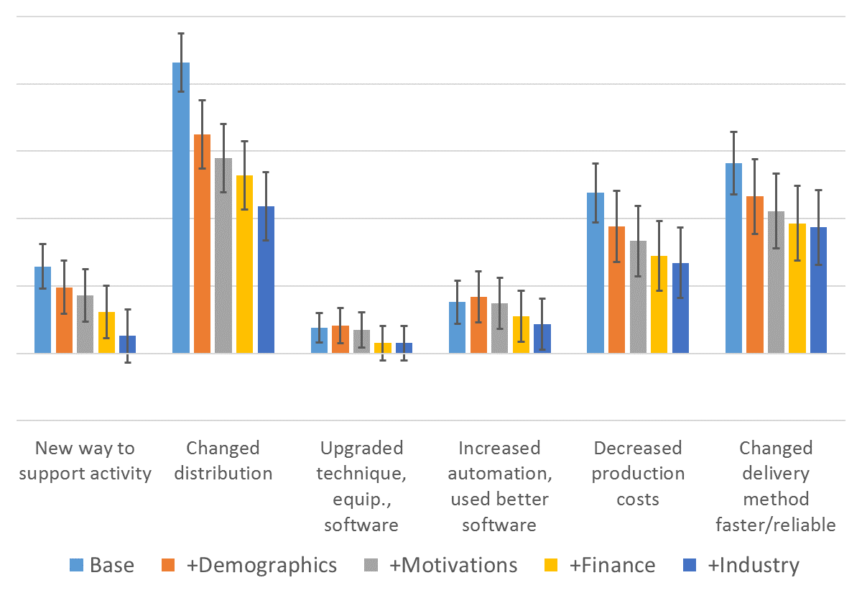
Process Innovation (Dummy)

Slide 25
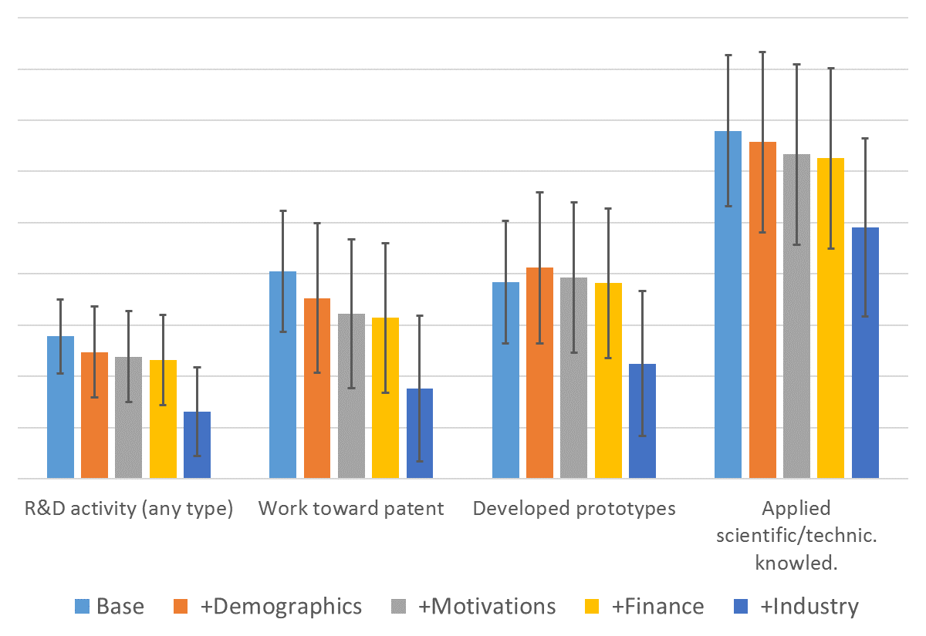
Any Type and Applied R&D (Dummy)

Slide 26
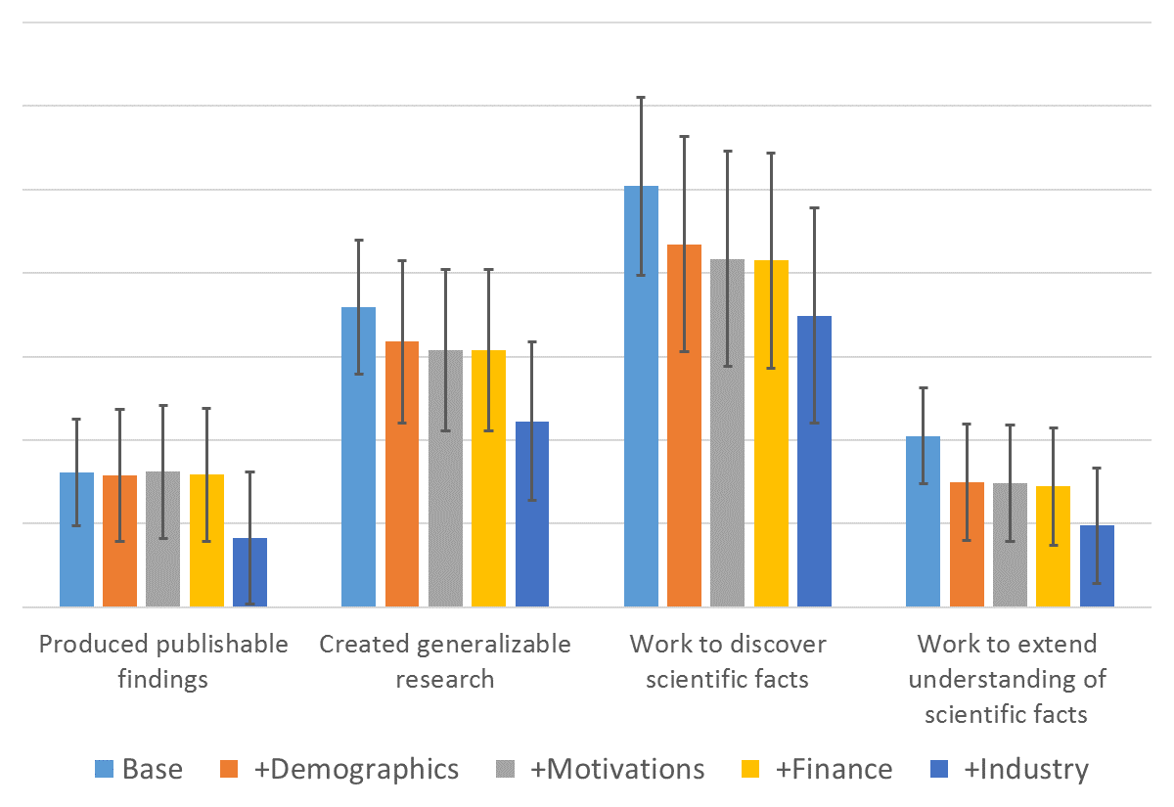
Basic R&D (Dummy)

Slide 27
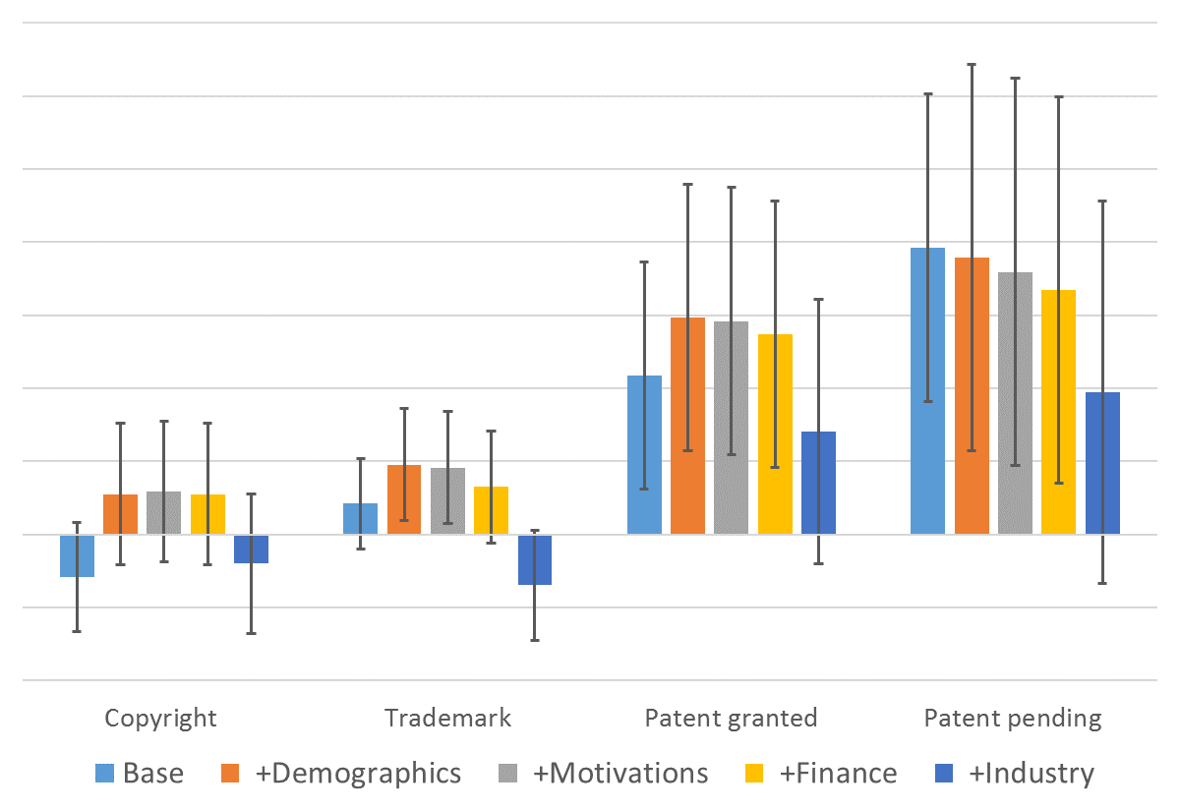
Copyright/Trademark/Patent (Dummy)

Slide 28
Heterogeneity in the Immigrant Effect
Our finding: on average, immigrant-owned firms are more likely to innovate
Does the immigrant innovation premium vary between high/low tech?
Most previous research focuses on high-tech
But most of economy is low-tech
Some types of innovation may be nearly universal in high tech
Owner education
Previous research on trends in high- and low-skilled immigration
Controversy over “merit-based” immigration policies
Owner race/ethnicity
Previous research on immigrants from different countries
We estimate heterogeneity along these 3 dimensions by interacting the immigrant owner dummy with vectors of categorical variables:
$Y_{ij}=ZijM_{ij}δ+{f(Age}_{j})+X_{ij}γ+ε_{ij}$
$Zij$= vector of interacted variables (high/low tech, education, race/ethnicity)
Notes:
28

Slide 29
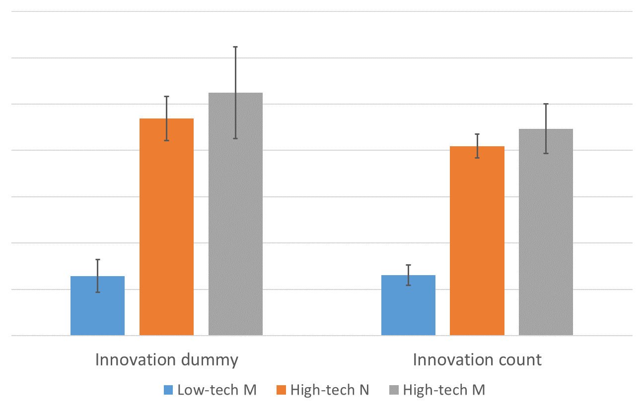
High- vs. Low-Tech (demographic controls): Innovation Dummy & Count

Slide 30
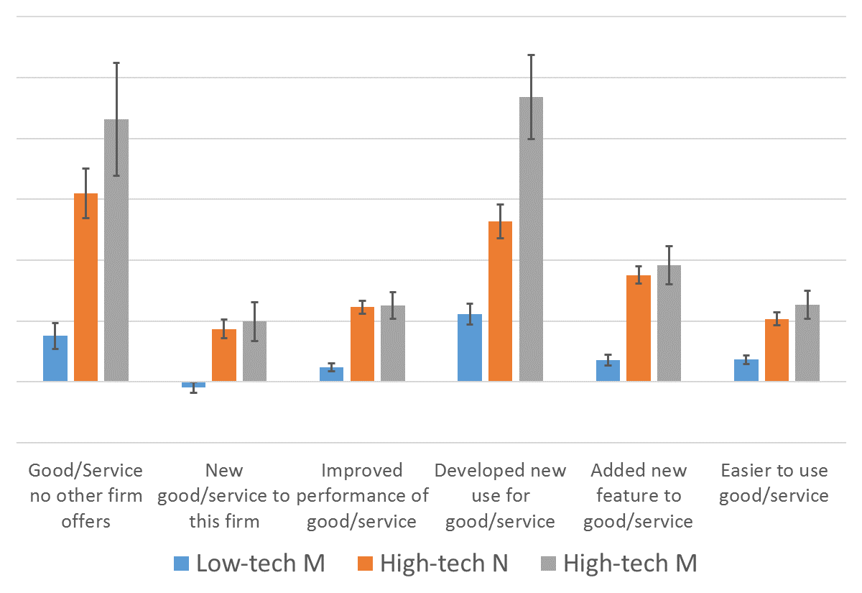
High- vs. Low-Tech (demographic controls): Product Innovation

Slide 31
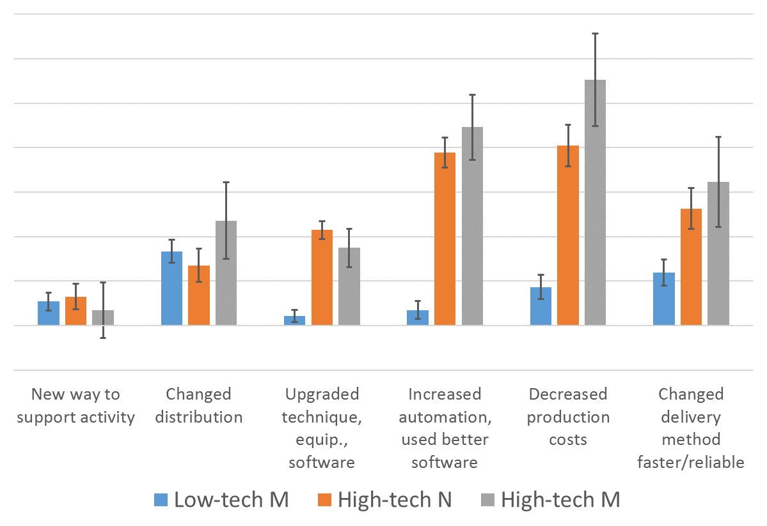
High- vs. Low-Tech (demographic controls): Process Innovation

Slide 32
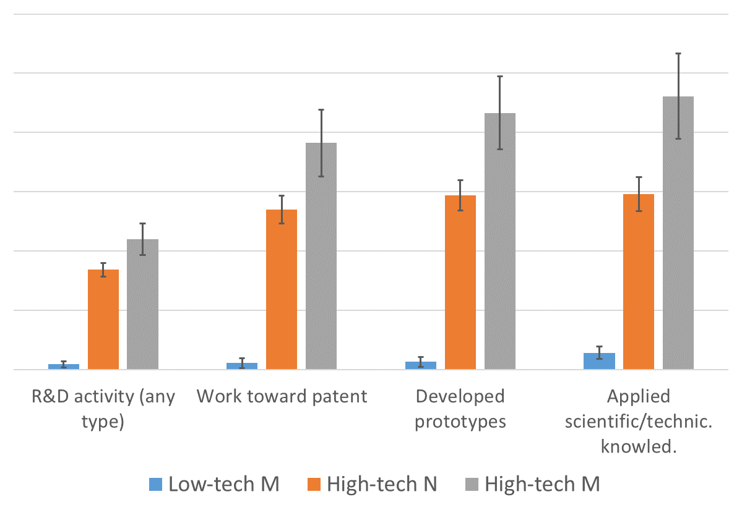
High- vs. Low-Tech (demographic controls): Any Type & Applied R&D

Slide 33
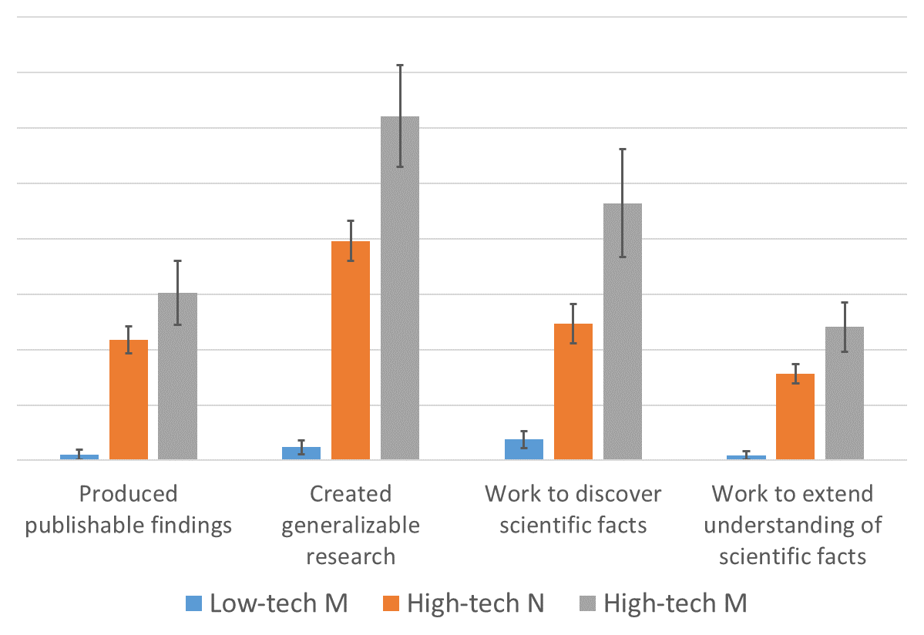
High- vs. Low-Tech (demographic controls): Basic R&D

Slide 34
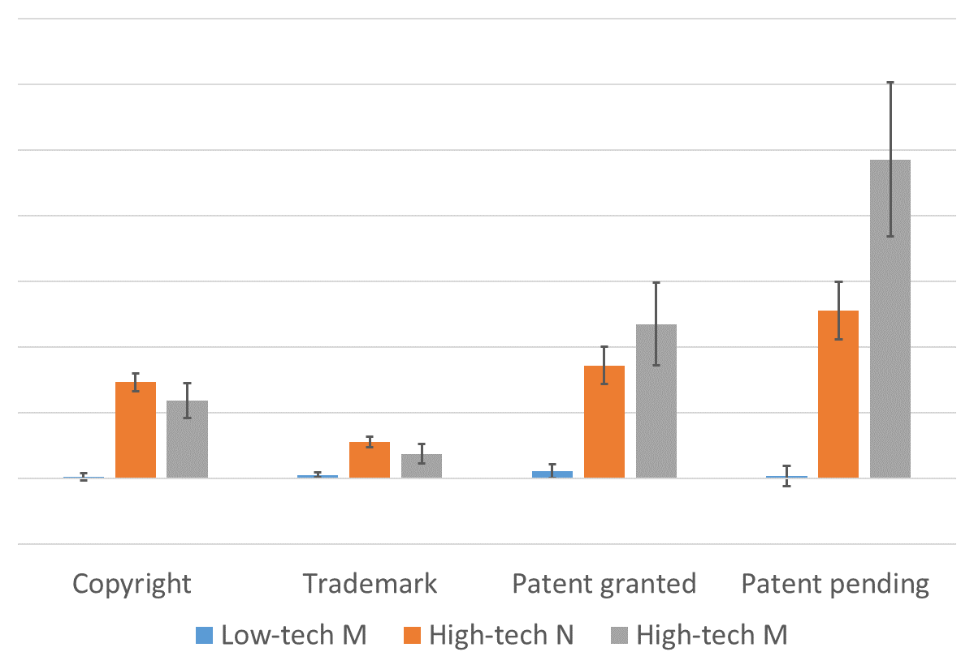
High- vs. Low-Tech (demographic controls): Copyright, Trademark, and Patents

Slide 35
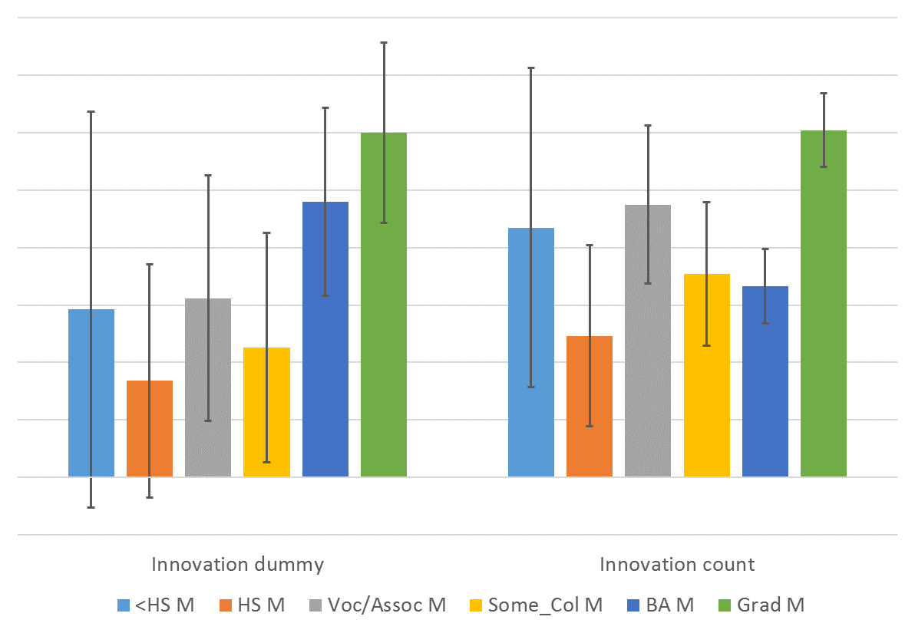
Education (demographic controls): Innovation Dummy & Count

Slide 36
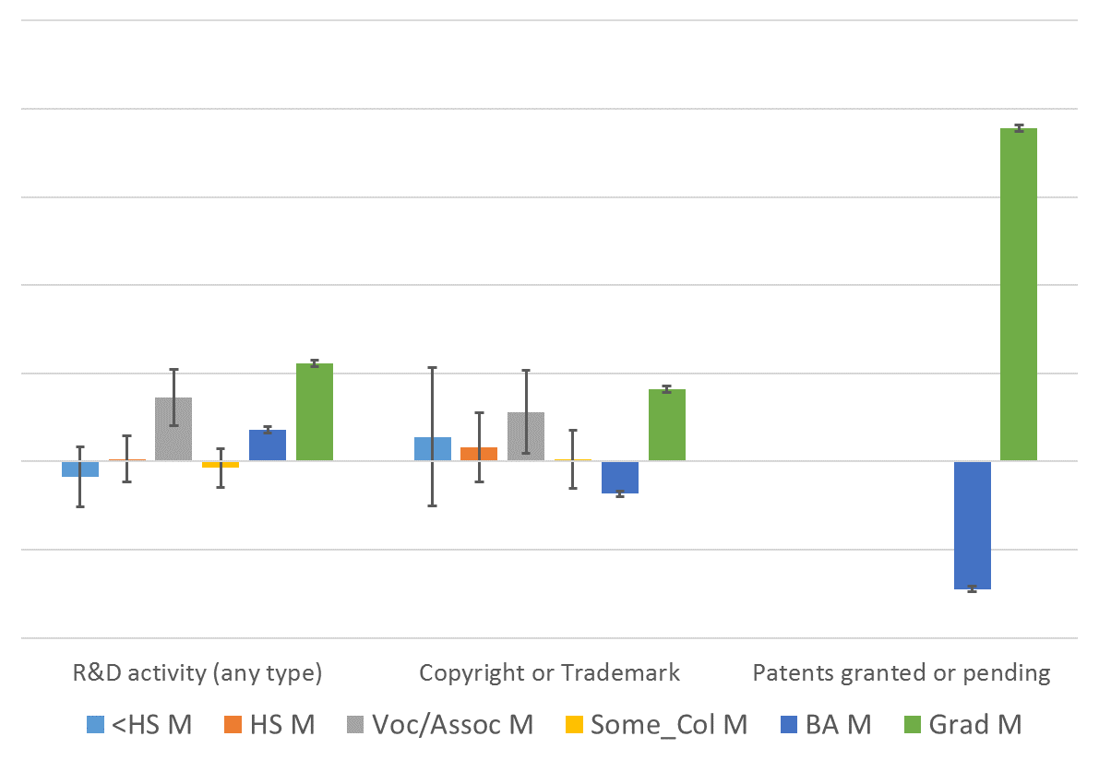
Education (demographic controls): Any Type R&D and Copyright/Trademark/Patents

Slide 37
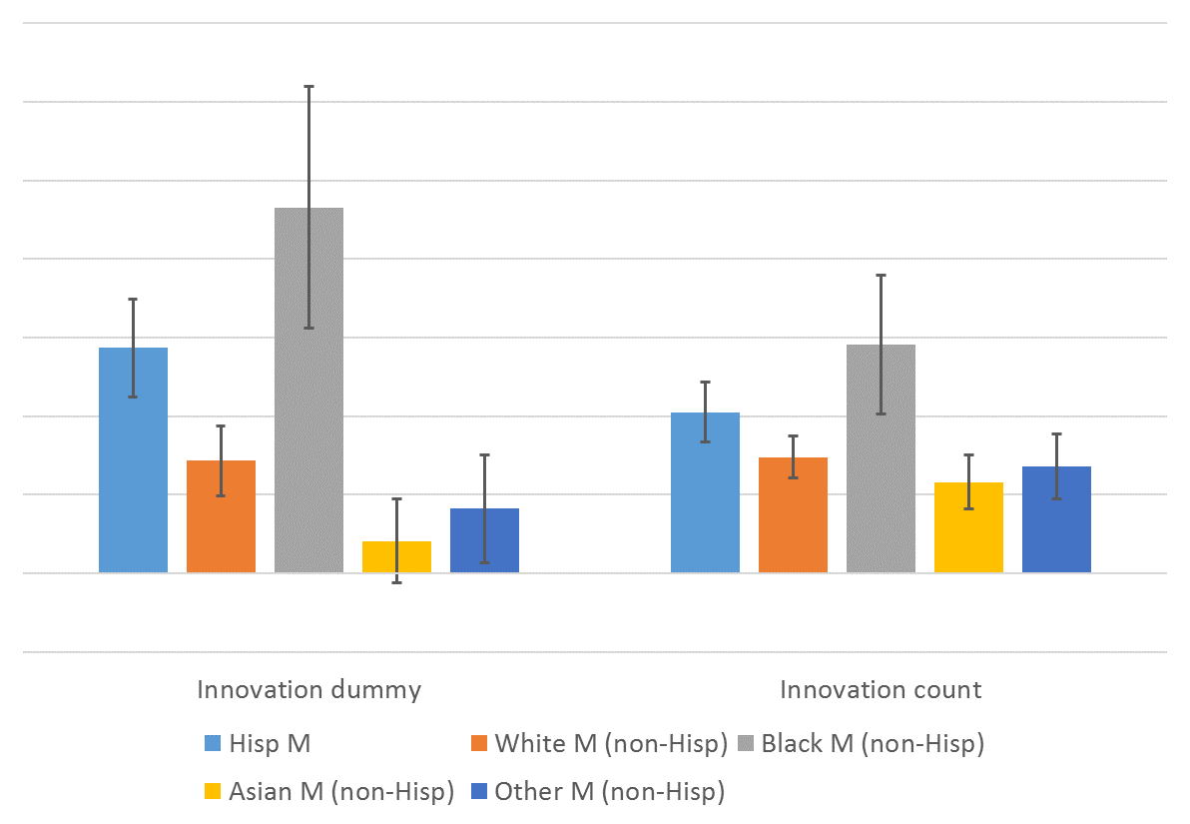
Race/Ethnicity (demographic controls): Innovation Dummy and Count

Slide 38
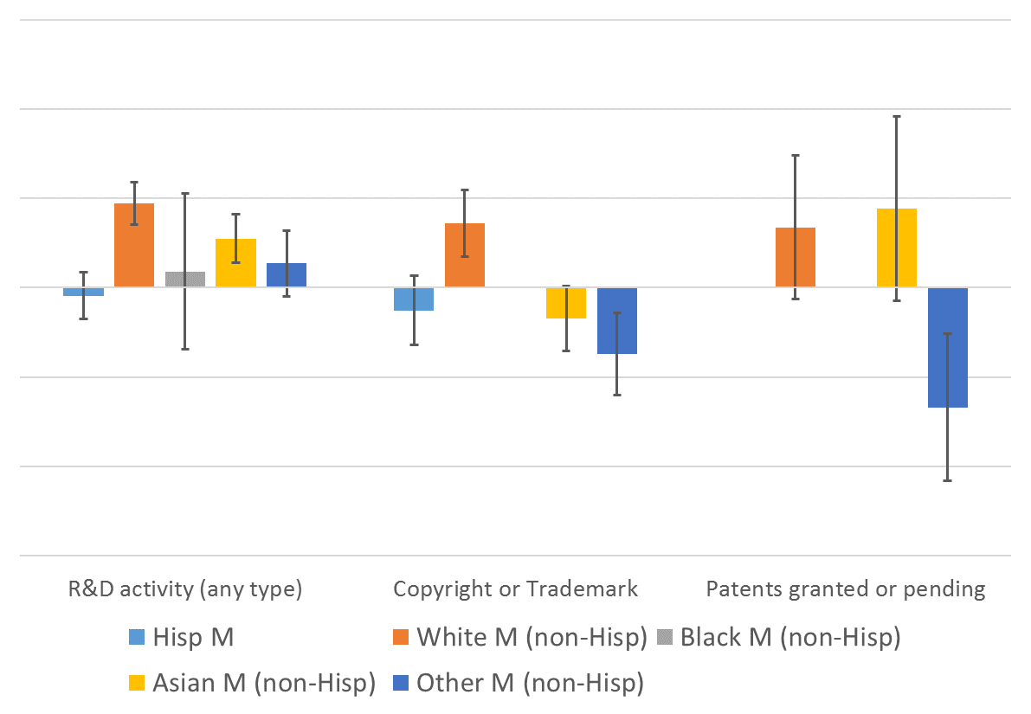
Race/Ethnicity (demographic controls): Any Type R&D and Copyright/Trademark/Patents

Slide 39
Conclusions (1)
Immigrant-owned firms have higher incidence for nearly all innovation measures
new use for good/service
changed distribution
discovered new scientific facts
produced publishable findings
patent pending
Robust to controlling for differences in human capital, motivations, start-up capital, and sector
Large immigrant-native differential remains

Slide 40
Conclusions (2)
The immigrant innovation advantage is in both high and low tech
Low tech: innovation activities
High tech: R&D and patenting
Immigrant-owned firms have higher innovation across the education spectrum
graduate education gap large for R&D and patents
Some racial differences
Black immigrants more likely to report innovation activities
White immigrants more likely to conduct R&D and patent

