Slide 1
AI and behavioral economics
Discovering variables
Human judgment overfits
Colin Camerer, Caltech
Robert Kirby Prof of Behavioral Economics
Director, T&C Chen Center for Social and Decision Neuroscience
Notes:
Detective interrogations
Online poker vs Doyle Brunson

Slide 2
Discovering variables
Behavioral economics definition
include natural limits of computation, willpower and selfishness
University-structure definition
Borrows from neighboring sciences
psychophysics (prospect theory), norms (sociology), sociality (psych, anthropology), self control (neuro)

Slide 3
Discovering variables
Search for predictive variables definition
Behavioral economics is open-minded
Defaults
Reminders
Social comparison
Cognitive skill
anxiety
Habit
“Nudge” experiments explore this space

Slide 4
Here comes ML
ML allows exploration of many variables
Can give upper bound to how well theory could do-- complete (Kleinberg et al 2017) or clairvoyant (economic value; Camerer et al QJE 2004)
Can discover new variables
Two examples:
Predicting initial play in 3x3 matrix games (bound)
Semi-structured bargaining (new)

Slide 5
Theory value as % of “clairvoyant” maximum (Camerer Ho Chong QJE 04)

Slide 6
Ex 1: Initial play in 3x3 games (Fudenberg, Liang 2017; cf. Hartford, Wright, Leyton-Brown 2016)

Slide 7
Poisson CH (Camerer+ QJE 2004)
ML
(88 features)

Slide 8
Trees with
2 splits

Slide 11
Ex 2: Semi-structured bargaining with private information (Camerer, Nave, Smith Mgt Sci in press)

Slide 12
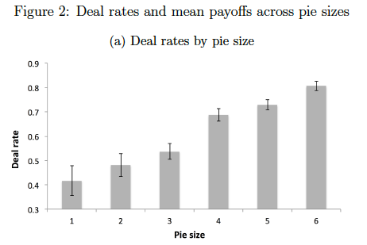
Efficient RP prediction

Slide 13
predicting disagreements ROC

Slide 15
II: Human and ML prediction
history
hypothesis:
Some human judgment patterns can be understood as imperfect ML

Slide 16
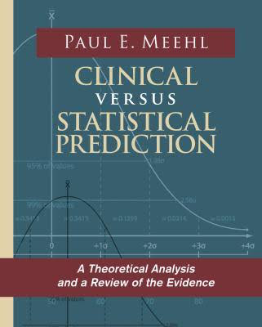
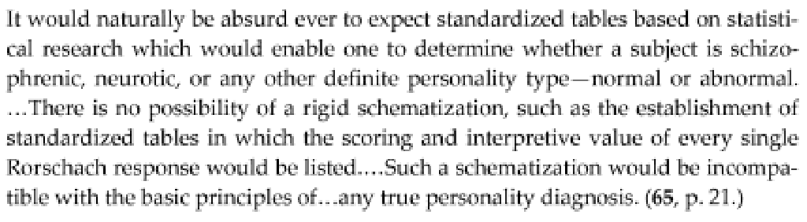
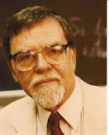
Paul Meehl 1920-2003
Univ Minnesota
Notes:
Picture of Freud in his office
Certified AmerBoard Psychologist (only one who took the test)
Practiced for 50 years VA
Mom died 16yo made him skeptical of doctors

Slide 17
scope of “clinical”
Psychiatric diagnosis
Homicidality
Juvenile delinquency
Recidivism
Academic performance
Graduate PhD admissions

Slide 18
background on “bootstrapping”
Meehl (1954):
“what I expected to be a floor turned out to be a ceiling”
Unstructured interviews and clinical judgment can be notoriously unreliable
“Bootstrap” (=fit judgments to X_{i}, discard ε)
≈ 10% > clinical
But there is some reliable intuition (omitted variables) in bootstrap residuals ≈ 1/3 of σ²(ε) (Camerer unpub’d thesis `81; compare test-retest with bootstrap)

Slide 19
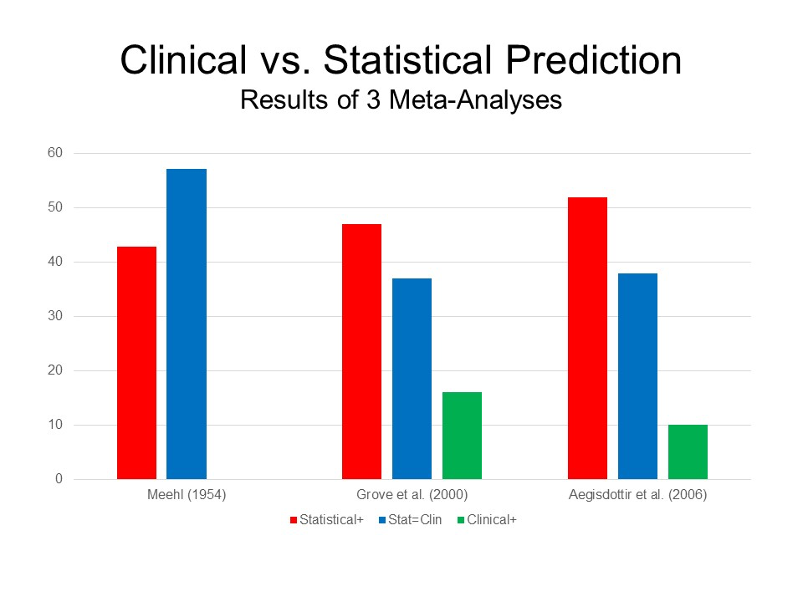
Grove Psych Assess. 2000
Ægisdóttir Counseling Psychologist 06
Typical effect size -.15 (no subsamples>0)
Notes:
Grove Psych Assess. 2000
Ægisdóttir Counseling Psychologist 06 (92 effect sizes)

Slide 20
History of skepticism
Strong bias against statistical >> clinical 1954-20??
almost no traction (except: bank credit scoring)
Why?
Clinicians thought to have ‘intuition’
Interactions
“broken leg cues” (rare, highly diagnostic)
“the question of whether the actuarial approach is superior to the clinical is tantamount to asking whether the sperm is more important than the ovum” (Zubin, 1956, p627)
small training sets

Slide 21
History of skepticism (cont’d)
sporadic, informal discussions of
selective labelling (eg Dawes ‘79 PhD admissions)
decision→ payoff
what is clinician’s objective function?*
now: Large training sets → ML reproduces
possible ‘intuition’ well
Interactions
Broken-leg cues
*cf. Einhorn, JPersAssess 86

Slide 22
properties of human judgment
we do not intuitively accept sparsity
(sex – fights)/wk and marital satisfaction r=.40-.81 (Dawes 1979)
(GRE+quality+GPA) and PhD success r=.48
(Dawes 1971)
(HS) ∩ (steady job) ∩ (no baby unwed)
= no poverty (Jencks)

Slide 23
we do not like sparsity (cont’d)
Obsession with personal interviews
(e.g. ASSA hotel meetings)
Outside >> “inside” view (Kahneman, Lovallo Mgt Sci 1993)
Clustering >> each case unique
…outside view throws away information

Slide 24
overconfidence and overfitting
Humans: prediction CIs are too narrow
ML: Overfitted prediction CIs are too narrow
(i.e., degraded fit in test/holdout samples)
Humans: more information increases confidence, not predictive accuracy
Clinical accuracy 26-28% (chance=20%)
confidence 33-53% (Oskamp 1965)

Slide 26
conclusion
ML can help discover new “behavioral” variables
Properties of human prediction could be understood as mistaken machine learning
not enough sparsity (regularization)
do not correct for overfitting → overconfidence

Slide 27
pro-ML
ML training sets will grow and grow
Can self-play around the clock
Individual- level “human training sets” are constrained by:
Genes
density of life experience
scope of life experience
Ability to learn from text, vicarious experience

Slide 28
pro-human
Human cultural accumulation
Wisdom of crowds and division of labor
‘group IQ’ can be > max IQ_{i}
Cross-domain generalization
ML: AlphaGo NN does not inform playing chess
Wisdom accumulates during a lifetime
meta-cognition, dimension reduction (better ideas, more quickly)
Can ML do these too??

Slide 29
Can ML be as creative as humans?
Typical model (e.g. Campbell 1960):
large variation of ideas, somehow select the good ones (MAYA)
product design, writing sentences, novel plots, music

Slide 30
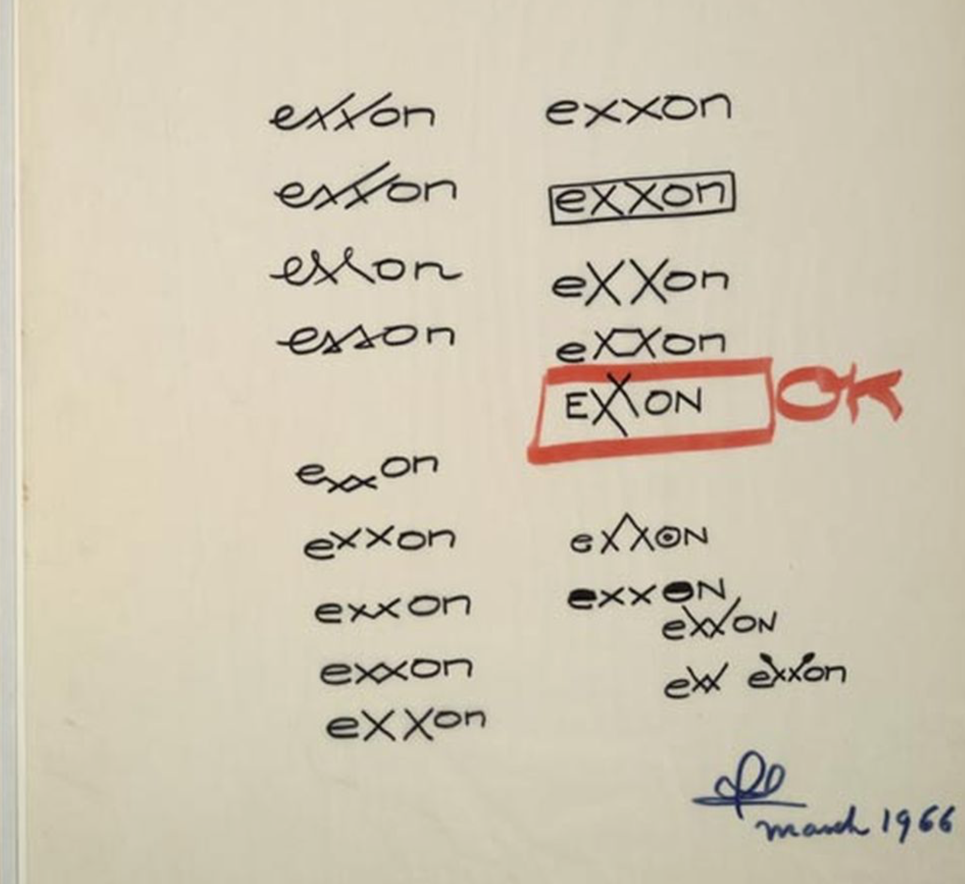

http://www.theverge.com/2013/11/5/5068132/raymond-loewy-the-man-who-designed-everything

