Slide 1
ADDRESSING THE CHALLENGES OF globalization in national accounts
Conference on Research in Income and Wealth
Bethesda, Maryland, March 9, 2018
Brent Moulton
Bureau of Economic Analysis (retired)
Peter van de Ven
Head of National Accounts, OECD

Slide 2
Overview
What are the main problems?
Solutions within the current international standards
Solutions beyond the current international standards
Practical considerations
Wrap-up and way forward

Slide 3
World Trade (% of World GDP)
Source: World Bank Open Data

Slide 4
What Are the Main Problems?

Slide 5
Transfer pricing
Large share of trade in goods and services within multinational enterprise groups
  In US, 38% to 46% of goods exports to affiliates entities; 43% to 48% of goods imports from affiliates
Multinationals have discretion in structuring transactions and setting prices
“Arm’s length principle” attempts to provide consistent basis for profit allocation
OECD’s Base Erosion and Profit Shifting (BEPS) Project reinforces arms length principle and ensures consistent compliance

Slide 6
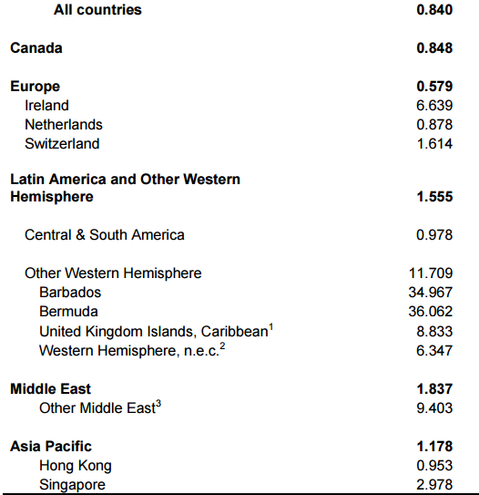
Ratio of Profit-type Return to Compensation of Employees
Source: Robert E. Lipsey: Measuring the Location of Production in a World of intangible Productive Assets, FDI, and Intra-Firm Trade (NBER Working Paper 14121)

Slide 7
Sourcing substitution bias
Houseman et al. (2011), and others have identified biases in import prices that affect GDP and productivity
Traditional price indices fail to pick up saving from switching from domestic to foreign suppliers (“outsourcing bias”).
  Upward bias to US manufacturing real value of 0.2 to 0.5 percentage point per year
Reinsdorf and Yuskavage (2018) note import prices also miss switches in supply from higher price countries to lower price countries

Slide 8
Sourcing substitution bias
Byrne, Fernald and Reinsdorf (2016) estimate upward bias to GDP growth of about 0.1 pct pt
Possible solutions:
Nakamura et al. (2015) suggest using hybrid unit value indices
  Could break down when goods highly heterogeneous/ made to order
Alterman (2015) suggests designing a price index to mimic buyer behavior – capturing seller substitution

Slide 9


Global production versus national statistics
Global production arrangements between firms and within MNEs
Statistical complications have long been recognised and discussed:
  Goods for processing/merchanting
  Transfer pricing
  Special Purpose Entities
  Relocations/reorganisations
  Asymmetries in trade data
Clear friction between national statistics based on residency and global behavior of MNEs
www.oecd.org/trade/valueadded

Slide 10


Adding IPPs and digitalisation
Added complication when globalisation meets IPPs and digitalisation
No physical and local constraints => relatively easy to relocate from one country to another
Impact can be large, especially in small economies
GDP still valid as a measure of domestic production? Is it still usable for designing monetary, fiscal and structural policies?

Slide 11
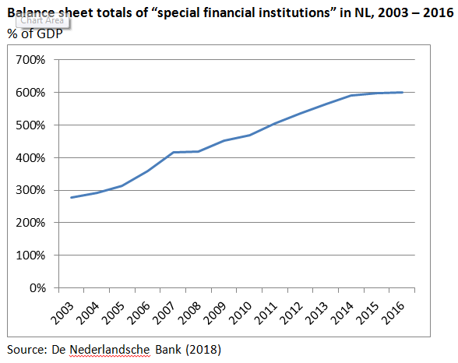
Special Purpose Entities in the Netherlands

Slide 12
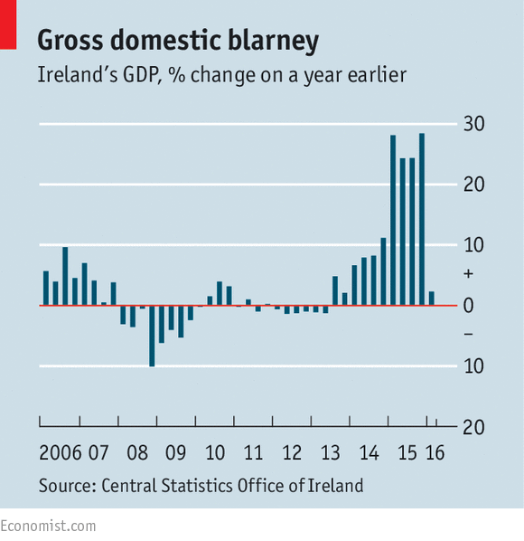
Have They Gone Mad?
Irish GDP up
by 26.3% in
2015!

Slide 13

Some quotes from the press
“This Tax Haven Just Revised Its 2015 GDP up From 7.8% to 26.3%” (Fortune)
“Handful of multinationals behind 26.3% growth in GDP” (Irish Times)
“Ireland’s Economists Left Speechless by 26% Growth Figure” (Bloomberg)
“Why GDP growth of 26% a year is mad” (Economist)
“It’s complete bullshit, it’s Alice in Wonderland economics” Colm McCarthy, University College Dublin)
“World Economies Watch As Ireland Reaps 26% GDP Windfall On Tax Inversions” (Business Insider)

Slide 14
Solutions Within the Current International Standards

Slide 15
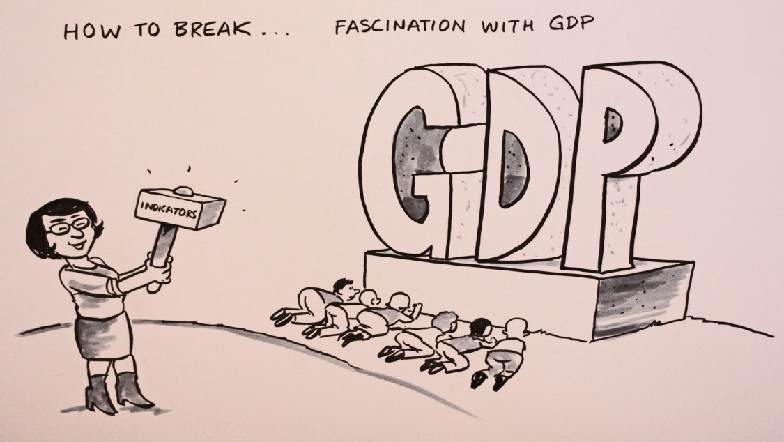
Highlighting alternative indicators
National Accounts ≠ GDP
The System of National Accounts is a framework from which a variety of indicators can be derived
Some indicators such as NNI and Household Disposable Income hardly/not affected by e.g. relocations
Better use and communication needed

Slide 16
More granularity
Proposed additional breakdowns in supply and use tables and in institutional sector accounts:
  Public corporations
  National private corporations, not part of domestic MNE
  National private corporations, part of domestic MNEs
  Foreign-controlled corporations
    Of which: Special Purpose Entities (SPEs)
Breakdown for SPEs may only be relevant for some countries

Slide 17
Defining additional indicators
GNI* (= GNI minus retained earnings of re-domiciled firms minus depreciation of categories of foreign-owned domestic capital assets (such as IP capital assets))
Contributions of inputs to (growth of) GDP (i.e. GDP excluding contributions of IPPs and other movable assets)

Slide 18
Solutions Beyond the Current International Standards

Slide 19



May lead to some reactions!

Slide 20
Step 1: Consolidating SPEs
If not located in another country, they would not be considered as separate institutional units and would be consolidated
No economic substance: often brass plates
Assigning e.g. ownership of IPPs to these units is matter of legality or practicality
Consolidate SPEs with the ultimate owner
What about affiliates with high volumes of IPPs and related value added, with a true physical presence and economic ownership of IPPs?

Slide 21
Step 2: Gross International Product
GDP: production by resident units, whoever controls them
GIP: production by domestically-controlled units, wherever it takes place
Allocates activities of affiliates abroad to the country where decisions are made (similar to treatment of embassies and consulates)
Insights on how economic decision-making generates GIP in the decision making country
Statistical unit = enterprise group
But … true physical presence, at least when it comes to employment and tangible capital

Slide 22
Step 3a: Allocating “only” profits and IPPs to the ultimate owner
Problems with allocation of output and value added mainly related to the parts that are neither physically not locally constrained
Logical alternative to GIP is to allocate profits and IPPs to the country of the ultimate owner, and allocate the other parts to the countries in which the affiliates are located
From a conceptual perspective, this would make sense as the parent is the true economic owner of the profits and corporate assets such as IPPs
Basically, upward shift of (distributed and reinvested) earnings from GNI to GDP
But what about relocations of headquarters?

Slide 23
3b. Alternative: proportional allocation of profits and IPPs
Proportional allocation of profits and (use of) IPPs across activities of MNEs
Denominator: compensation of employees and depreciation of tangible capital?
More stable macro-economic data, but would it lead to better interpretable results from an economic substance point of view?
Allocating IPPs to countries with low knowledge-intensive activities
What about e.g. macro-analysis of multinational activities?
Results are largely imputed without much economic rationale, thus creating a fictitious world

Slide 24

Step 4: Treat profits and IPPs of MNEs at a supranational level
One of the problems with option 3a (not option 3b) is related to the impact of possible relocations of headquarters on the level and growth of GDP
Treat profits and IPPs of MNEs as supranational phenomena, which cannot be allocated to national economies
∑ GDP of national economies ≠ World GDP
The end of GDP?
Additional consideration: extend reinvested earnings approach to the ultimate owners of the equity?
∑ NNI of nat. economies = World NNI
GDP

Slide 25
Step 5: Supplementary tables on MNEs
Whatever solution is chosen, within or beyond the 2008 SNA, analysis of MNE-behaviour requires looking at the complete elephant, not the national parts
Supplementary tables on MNEs, in addition to the traditional monitoring of national economies?
BIS already compiles, for example, banking statistics on a “nationality” perspective, to arrive at a better understanding of foreign exposures
Similarly, performance and productivity analysis of MNEs is perhaps only feasible when considering the whole enterprise group

Slide 26
Practical Considerations

Slide 27
“In between dream and act there are hindering laws and practical issues” *
Application of solutions beyond the 2008 SNA requires extensive exchange of individual enterprise information at the international level
  Top-down approach (e.g. BEPS-data, or alternative/additional collection of data on MNEs at the international level)
  Bottom-up approach (monitoring and analysis of MNEs primarily based on collection of data on the national level)
But … we already have major problems in arriving at consistency at the national and international level, even problems in arriving at exhaustive estimates at international level
Need for enhancing (the possibilities for) international co-operation and co-ordination
* Quote from the poem “The Marriage” by Willem Elsschot

Slide 28
Wrap-up and Way Forward

Slide 29


Wrap-up and way forward
At the national level, no conceptual issues in applying solutions within the current framework of national accounts
But … it does require sources, resources and time to implement
Need to continue and step up current initiatives, such as EuroGroups Register, Early Warning System, and Large Cases Units
Currently no appetite for revision of the 2008 SNA, but can we wait until say 2030?
Is there an intermediate solution to adapt the conceptual framework?

Slide 30


Thank you for your attention!

